Slide 1
INFO1110
Introduction to Programming
同步辅导课6
Tutor：Hilbert

Slide 5


Hilbert
USYD Bachelor of Advanced Computing Honours First Class毕业 (Major in Software Development)
東京工業大学Master of Artificial Intelligence在读
曾任USYD INFO1110的Lab Tutor
INFO1110总分91.0 HD
2018年加入HD Edu，主要教授预科及本科的IT入门课程
HD Edu学科带头人兼面试官，曾经撰写过HD的INFO课程规范指南

Slide 8

1
Recursion
2
Array and Multi-dimensional List
3
Binary Search *
4
Tree and DFS/BFS *

Slide 9

本节考点
1、 Program Basics
题型：选择题、简答题
内容：
What is a program/interpreter/compiler?
Program running procedures
考察惯例：考察可能性较小
题目展示：
2、 Terminal Commands
题型：非考题，但是融入你接下来13周的方方面面
内容：Directory operations, Copy/Move, Run program, etc.
考察惯例：无
How does the execution process differ for a program written in an interpreting programming language compared to a compiled language?
(自编题)
注： 代表重要程度，并非难度

Slide 10
知识点讲解

Slide 11

考点1. Recursion 递归
Definition: A function that calls itself.
Recur (v.), Recursive (adj.)
A workable recursion must include:
Base case(s): to terminate
Recursive case(s): to expand/continue
从数学的角度来看，recursion就是在一个函数的定义里又用到了这个函数自身：
$$f(x) =f(x − 1) + x$$

Slide 12
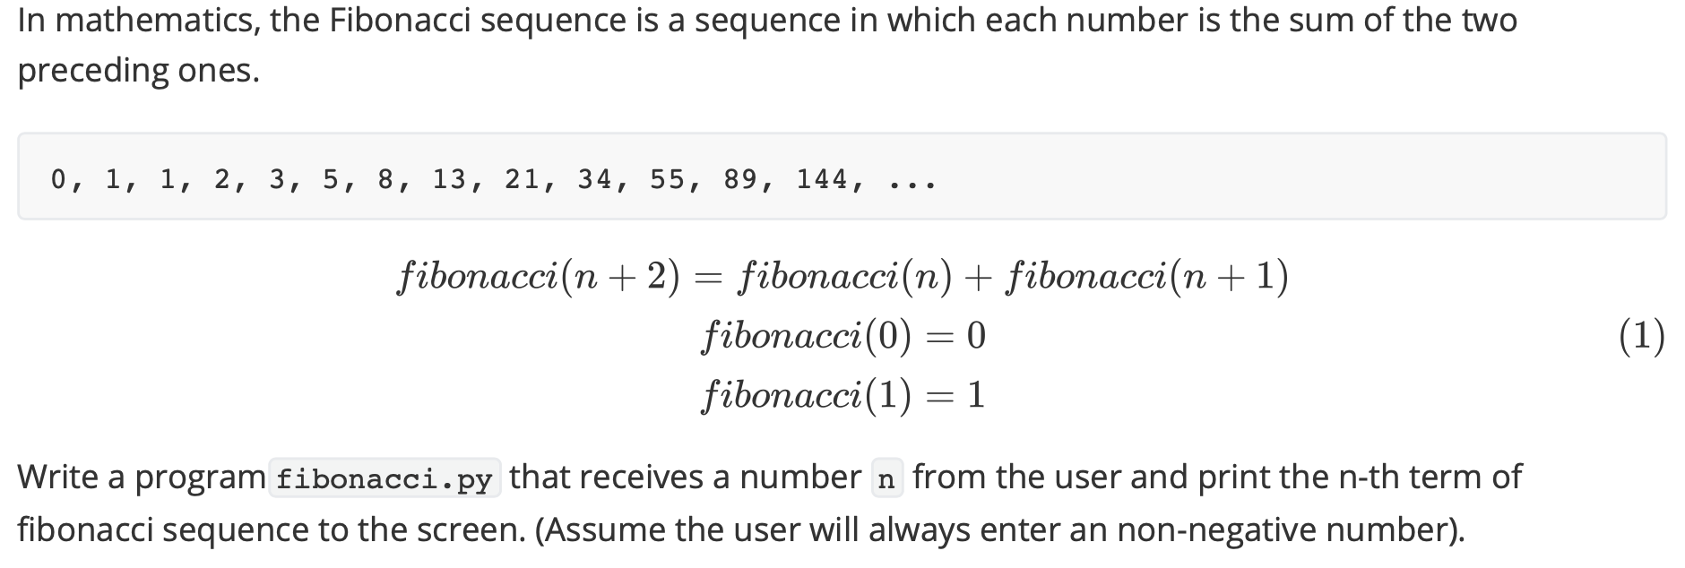
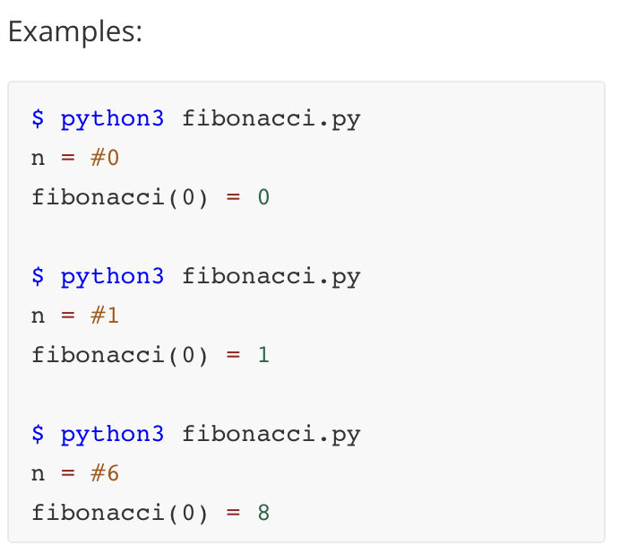
考点1. Recursion – Fibonacci Series

Slide 13
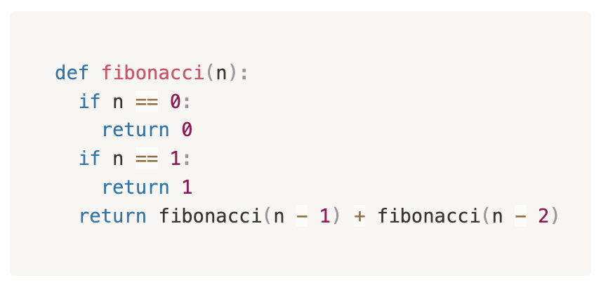
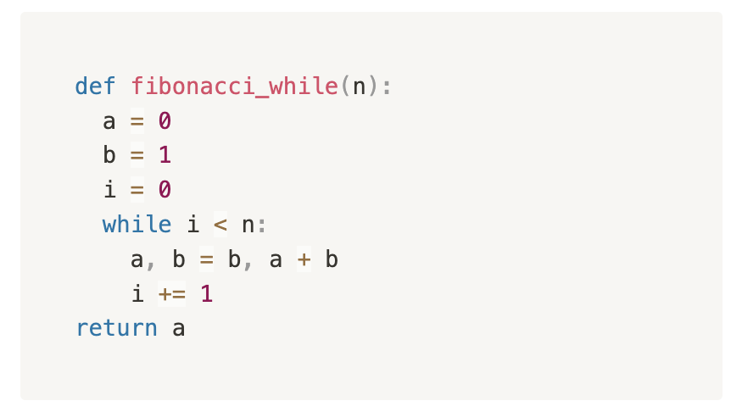



考点1. Recursion – Fibonacci Series
Fibonacci Sequence = 0, 1, 1, 2, 3, 5, 8, 13, 21, 34, ….
Write a recursive function fibonacci() that returns the n^{th} fibonacci number.
$$f(0) =0$$
$$f(1) =1$$
$$f(n) =f(n−1) + f(n−2)$$

Slide 14
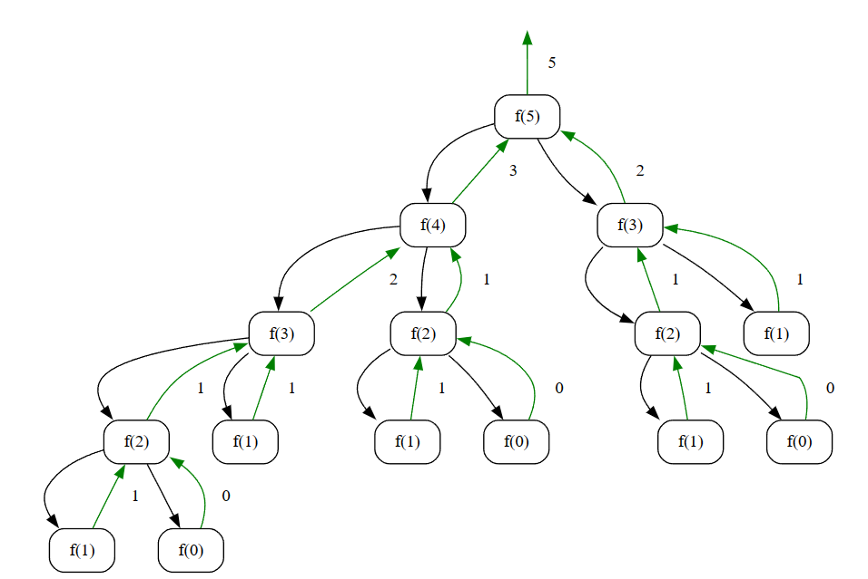
考点1. Recursion – Call Stack

Slide 15
考点1. Recursion – Pros and Cons
每一个能用Recursion解决的问题，都一定有Iterative（循环）的解法。
Pros:
Elegant (Clean and more readable)
A unique way of implementing a variable number of nested loops
Cons:
Slower
More memory used

Slide 16
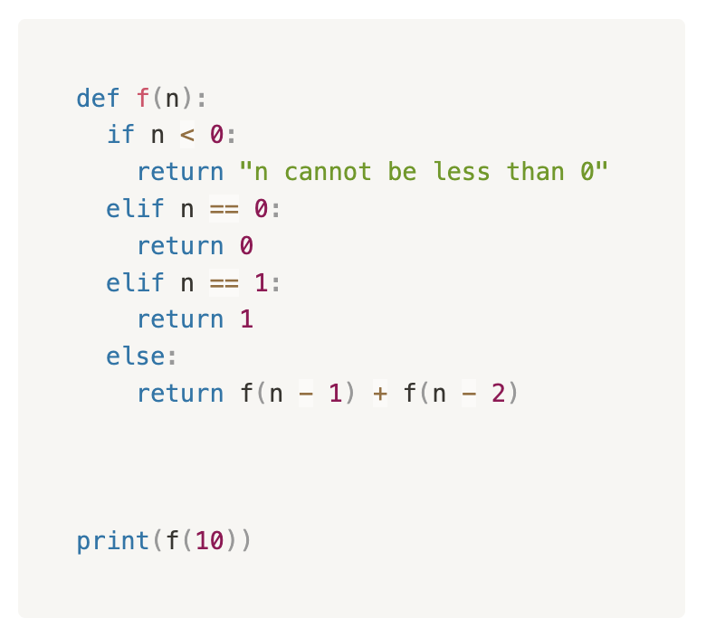
考点1. Recursion – Tech 面试真题

Slide 17
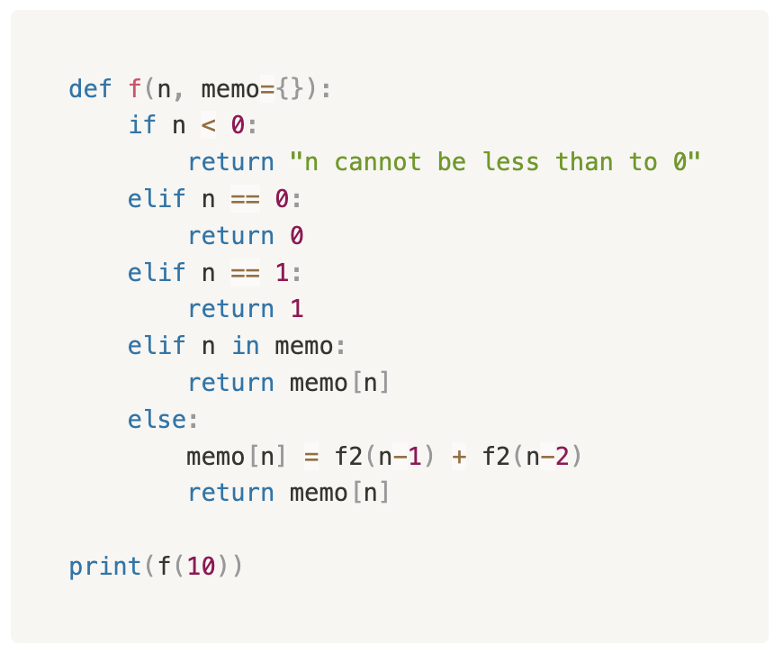
考点1. Recursion – Tech 面试真题

Slide 18
考点2. Array vs. List
根据往届的情况，numpy和array不会成为考察的重点。← Cheatsheet
Array:
An array is a fixed-size, contiguous memory block that stores elements of the same data type.
Elements in an array are accessed using an index or a subscript that represents their position in the array. The index typically starts at 0.
Arrays have a fixed size and type, meaning you need to know the number of elements you want to store in advance, and that size cannot be changed during runtime.
List:
A list is a dynamic data structure that can grow or shrink in size during runtime.
Also use index operator to access
Lists are more flexible than arrays because you can easily add or remove elements of different datatypes.

Slide 19
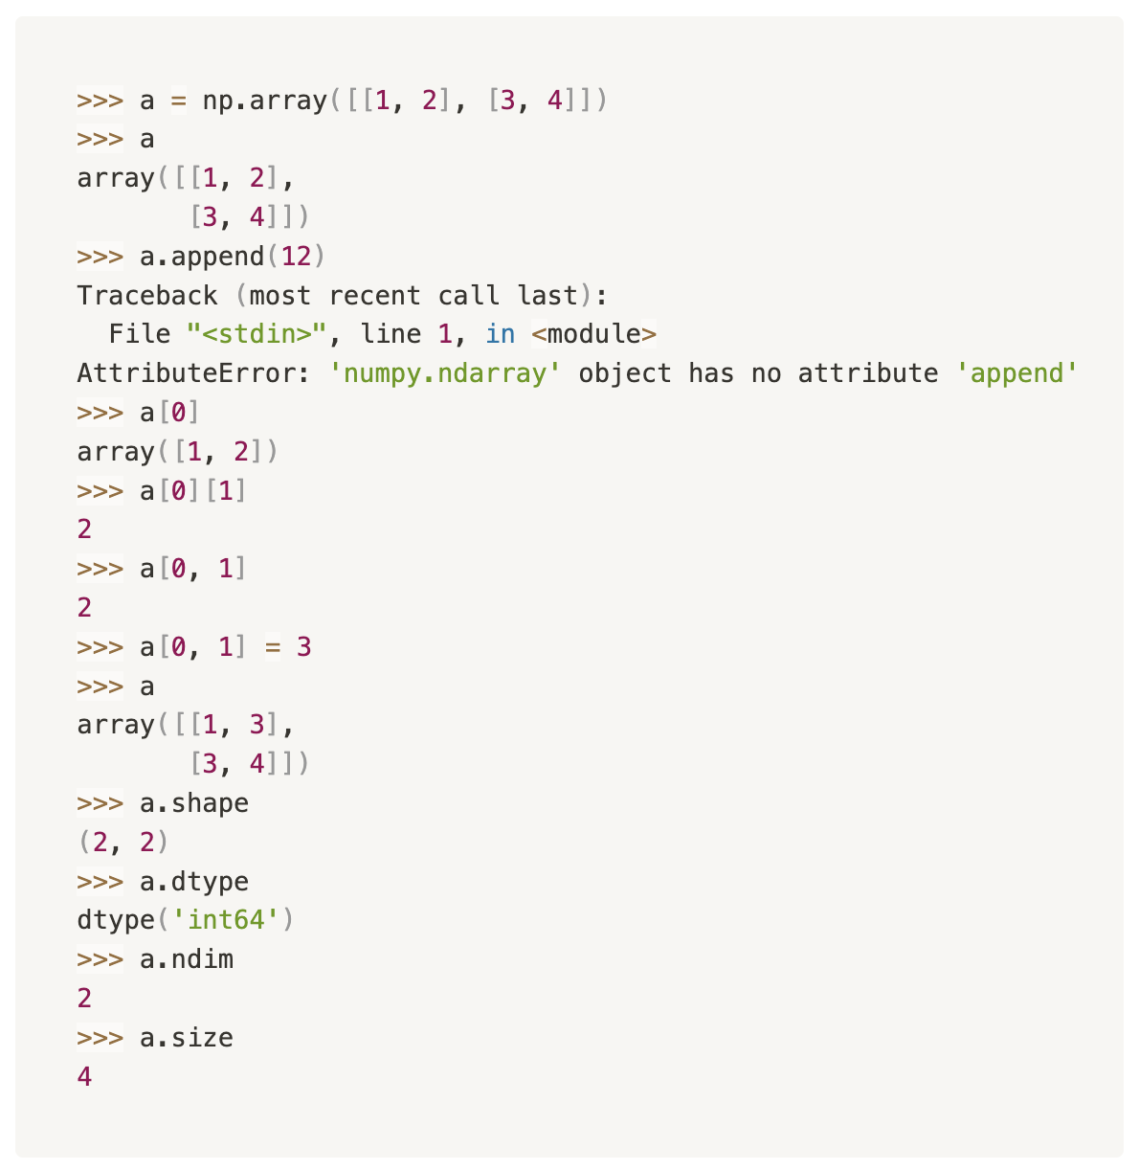
考点2. Numpy Array
Array is the most primitive collection data type in most programming language (but not Python😂)
import numpy as np
np.array() 可以把一个collection变成array
np.ones() and np.zeros()
array.shape/array.dtype/array.ndim/array.size

Slide 20
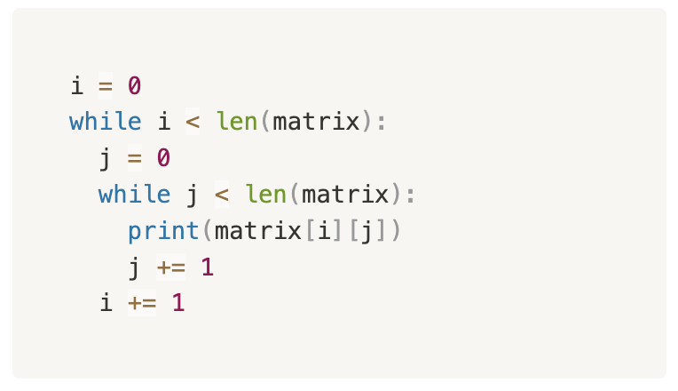
考点2. Multi-dimensional Traversal
有多少维就要有几层nested循环
[1, 2, 3, 4, 5],
[1, 2, 3, 4, 5],
[1, 2, 3, 4, 5],
[1, 2, 3, 4, 5]
matrix

Slide 21
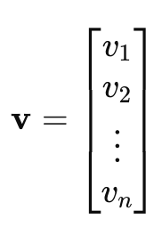
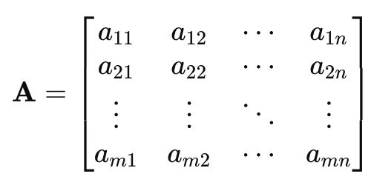

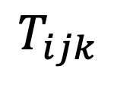
考点2. Vector, Matrix and Tensor
Tensor -> nD
  Notation: Tensors are often represented with multi-index notation. For example, a third-order tensor T might be written as:
Vector -> 1D
Matrix -> 2D
$$T_{ijk}$$
where i, j, k are dimensions of the tensor.

Slide 22
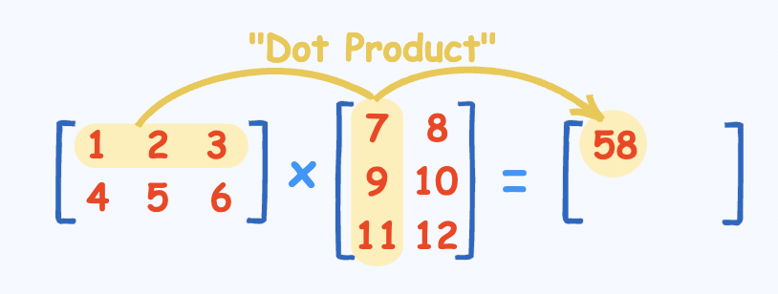
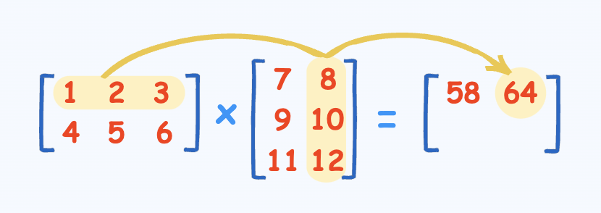
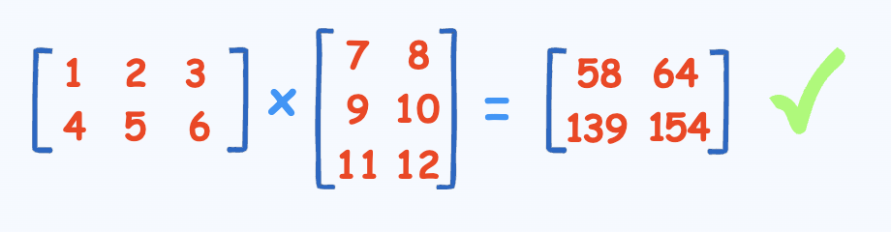
考点2. Matrix Multiplication

Slide 23
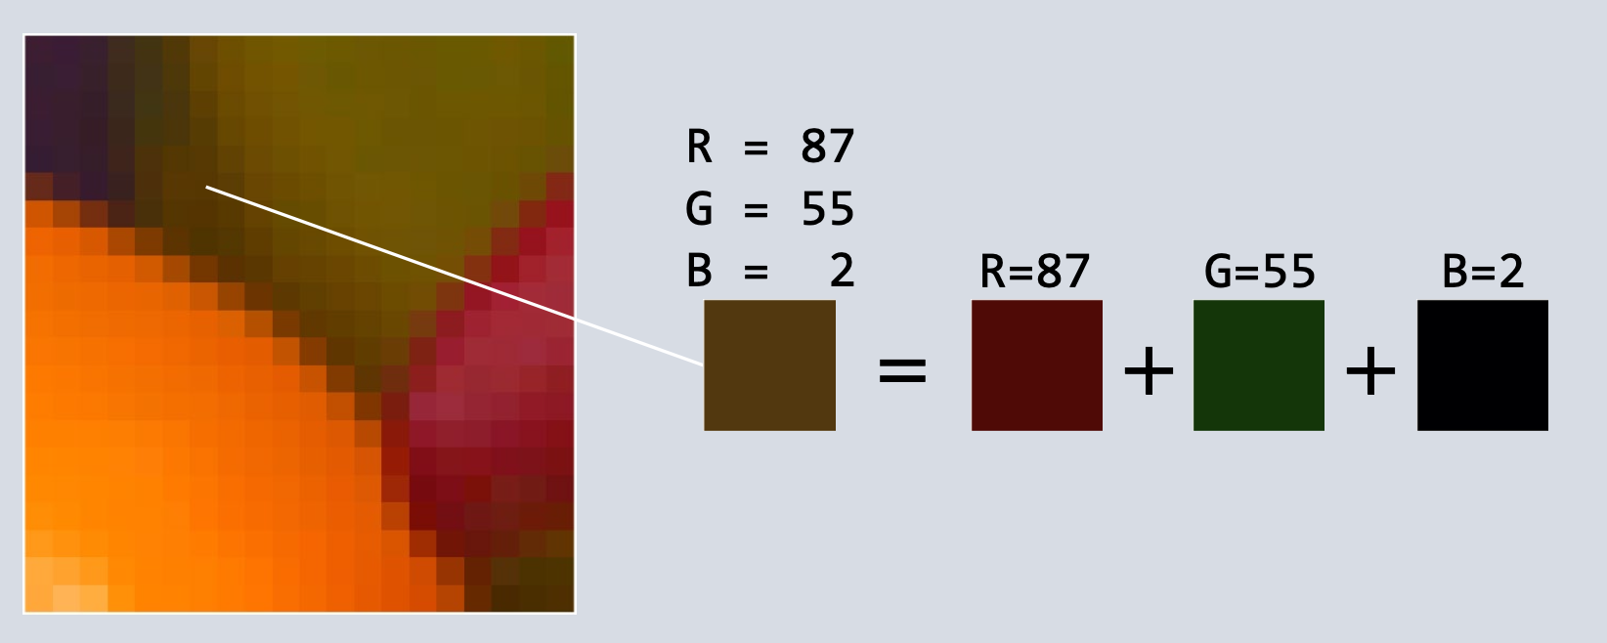
考点2. Image
SRGB -> Standard RGB [0, 255]
Three Channels -> Red, Green, Blue

Slide 24
考点3. Binary Search *
如果对于一个乱序的Array，没有任何办法，我们必须过n个elements
但如果是一个sorted的Array，情况就稍许不同了：
find(3)
1 | 3 | 5 | 7 | 9 | 11 | 13 | 15 | 17 | 19

Slide 25
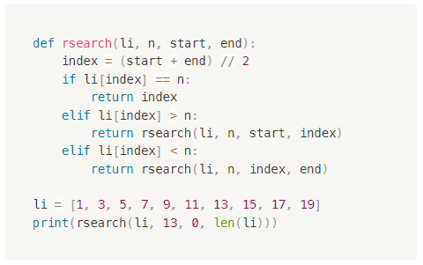
考点3. Binary Search *

Slide 26
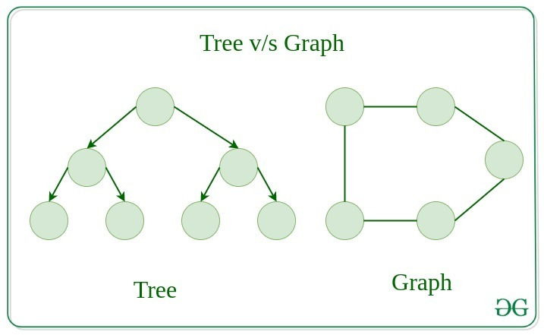
考点4. Node, Tree and Graph *
Ref. : https://www.geeksforgeeks.org/difference-between-graph-and-tree/

Slide 27
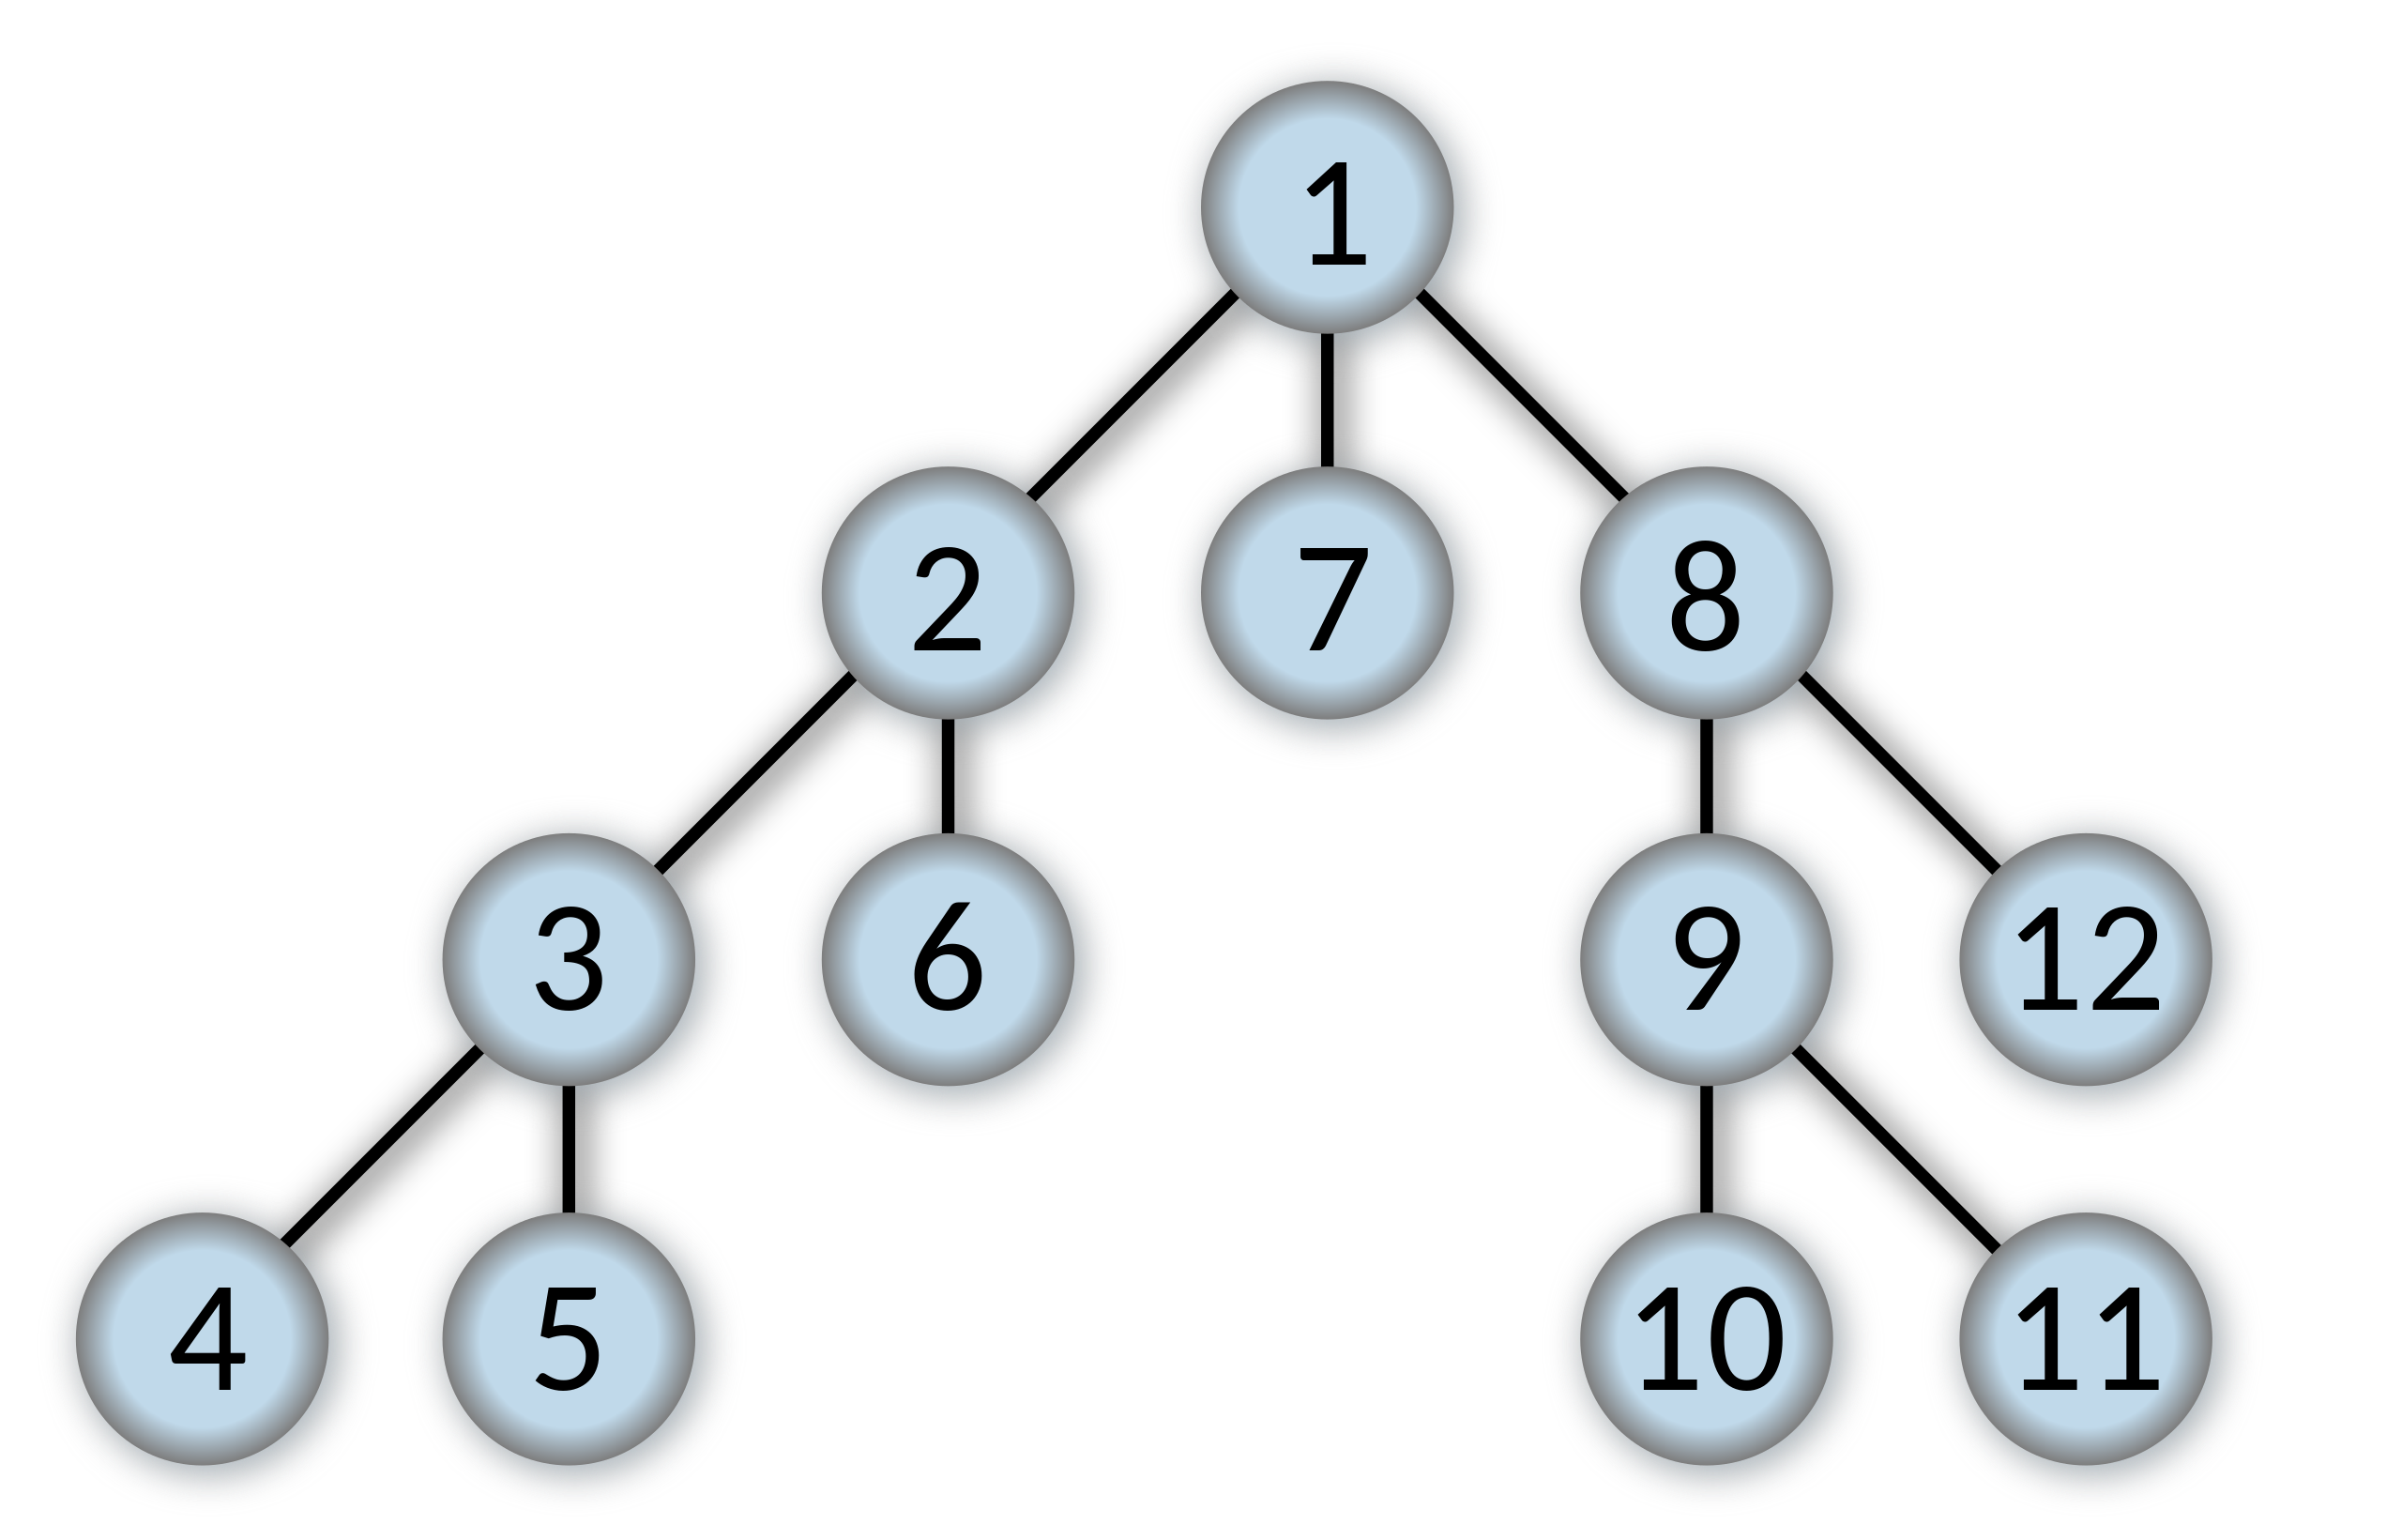
考点4. Depth First Search *

Slide 28

考点4. Breadth First Search *

Slide 29
经典题型放送

Slide 30
Find the Capital
（自编题）
Write a program that accepts a string and print the index of the first capital letter in the string or -1 if not exists. You are not allowed to use while and for loops.

Slide 31
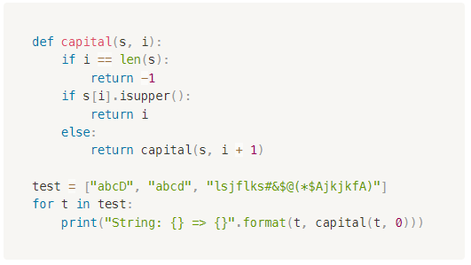
Find the Capital
（自编题）

Slide 32
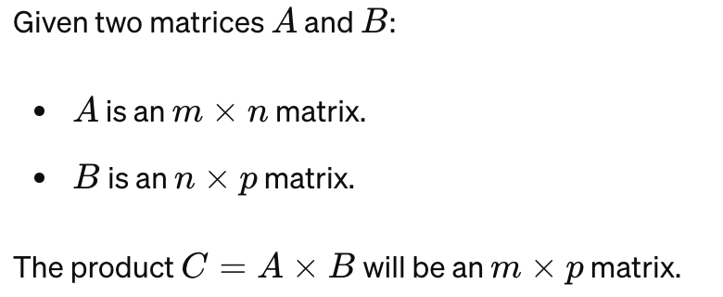
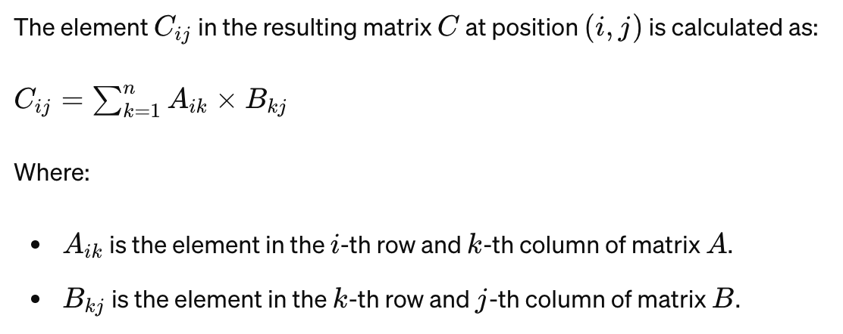
Matrix Multiplication
（自编题）
Write a function that accepts two matrices and perform matrix multiplication based on the definition.

Slide 33
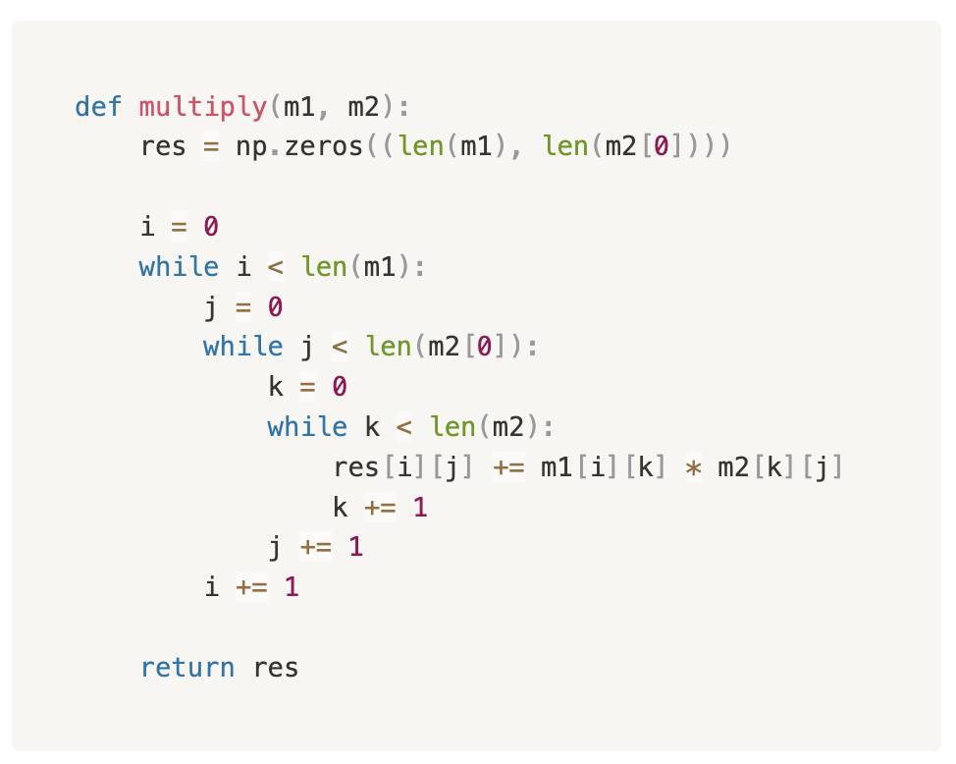
Matrix Multiplication
（自编题）

Slide 34
Find the Subsets *
（自编题）
Given an array of integers, print sums of all subsets in it without using a loop. Output sums can be printed in any order.
Input: [2, 3]
Output: 0 2 3 5
Input: [2, 4, 5]
Output: 0 2 4 5 6 7 9 11
Ref. : https://www.geeksforgeeks.org/print-sums-subsets-given-set/

Slide 35
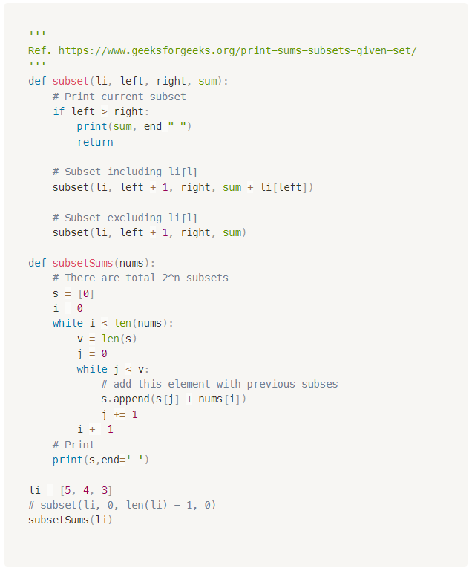
Find the Subsets *
（自编题）

Slide 36
重难点总结

Slide 37
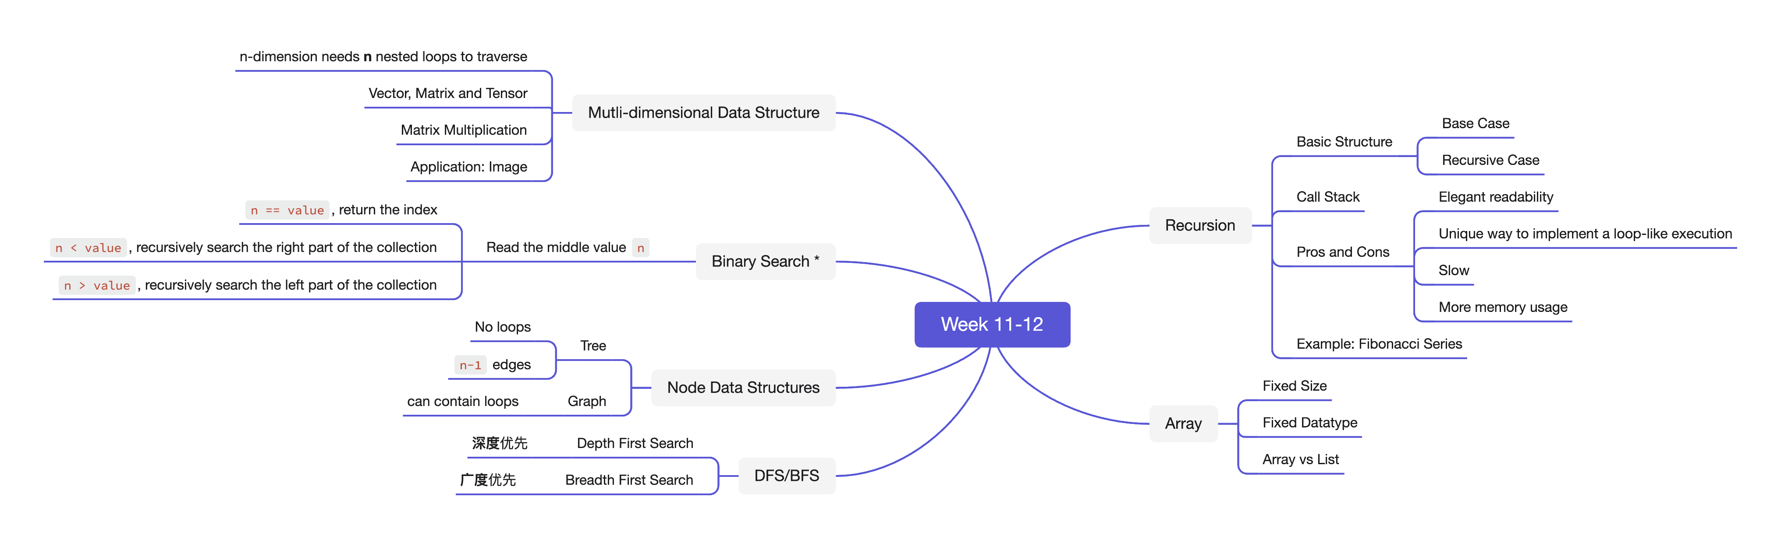
重难点总结

Slide 38
下节课预告

Slide 39

下节课预告
Final理论复习
  考试的注意事项和技巧
  按照Final重要考点顺序重新梳理
Final刷题课
  针对自命题的考卷进行讲评

Slide 40

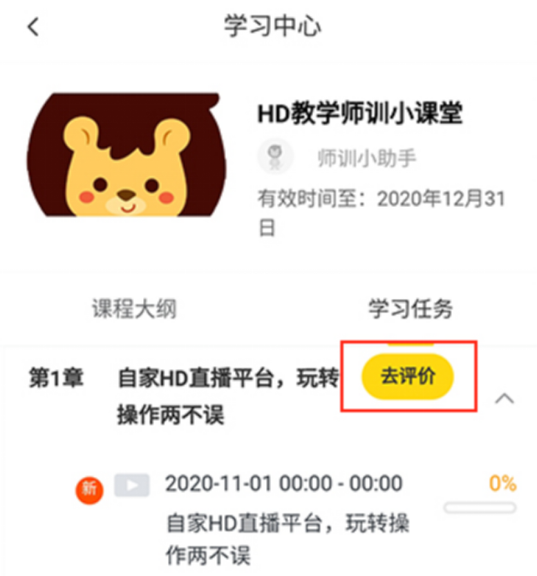

您每一份诚挚的问卷都会拯救一根濒临掉落的头发。
帮我开个张吧，求求你了！

Slide 42
Q & A

