Slide 1
INFO1110
Introduction to Programming
同步辅导课5
Tutor：Hilbert

Slide 5


Hilbert
USYD Bachelor of Advanced Computing Honours First Class毕业 (Major in Software Development)
東京工業大学Master of Artificial Intelligence在读
曾任USYD INFO1110的Lab Tutor
INFO1110总分91.0 HD
2018年加入HD Edu，主要教授预科及本科的IT入门课程
HD Edu学科带头人兼面试官，曾经撰写过HD的INFO课程规范指南

Slide 8

1
File I/O
2
File Names and Extensions *
3
os Module *
4
Testing
5
CSV
6
Shell Redirection *

Slide 9

本节考点
1、 Program Basics
题型：选择题、简答题
内容：
What is a program/interpreter/compiler?
Program running procedures
考察惯例：考察可能性较小
题目展示：
2、 Terminal Commands
题型：非考题，但是融入你接下来13周的方方面面
内容：Directory operations, Copy/Move, Run program, etc.
考察惯例：无
How does the execution process differ for a program written in an interpreting programming language compared to a compiled language?
(自编题)
注： 代表重要程度，并非难度

Slide 10
知识点讲解

Slide 11
考点1. File I/O
So far, 我们已经学了一下几个方式给我们的程序input，以及让程序输出output:
Inputs:
  input() function: Read from stdin
  Command-line arguments
    import sys; sys.argv
Outputs:
  print() function: Print to stdout
而学完这个章节，我们会额外得到两个新的方式分别是从文件读取inputs和output到文件

Slide 12
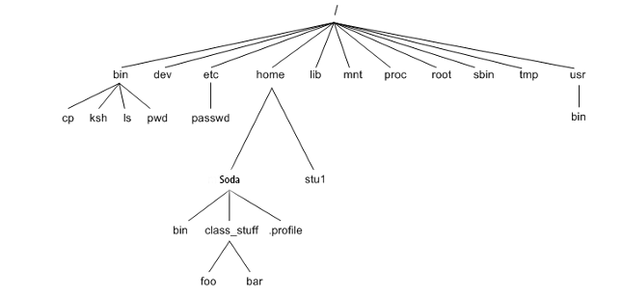
考点1. File I/O - Path
Absolute Path vs Relative Path
Absolute: You can access the same file from any location. E.g. /bin/sh
Relative: You can access the file based on current location e.g., soda/Downloads
当你用python file.py运行你的程序的时候，你的working directory就在这个file.py所在的位置

Slide 13
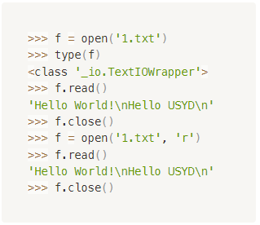
考点1. File I/O – open() function
f = open(path: str, mode=‘r’: str)
‘r’, ‘w’, ‘a’ => Read, Write, Append
# Some IO operations
…
…
…
f.close() <- 这是一个method
注意有开就要有关!

Slide 14
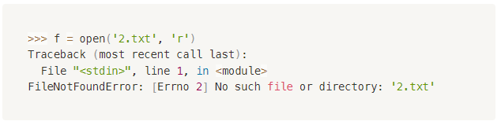
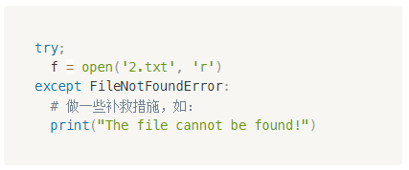
考点1. File I/O – Reading
当你读文件的时候，最重要的一个点在于有这个文件可以读，否则:
所以，比较常见的读文件的结构一般会和try用在一起:

Slide 15
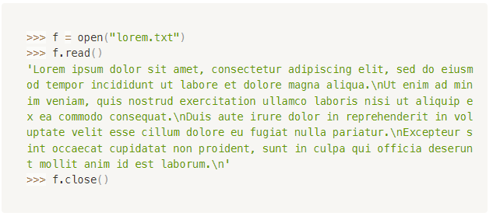
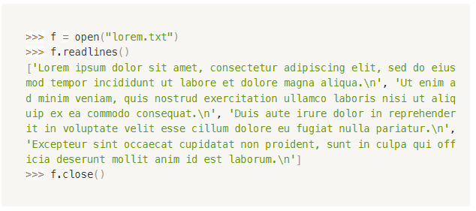
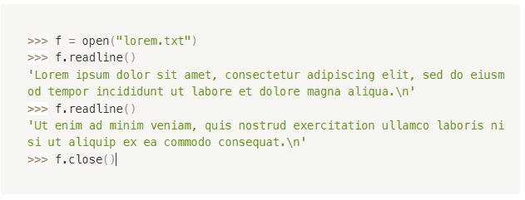
考点1. File I/O – Read Methods
Reading methods:
f.read()
f.readline()
f.readlines()
f.read().splitlines()

Slide 16
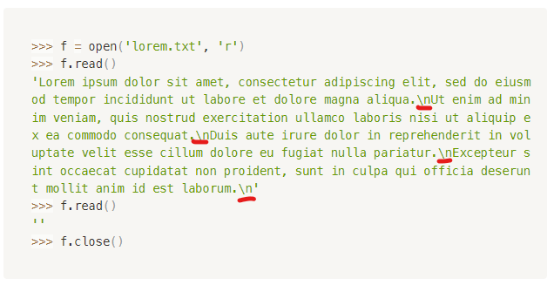
考点1. File I/O – Read Methods
Reading methods:
f.read()：读整个文件，return一个string （Pointer移到文件尾)
f.readline() ：读一行，return一个string（Pointer移到下一行开头)
f.readlines() ：读整个文件，每行是一个string，return一个list （Pointer移到文件尾)
f.read().splitlines()
注意New line character!
注意有光标的概念

Slide 17
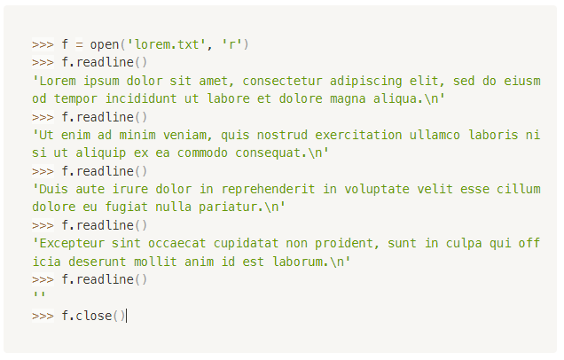
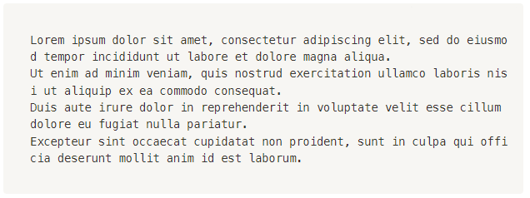
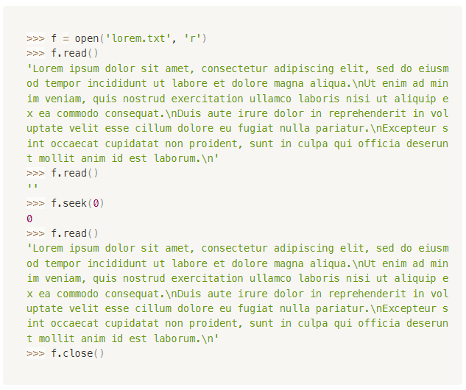
考点1. File I/O – Pointer
* f.seek(0)：把Pointer移到文件开头

Slide 18
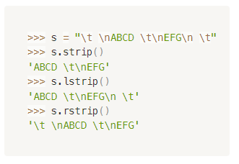
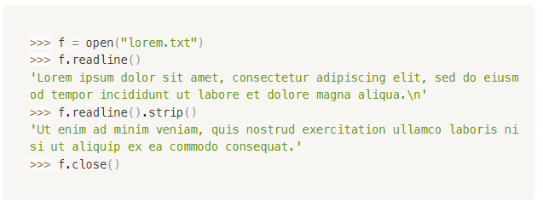
考点1. File I/O – str.strip()
str.strip()：把str开头和结尾处所带的空格字符（包含空格及特殊字符如\n, \t等）“脱”去
str.lstrip()：Strip left
str.rtrip()：Strip right
注意strip只会看两边
str.splitlines() = str.split(“\n”)

Slide 19
考点1. File I/O – Stream
Stream I/O (Input/Output) refers to the concept of handling data as a continuous stream of bytes or characters, rather than reading or writing data all at once.
It allows for efficient data processing, especially when dealing with large amounts of data or data that is being transmitted over a network.
虽然但是，我建议大家在INFO1110涉及到文件Reading都优先采取把文件完整内容读完存进一个variable里，然后接下来所有的操作都通过这个variable来做。
因为INFO1110所有打交道的文件都不大，全部读进内存里可以省去很多麻烦事。

Slide 20
考点1. File I/O – Writing
当你写文件的时候，就不存在FileNotFoundError的情况
如果文件不存在，Python会自动建一个文件并写入write的内容
如果文件存在：
  “w”: Overwrite覆盖
  “a”: Append续写
Write methods记得一定要自己加\n否则不会换行
f.write(str) -> return int(Number of characters written)
f.writelines(list) -> return None
Write写的内容都会暂存在buffer里，只用等到f.close()之后才会flush到对应的文件。

Slide 21
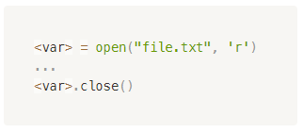
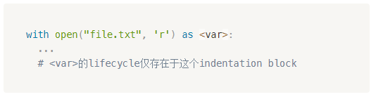
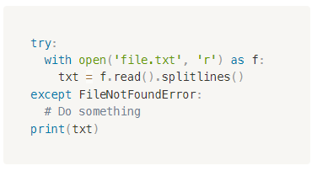
考点1. File I/O – with statement
用with就不需要专门去call close() method。Python会自动帮你关闭。
但是with是只有Python才有的Syntax，其它编程语言没有
我INFO1110最喜欢最喜欢用的读文件操作：
之后只需要读txt这个variable就可以啦！

Slide 22
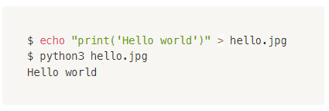
考点2. File names and their extensions *
The file extension is a convention that provides a hint about the file type and its intended use, allowing operating systems and applications to associate files with appropriate programs and utilities. However, the actual content and format of a file are not solely determined by its extension.
所以，把一张图片的后缀名从.jpg改成.pdf并不就意味着你把一张图片转换成了PDF文档。只是改了文件名，不会影响文件本身存的data和format。

Slide 23
考点3. os module *
os.getcwd() - Return a string representing the current working directory.
os.listdir(path: str) - Return a list containing the names of the entries in the directory given by path.
os.path.exists(path: str) - Check if the path exists
os.path.isdir(path: str) - Check if the path is a directory
os.path.idfile(path: str) - Check if the path is a regular file
os.path.abspath(path: str) - Return the absolute path of the given path
Official Doc

Slide 24
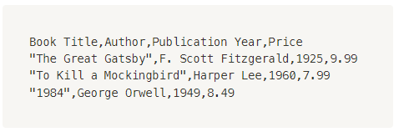
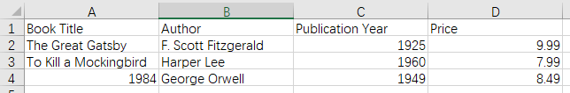
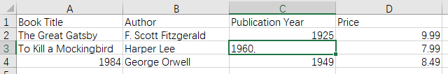
考点4. CSV
CSV stands for Comma-Separated Values. It is a simple file format used to store tabular data, such as spreadsheets or databases, in a plain text format.
Csv靠comma来分列，靠\n来分行
那如果数据里面就有逗号怎么办？

Slide 25
考点5. Testing – Test-driven Development
Testing can prove the presence of bugs, but not their absence. ——Edsger Wybe Dijkstra
Test-Driven Development (TDD) is a software development process that relies on the repetition of a very short development cycle: first, the developer writes an (initially failing) automated test case that defines a desired improvement or new function, then produces the minimum amount of code to pass that test, and finally refactors the new code to acceptable standards.
Write tests first
Regression Testing

Slide 26
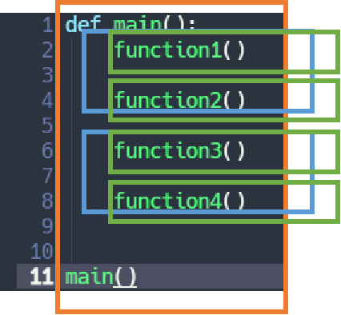
考点5. Testing – The Testing Pyramid
End-to-end test: test the functionality and performance of an application under product-like circumstances and data to replicate live settings.
Integration test: in which the different units, modules or components of a software application are tested as a combined entity.
Unit test: in which the smallest testable parts of an application, called units, are individually and independently scrutinized for proper operation

Slide 27
考点5. Testing – Different Types of Testcases
Positive Case
  Testing the software with valid inputs and expected conditions. The goal is to verify that the software behaves correctly when provided with correct and valid data, and that it produces the expected output or behavior.
Negative Case
  Testing the software with invalid, unexpected, or extreme inputs and conditions. The purpose is to ensure that the software can handle errors, exceptions, and edge cases gracefully, without crashing or producing unexpected behavior.
Edge Case occurs at an extreme (maximum or minimum) operating parameter.
Corner Case is when multiple parameters are simultaneously at extreme levels.

Slide 28



考点5. Testing – Edge Case and Corner Case
An edge case is an issue that occurs at an extreme (maximum or minimum) operating parameter.
一个维度的边界
A corner case is when multiple parameters are simultaneously at extreme levels.
多个维度同时到达边界
Reference: https://www.educative.io/answers/corner-case-vs-edge-case

Slide 29
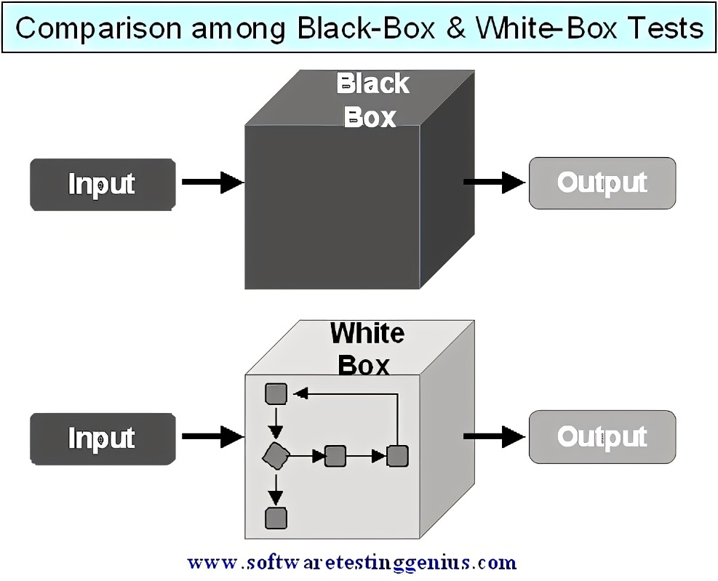
考点5. Testing – Black-box/White-box Testing
Black-box Testing
  Black-box testing, also known as functional testing or opaque testing, is a testing approach that involves testing the software from an external or end-user perspective, without having any knowledge of the internal structure, design, or implementation details of the software.
White-box Testing
  White-box testing, also known as structural testing, glass-box testing, or clear-box testing, is a testing approach that involves examining the internal structure, design, and implementation details of the software.

Slide 30
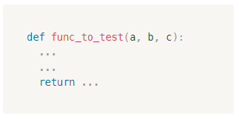
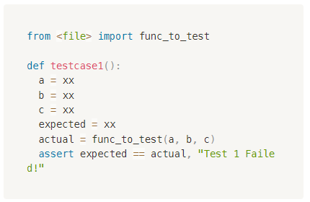
考点5. Testing - Assert

Slide 31
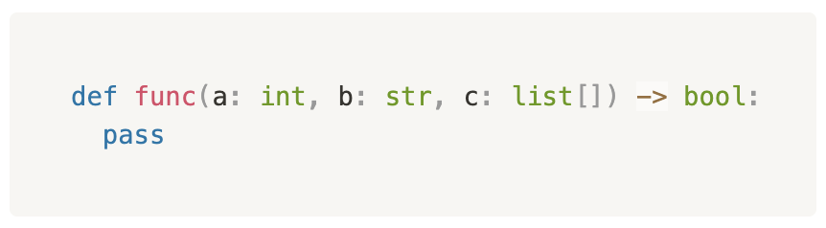
考点5. Testing - Testcase设计攻略
Unit Test里面优先看function signature
Int/float
  正/副/零/特殊值
Str
  “”Empty string
  “ “
  “ldsjfklsj”
Reference Datatype
  None
Boolean
  True/False
保证测试范围覆盖广
变量排列组合

Slide 32
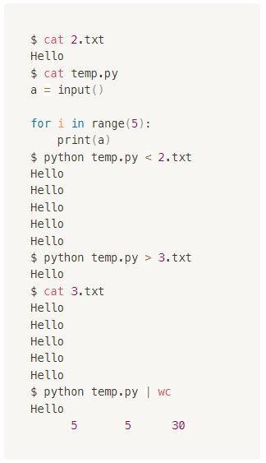
考点6. Shell Redirection *
Input Redirection <
Output Redirection >
Pipe

Slide 33
考点1.

Slide 34

考点1.

Slide 35
经典题型放送

Slide 36
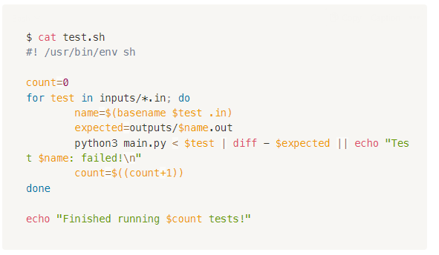
Bash Diff Test Example
(自编题)
+ test.sh
+ main.py
+ inputs
+ - - 1.in
+ - - 2.in
+ outputs
+ - - 1.out
+ - - 2.out
这种测试必须保证main.py里面有input()接受输入以及print()给出输出

Slide 37
Black/White Box Testing
(自编题)
count(li, s) returns the number of occurrences of s in li.
s: a character
li: a list of strings
Testcase ID | Inputs | Expected Output
1
2
3
4

Slide 38
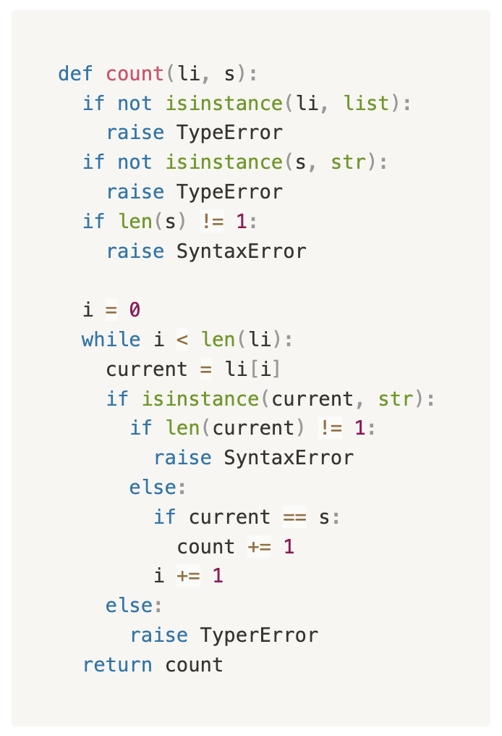
Black/White Box Testing
(自编题)
Testcase ID | Inputs | Expected Output
1
2
3
4

Slide 39
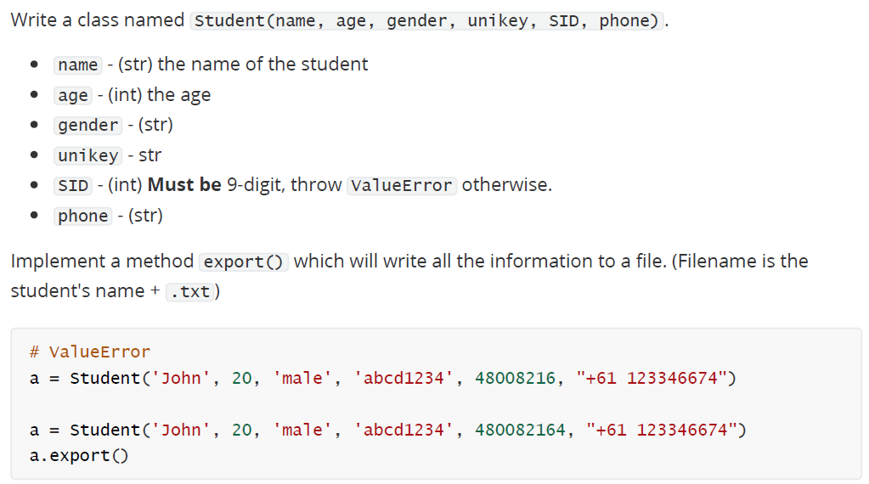
Class and File I/O
（自编题）

Slide 40
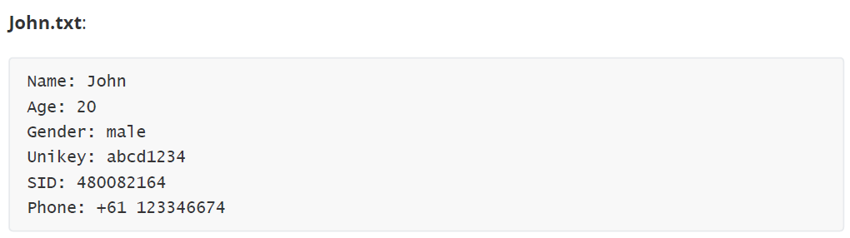
Class and File I/O
（自编题）

Slide 41
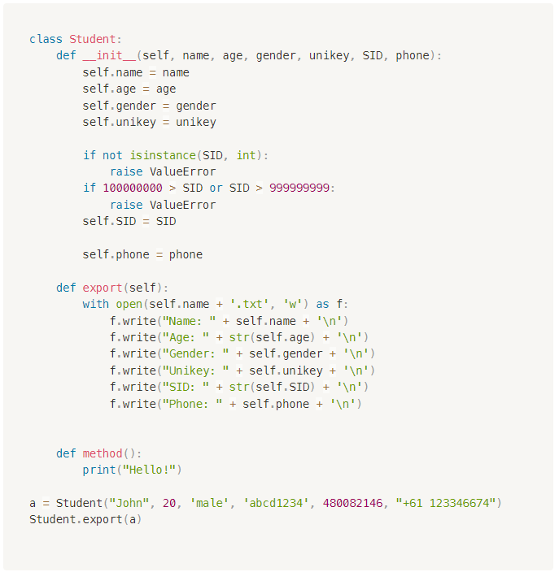
Class and File I/O
（自编题）

Slide 42
Code – Sort
(自编题)
Write a function sort(li) that receives a list of integers and return a sorted list in ascending order.
Assume the list does not contain duplicates.
sort([4, 5, 2, 8, 1, 0, 3, 7] -> [0, 1, 2, 3, 4, 5, 7, 8]

Slide 43
Intuitive Sort with Min
Function my_sort(collection):
new_collection = []
i = 0
while i < len(collection):
temp = find 第i小的element in collection
new_collection.append(temp)
return new_collection

Slide 44
Sort – in-place
Function bubble_sort(collection):
i = 0
while i < length of the collection then
j = 0
while j < length of the collection - i - 1 then
if collection[j] > collection[j+1] then
swap values between collection[j] and collection [j+1]
j += 1
i += 1
return
Descending order?
6 | 5 | 3 | 1 | 8 | 7 | 2 | 4

Slide 45
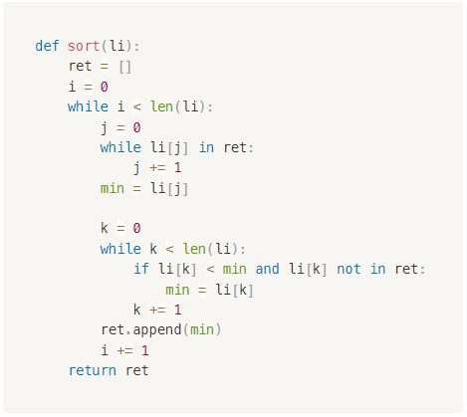
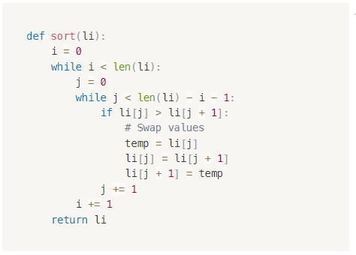
Code – Sort
(自编题)
Write a function sort(li) that receives a list of integers and return a sorted list in ascending order.
Assume the list does not contain duplicates.
sort([4, 5, 2, 8, 1, 0, 3, 7] -> [0, 1, 2, 3, 4, 5, 7, 8]

Slide 46
重难点总结

Slide 47
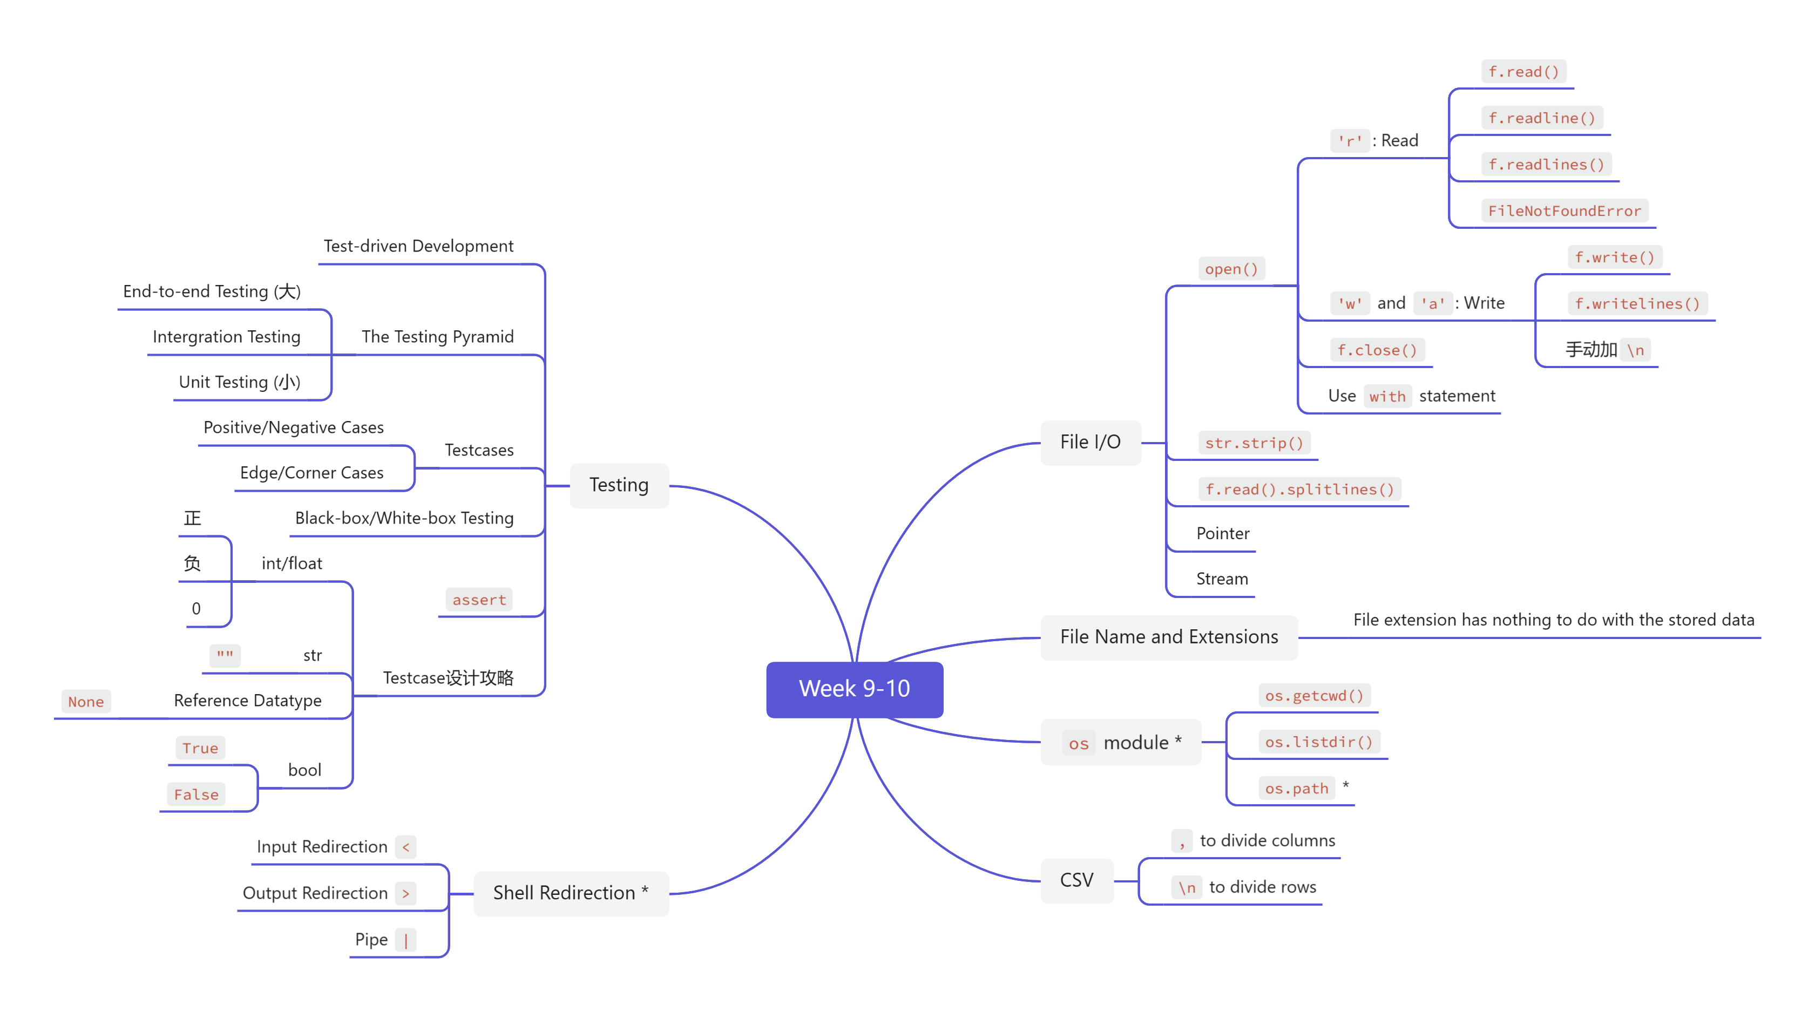
重难点总结

Slide 48
课后作业

Slide 49
下节课预告

Slide 50

下节课预告
Recursion
  What will happen if a function calls itself?
Iterator
  What is actually going on in for-each loop?

Slide 51

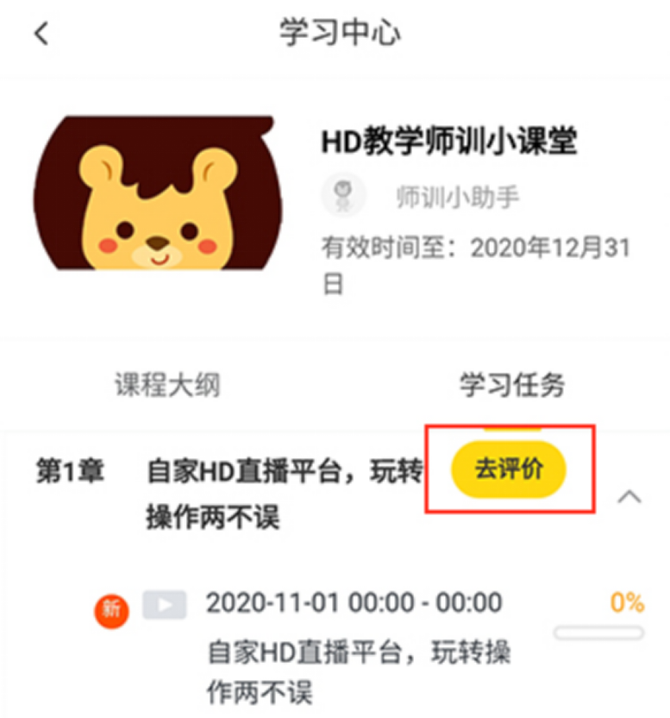

您每一份诚挚的问卷都会拯救一根濒临掉落的头发。
帮我开个张吧，求求你了！

Slide 53
Q & A

