Slide 1
INFO1110
Introduction to Programming
同步辅导课4
Tutor：Hilbert

Slide 5


Hilbert
USYD Bachelor of Advanced Computing Honours First Class毕业 (Major in Software Development)
東京工業大学Master of Artificial Intelligence在读
曾任USYD INFO1110的Lab Tutor
INFO1110总分91.0 HD
2018年加入HD Edu，主要教授预科及本科的IT入门课程
HD Edu学科带头人兼面试官，曾经撰写过HD的INFO课程规范指南

Slide 8

1
OOP and Classes
2
Iteration Revisit
3
Error Handling
4
Random
5
enumerate() and zip() *
6
Unpack Operation *

Slide 9

本节考点
1、 Program Basics
题型：选择题、简答题
内容：
What is a program/interpreter/compiler?
Program running procedures
考察惯例：考察可能性较小
题目展示：
2、 Terminal Commands
题型：非考题，但是融入你接下来13周的方方面面
内容：Directory operations, Copy/Move, Run program, etc.
考察惯例：无
How does the execution process differ for a program written in an interpreting programming language compared to a compiled language?
(自编题)
注： 代表重要程度，并非难度

Slide 10
知识点讲解

Slide 11
考点1. Class
A class (类） is the blueprint of a category of objects (instances).
如何判断两个Objects是否同类：
  有相同的属性(Attributes)
  有相同的行为(Methods)
我们之前一直使用的都是Python pre-defined的classes，而现在使用keyword class，我们可以DIY自己的Datatype！

Slide 12
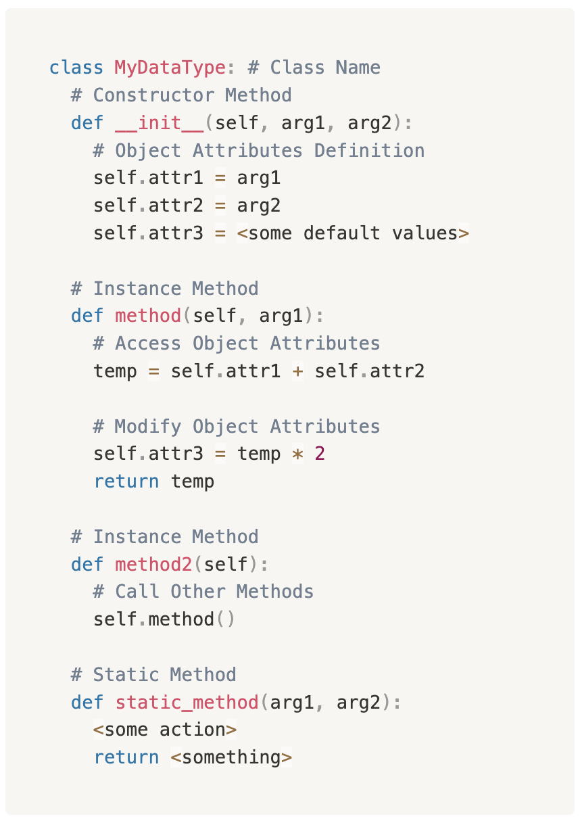
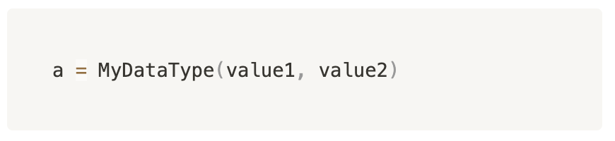
考点1. Class Syntax
Constructor describes how the object will be instantiated.
  This method is usually the first method defined in a class spec.
Instance methods
Also known as class method (Methods belongs to the class not instance)
Can be called without creating an instance of the class.

Slide 13
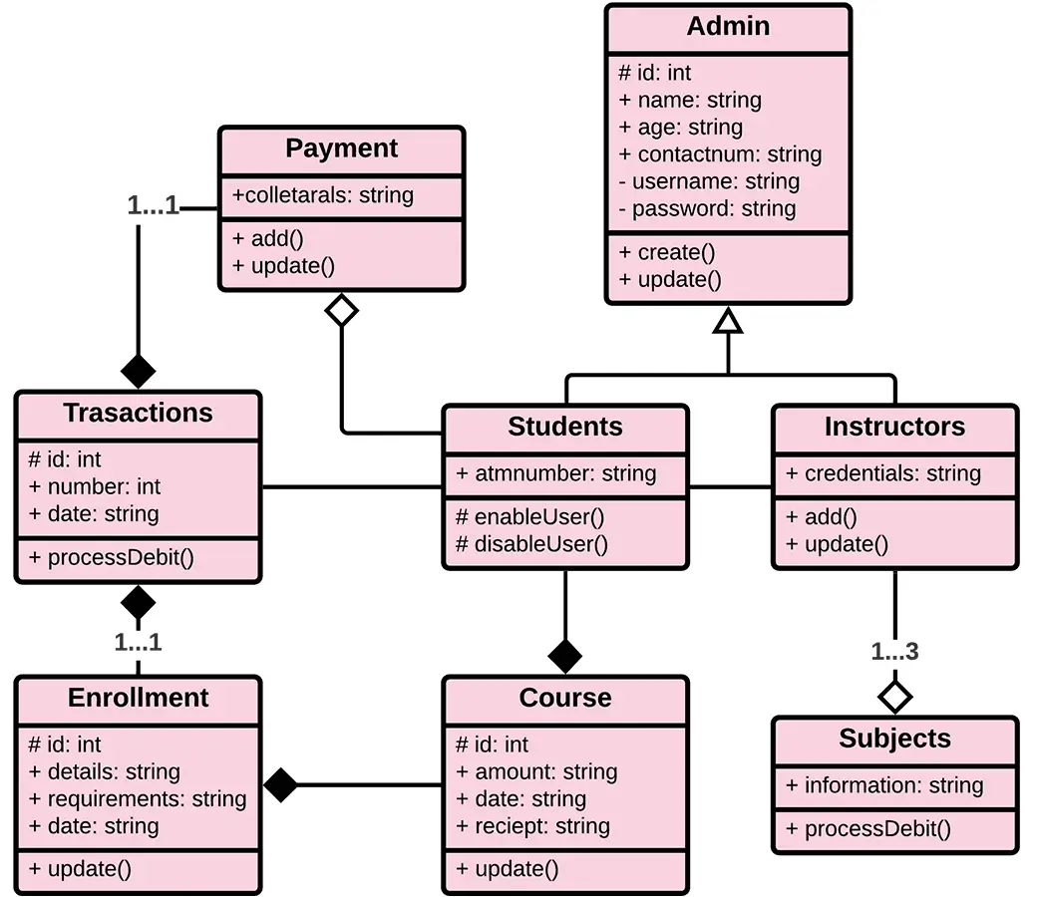
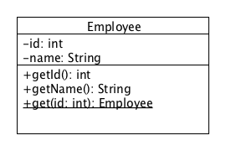
考点1. Class Diagram
我们目前所学的仅仅是一个Class的diagram
It is a part of Unified Modeling Language (UML)，用来描述class与class之间作用关系的diagram
Static content is indicated using underline

Slide 14
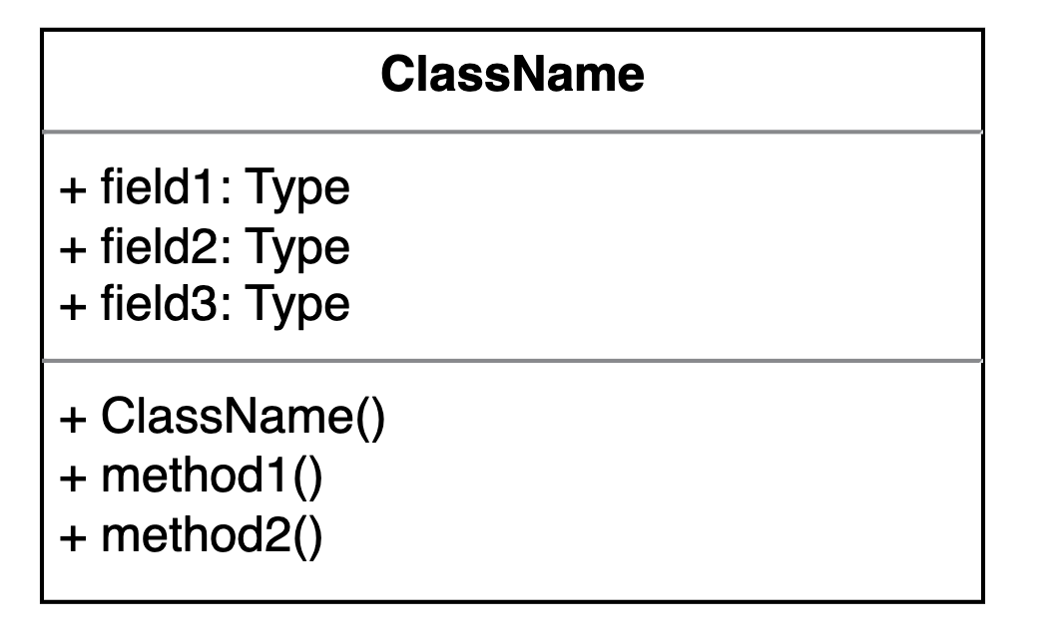

考点1. Class Diagram
Diagram head部分写Class Name
每一个attribute和method前先加一个符号代表该项的Accessability
  +: Public（对1110而言，永远是+）
  -: Private
  #: Protected
第一个Method一定是Constructor!
Just like Flow Charts: You should be able to convert from Class Diagram to Code and vice versa

Slide 15
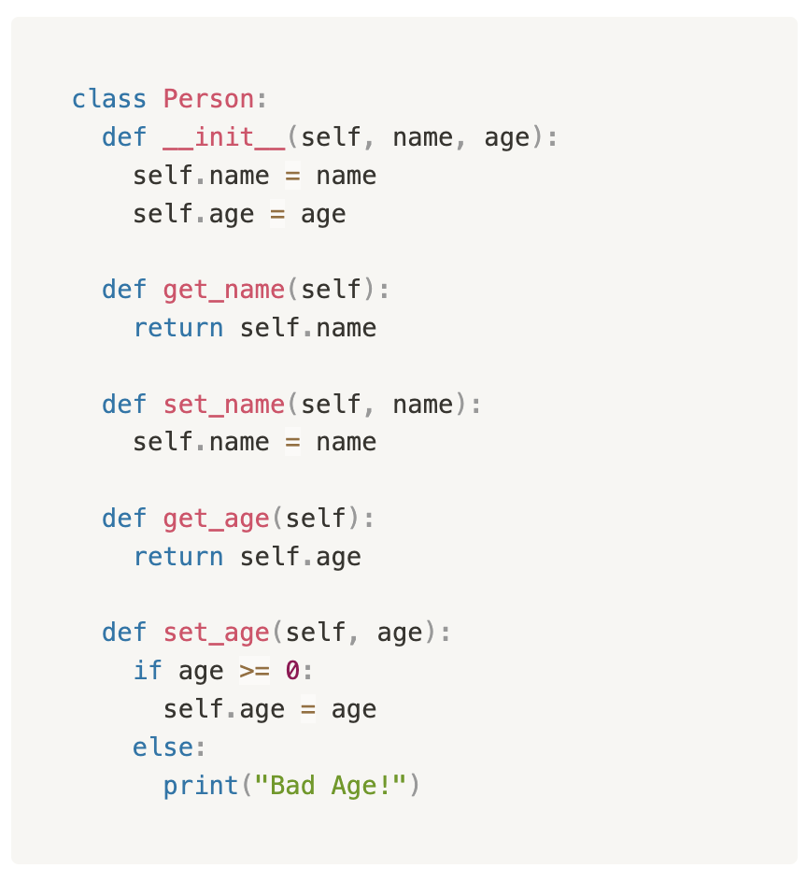
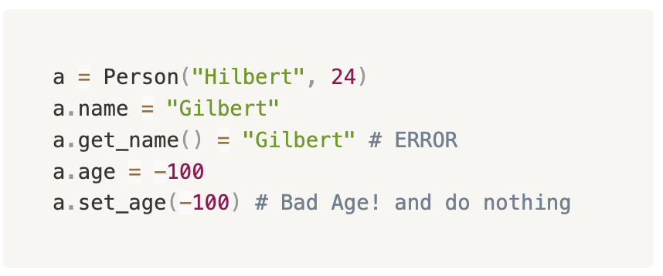
考点1. Getters and Setters
Getter are methods to retrieve attribute values.
Setters are methods that update corresponding attribute values.
It is generally a bad practice to access and modify attributes DIRECTLY:
直接访问和修改很方便，但是也会有安全性的问题
对于一些attribute我们可能会有更复杂的value update逻辑，直接assign的话，无法emforce。

Slide 16
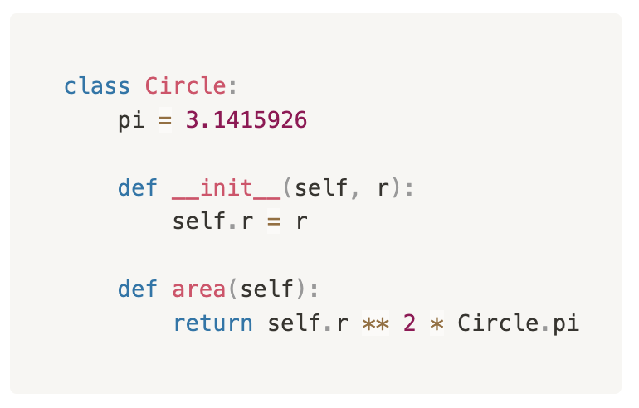
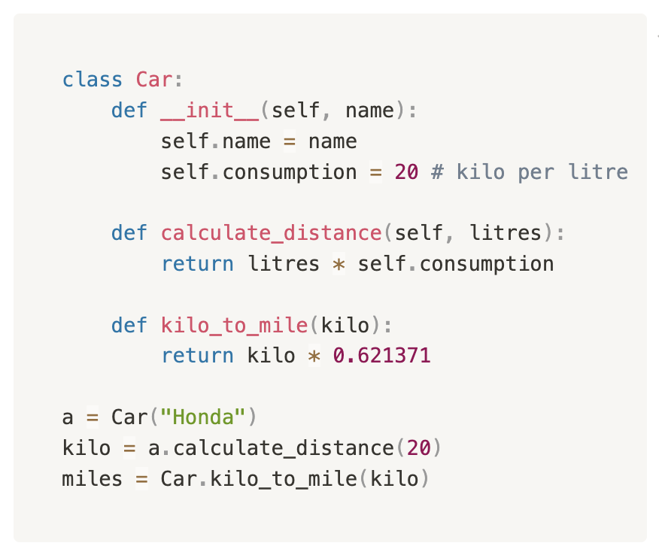
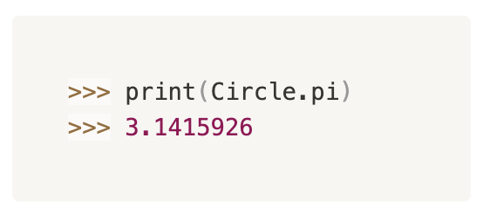
考点1. Static (Class) Variables and Methods
Static variables belong directly to the class:
Static methods also belong directly to the class:
And can be accessed via the class name
One rule-of-thumb: ask yourself "Does it make sense to call this method, even if no object has been constructed yet?" If so, it should definitely be static.
Ref. https://stackoverflow.com/questions/2671496/when-to-use-static-methods

Slide 17
考点1. Some Comparisons
Class vs. Instance
  A class is a blueprint for creating objects (instances). It defines the attributes and behaviors that the objects of the class will have. Think of a class as a template or a set of instructions for creating objects.
  An instance is a specific realization of a class. It is an actual object created (instantiated) from the blueprint defined by the class. Each instance has its own unique set of data and can behave independently of other instances, although they all follow the structure defined by the class.

Slide 18
考点1. Some Comparisons
Procedural Programming vs. Object-oriented Programming
  Procedural Programming (基本单位是Function）
    解决问题的逻辑和流程
    Functionalise and reuse some just general program-solving patterns
    Control flow
  Object-oriented Programming (OOP) （基本单位是Class）
    Model a complex system’s interaction between different modules
    Modularity and extensibility
    Inheritance, polymorphism, and encapsulation for code organization and reuse (*)

Slide 19
考点1. Some Comparisons
Functions vs. Methods
Functions are standalone blocks of code that perform a specific task, while methods are functions associated with objects in object-oriented programming and operate on the data within those objects. The choice between using functions and methods depends on the programming paradigm being used and the context in which the code is being developed.

Slide 20
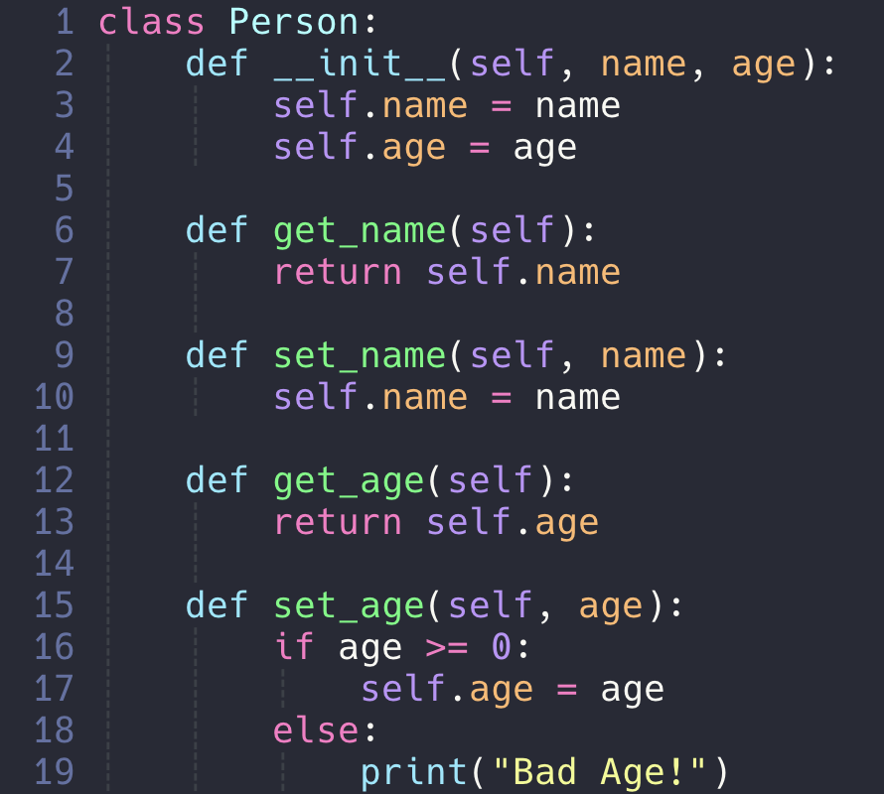
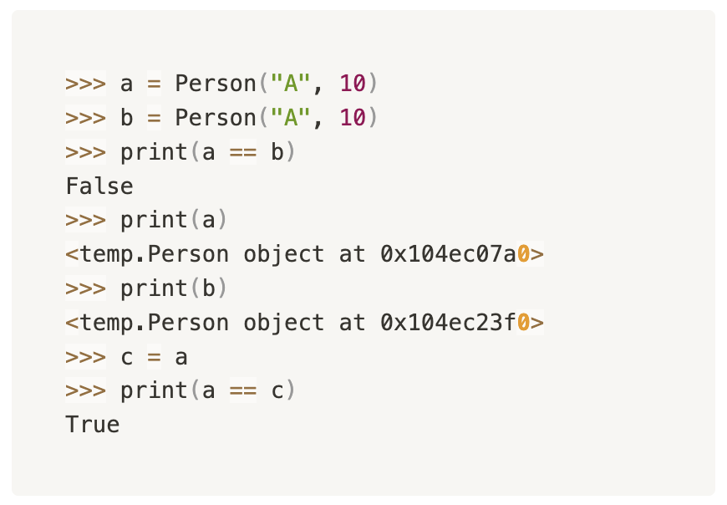
考点1. Equality
By default, the objects defined are compared based on memory addresses.

Slide 21
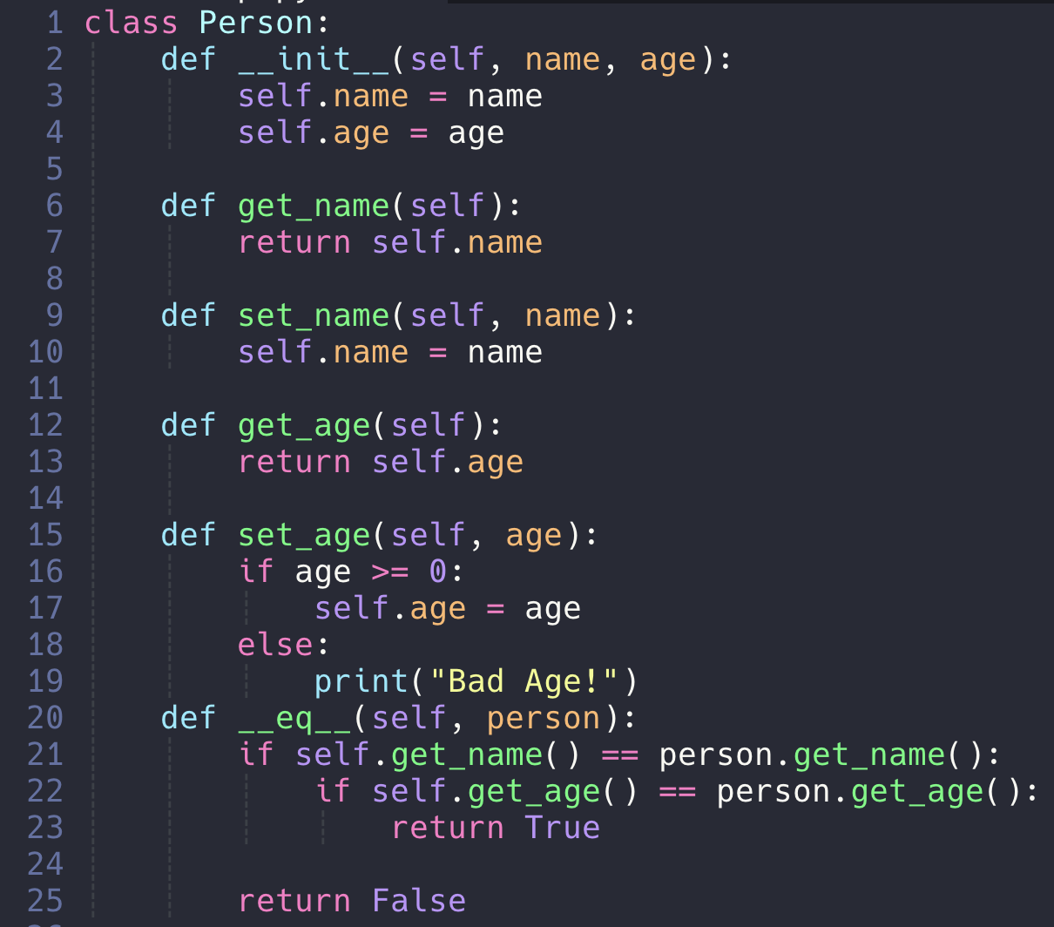
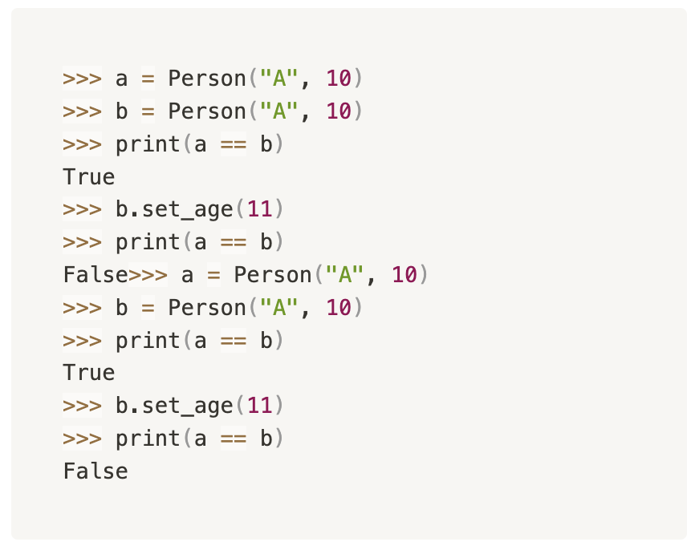
考点1. Equality
By defining __eq__() method, we can freely design the equality for our own class:

Slide 22
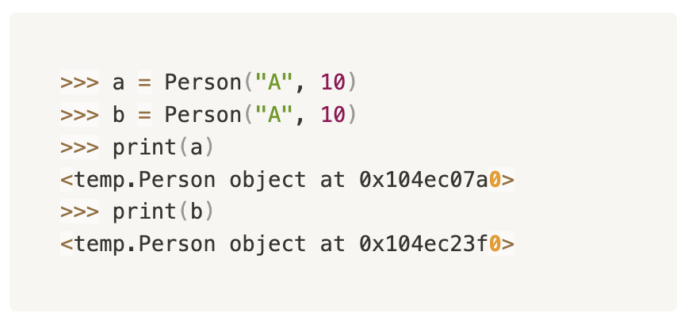
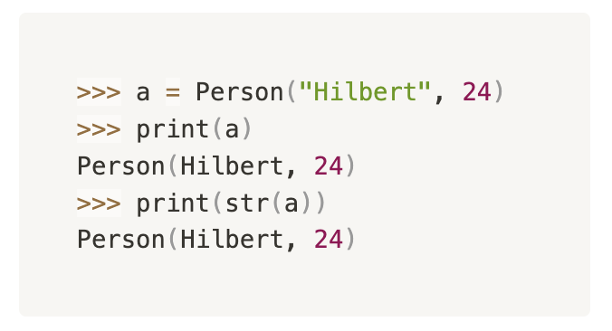
考点1. String and Representation
When we try to print our own defined objects, the message follows Python’s default template:
  <”class” object at “memory”>
But again, we can define __str__() or __repr__() to overwrite the default behaviour.

Slide 23
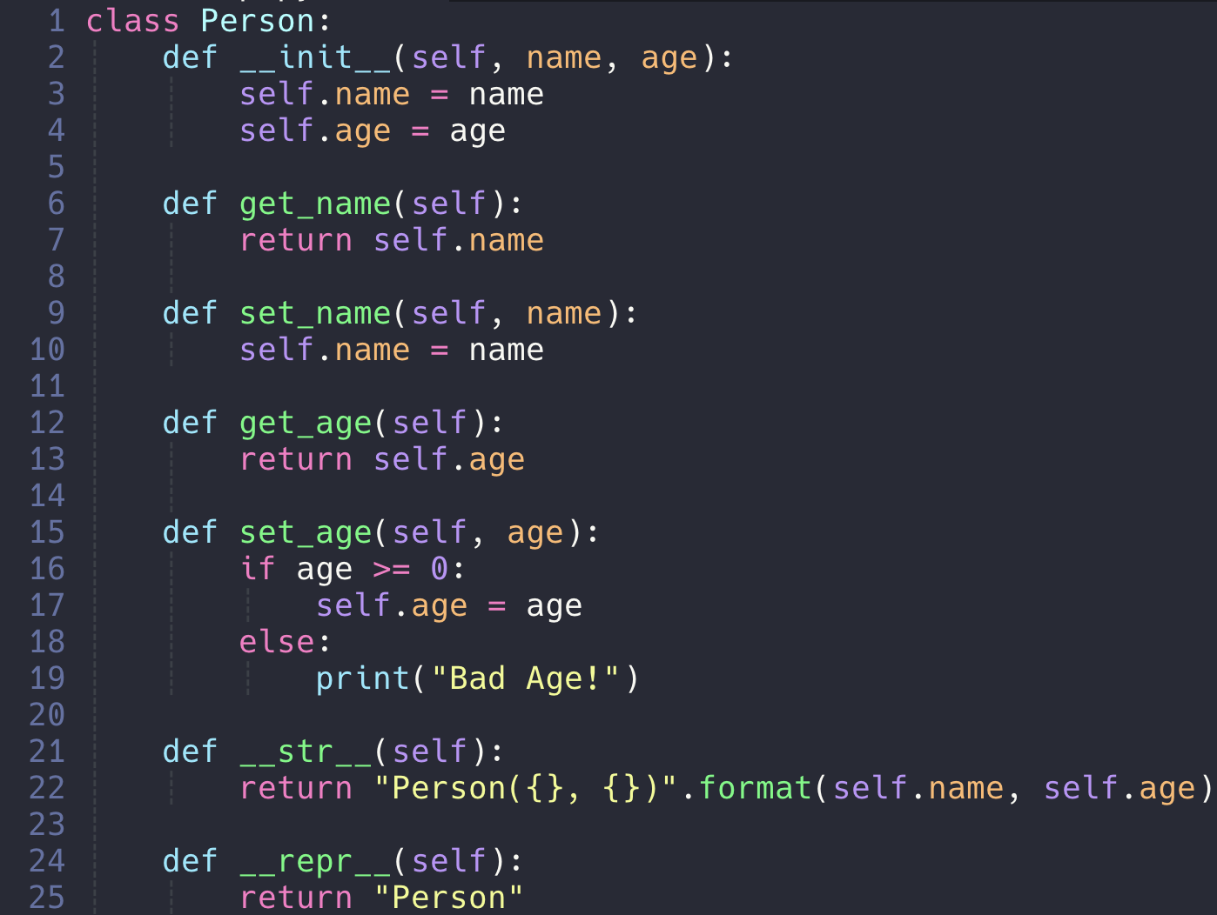
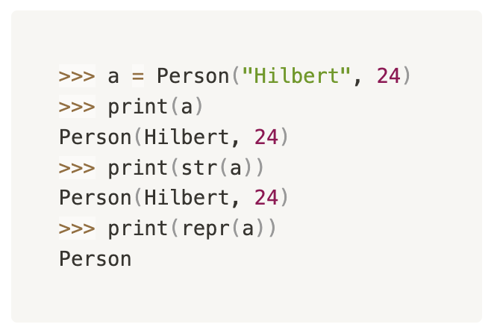
考点1. str() and repr() *
Usually define either __str__() or __repr__() will do the job.
But if we have them both, __str__() is prioritized.
Deep down inside, they just define the bahaviours called by str() and repr() function.
print() function implicitly involves those functions to get the printing content.

Slide 24
考点1. str() and repr() *
__str__(): This method is called by the str() built-in function and by the print() function to obtain the "informal" or user-friendly string representation of an object. It is meant to return a human-readable string that describes the object. This method is often used for logging or displaying objects to end-users.
__repr__(): This method is called by the repr() built-in function to obtain the "official" or unambiguous string representation of an object. It should return a string that, when passed to the eval() function, would create a new object with the same value. This method is typically used for debugging and development purposes.

Slide 25
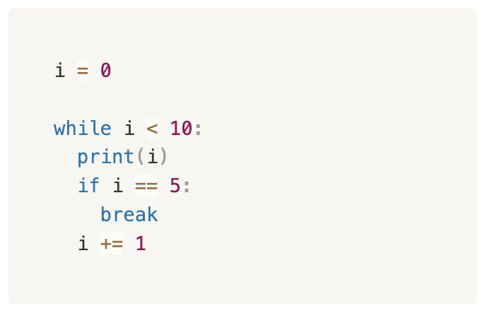
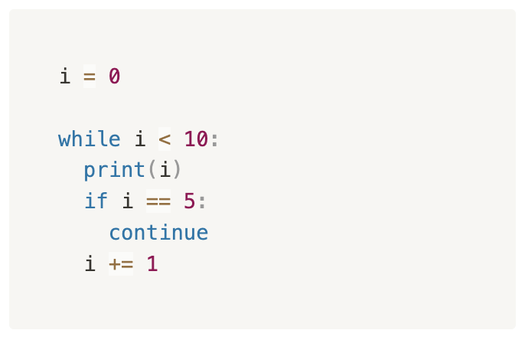
考点2. Iteration Revisit
break: terminate the iteration
continue: skip the current iteration

Slide 26
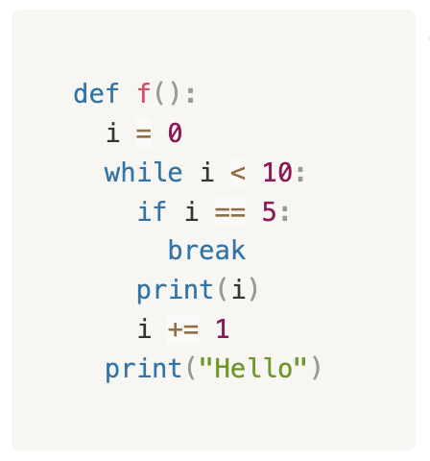
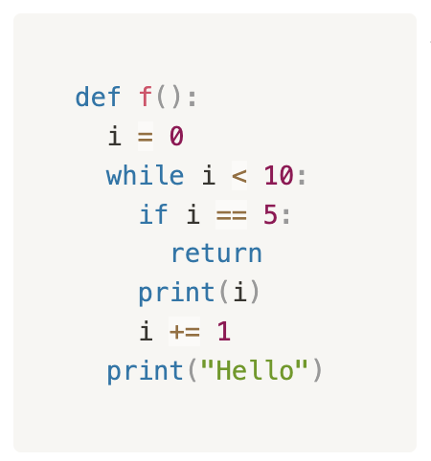
考点2. break and continue
Just like return, any other code under them will be ignored.
In nested loops, the keywords will only perform the action to the loop with corresponding indentation level.
In function definition, return can also terminate. What is the difference?
How to draw the flow charts of code having break and continue?

Slide 27
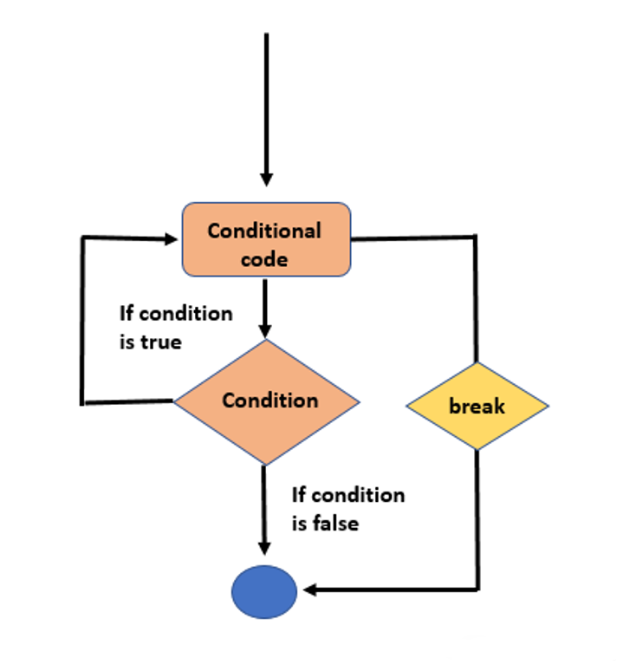
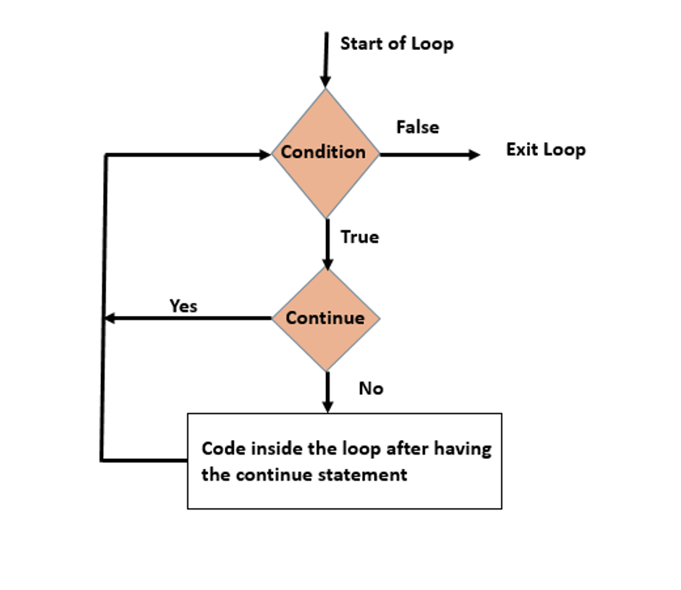
考点2. break and continue

Slide 28
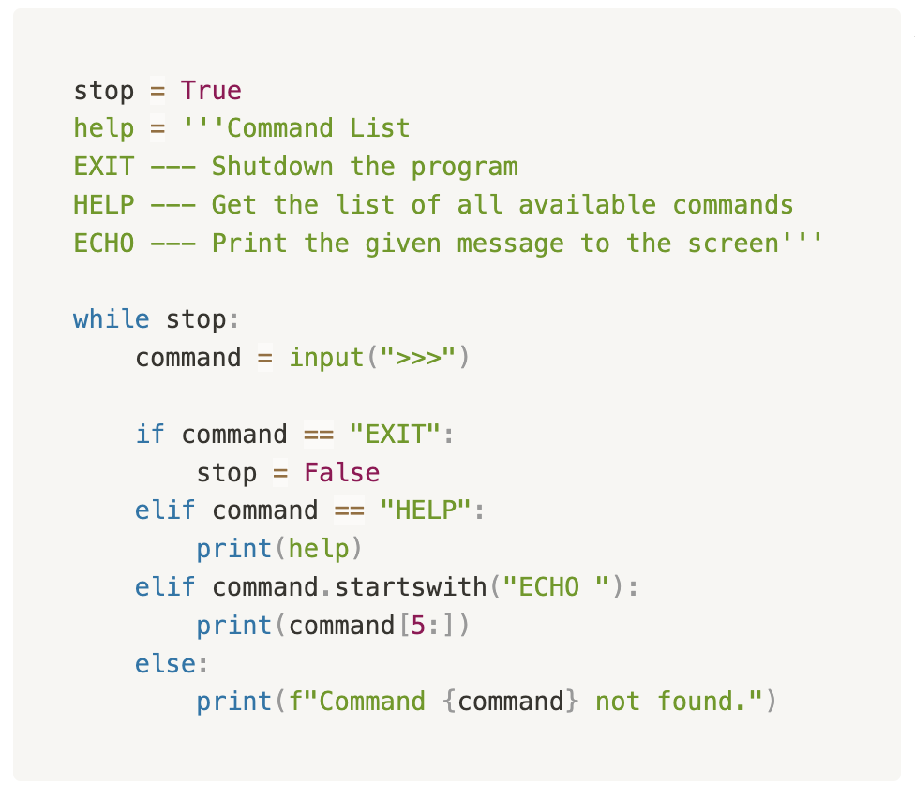
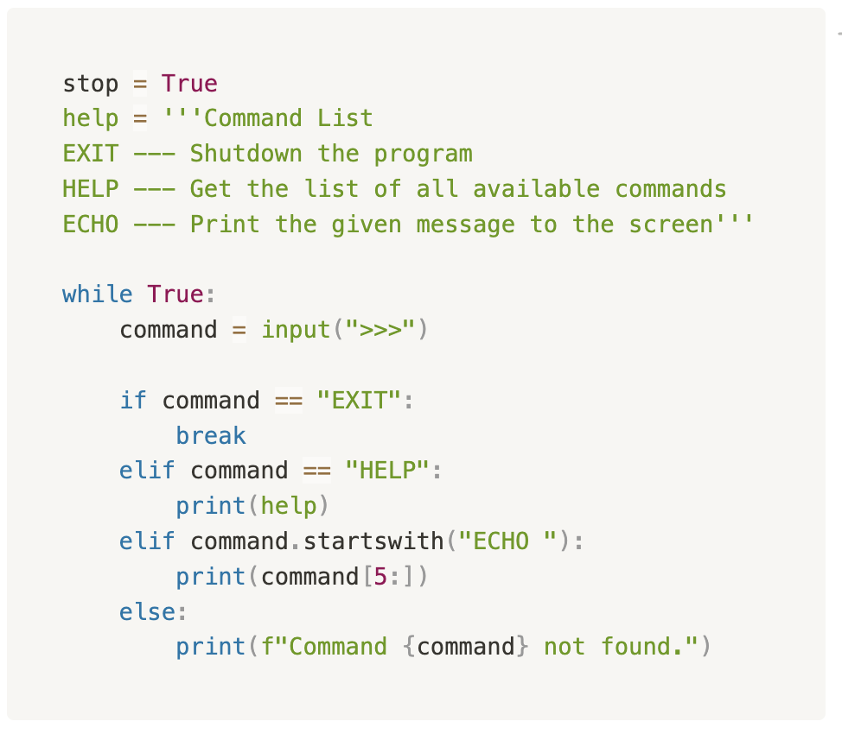
考点2. Iteration Revisit
现在有了break和continue，在event-controlled loop里我们就不一定需要一个flag variable来实现了。

Slide 29
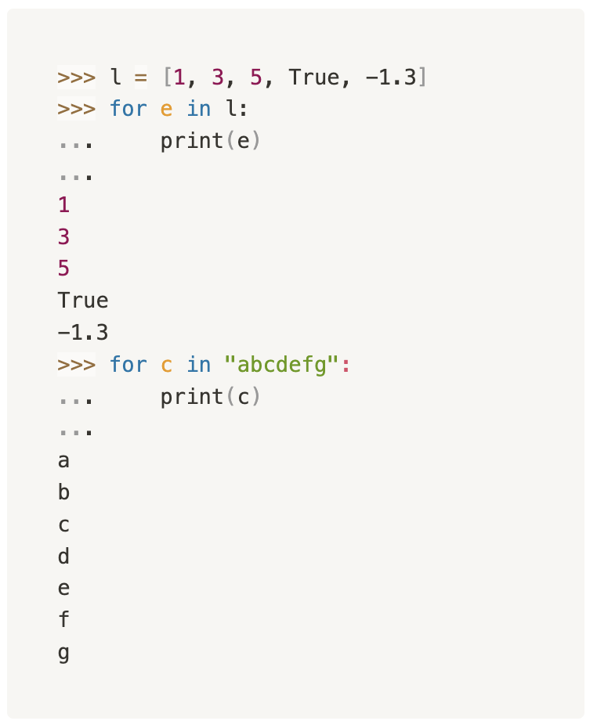
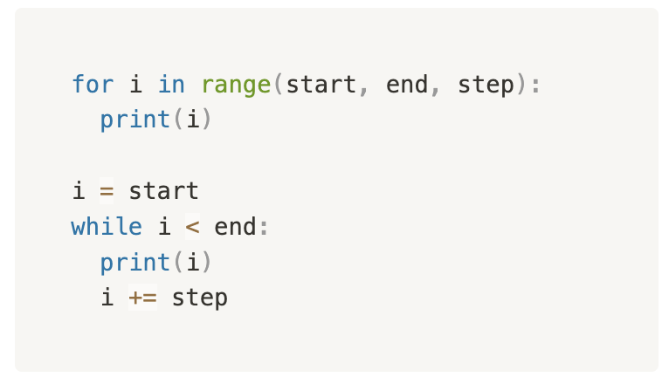
考点2. for loop
For-each loop
  For <variable> in collection:
  print(variable)
Index based iteration
  Range包含起点不包含终点 (同slicing)
Assignment，Final大概率无法使用

Slide 30
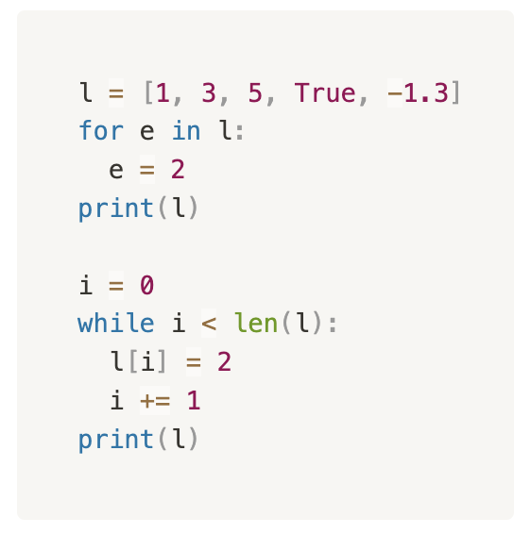
考点2. for loop - drawback
以下程序运行后会输出什么？

Slide 31
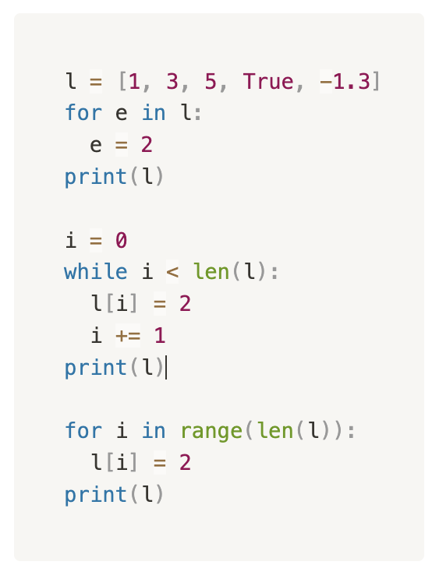
考点2. for loop - drawback
以下程序运行后会输出什么？

Slide 32
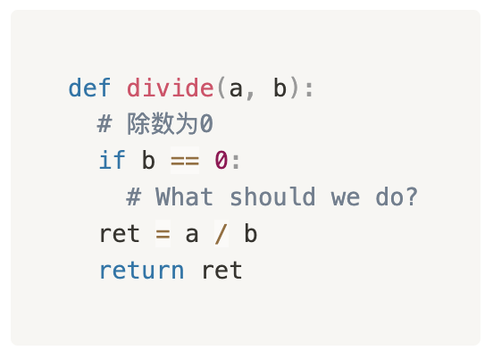
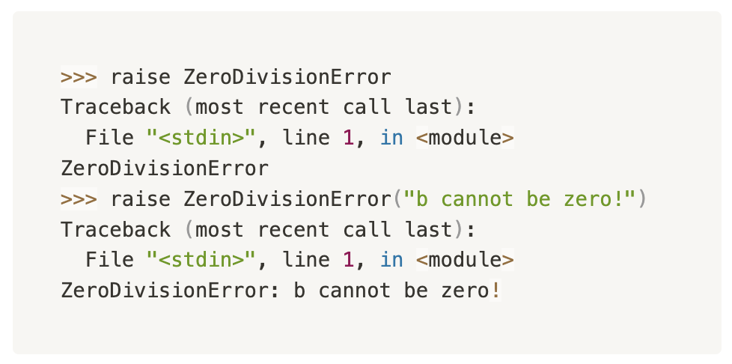
考点3. Error Handling - raise
Sometimes our program would run into some situations that it makes no sense to continue execution. However, it also should not be no differece between normal program termination.
We raise (throw) an error and let the program crashes!

Slide 33
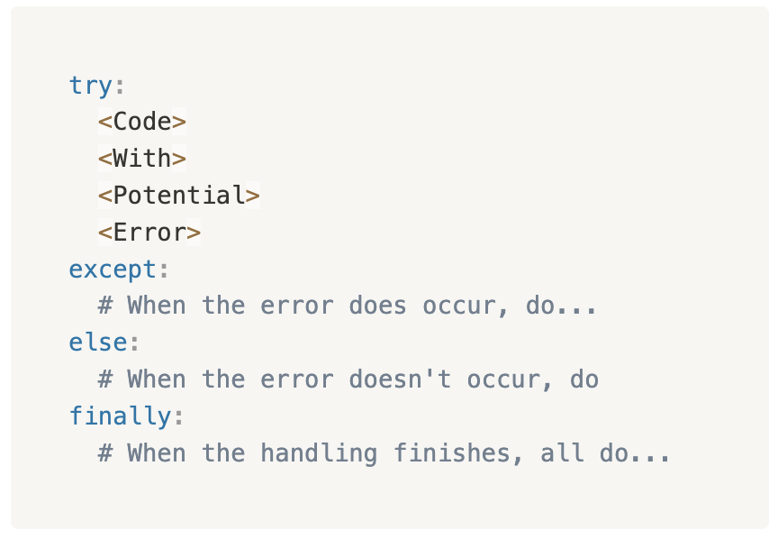
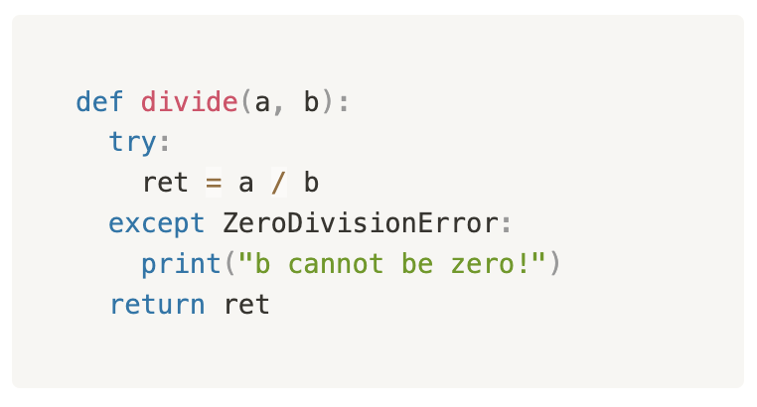
考点3. Error Handling – Error Catching
Sometimes we may suspect some part of our code might run into errors, when this does happen we want to handle it specifically rather than just letting it crashes and ends the whole program.

Slide 34
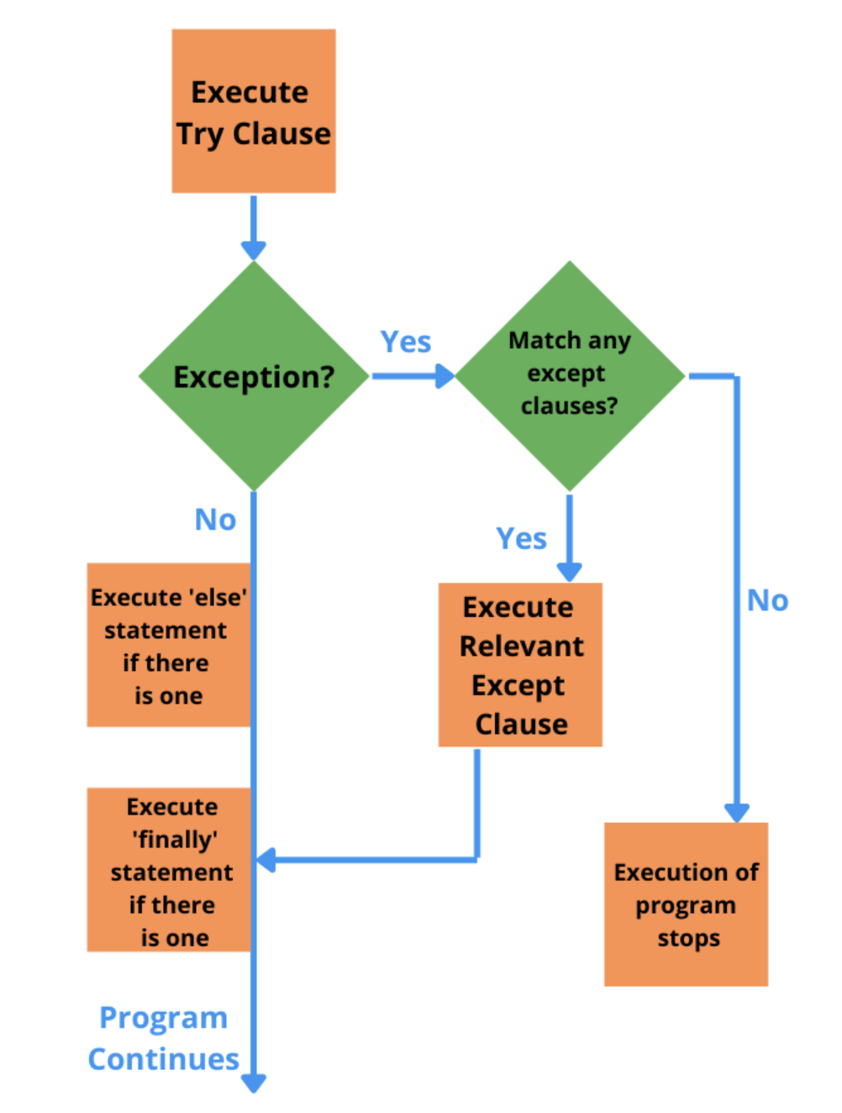
考点3. Error Handling – Error Catching
Didn’t catch the error

Slide 35
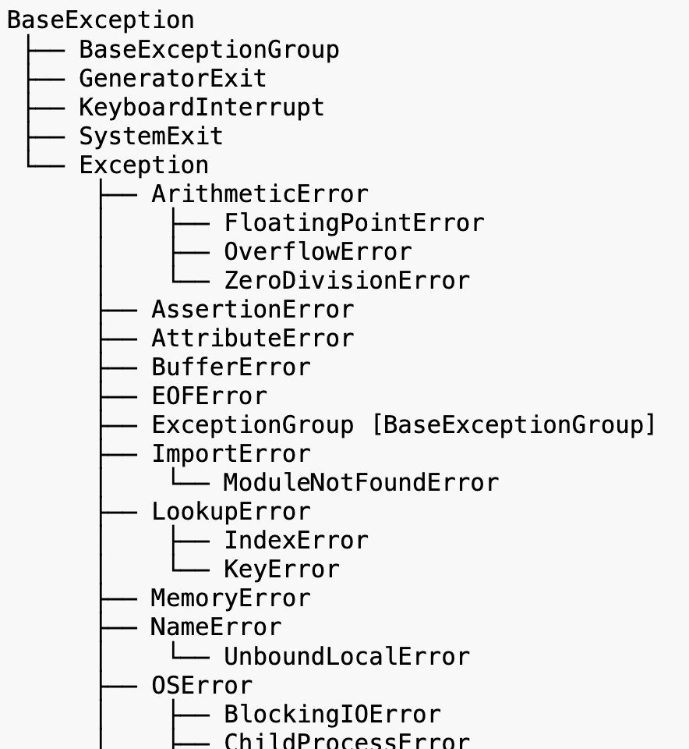
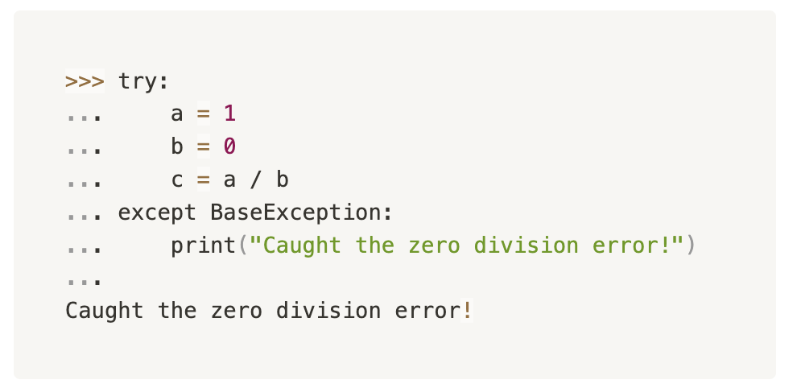
考点3. Error Handling – Exception Hierarchy (*)
Inheritence (*)
E.g., Car
  Tesla
  Truck
  Etc.
The ZeroDivisionError was caught because it inherited from BaseException
Ref.: https://docs.python.org/3/library/exceptions.html#exception-hierarchy

Slide 36
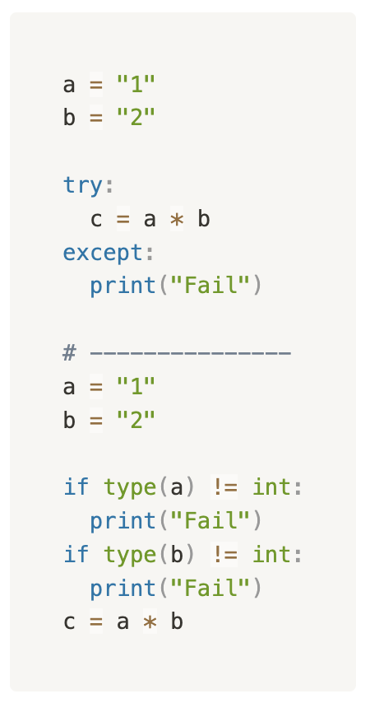
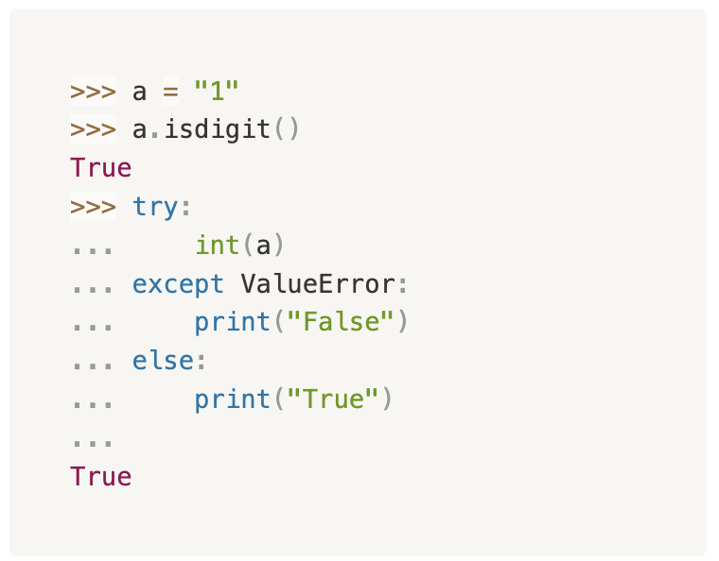
考点3. Only do Error Handling when you must
Error Catching是最后的最后的手段，能用正常control flow解决的问题就不要用try-except

Slide 37
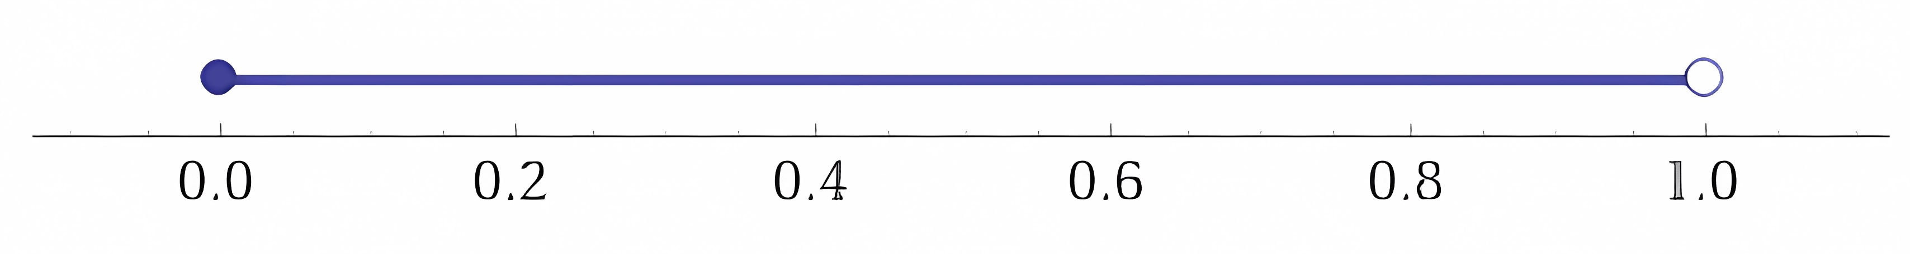
考点4. Random
需要多少的概率，就把这段范围多少等分
注意random.randint(a, b)的随机范围是既包含a也包含b的([a,b])
Ref.: https://docs.python.org/3.10/library/random.html

Slide 38
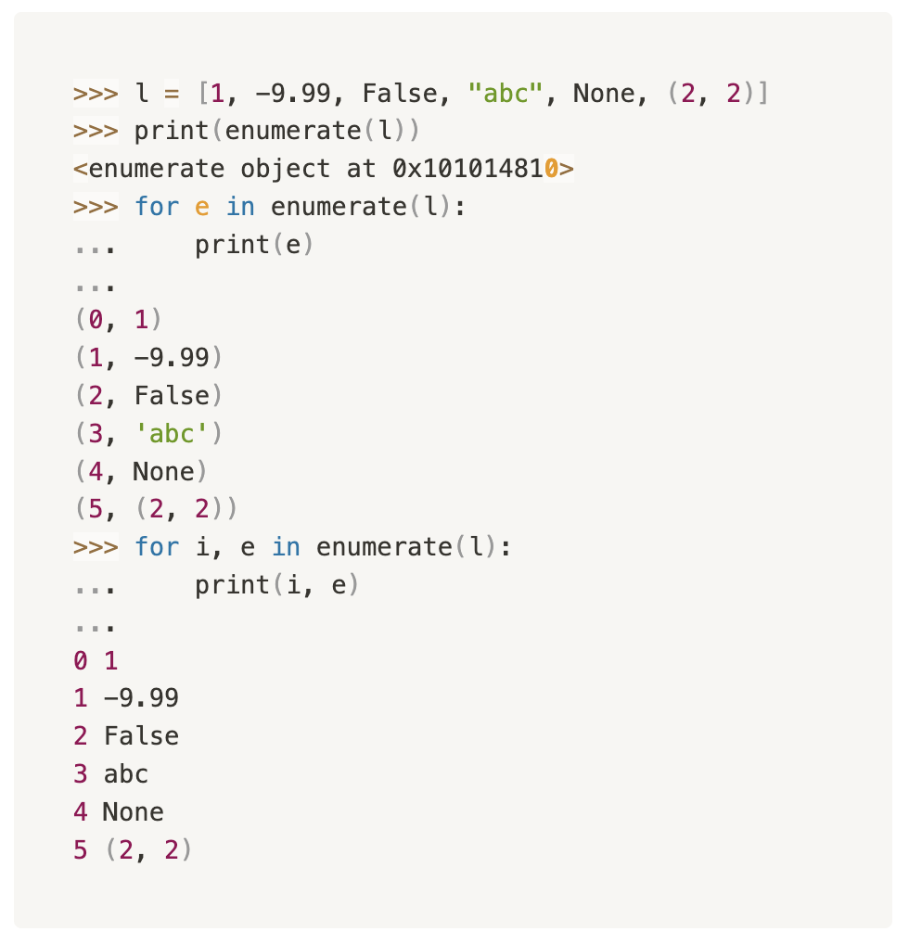
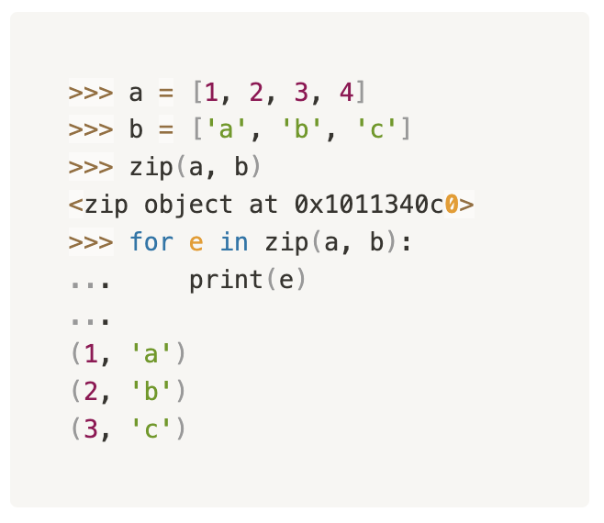
考点5. enumerate() and zip() *
Usually use along with for loops.

Slide 39
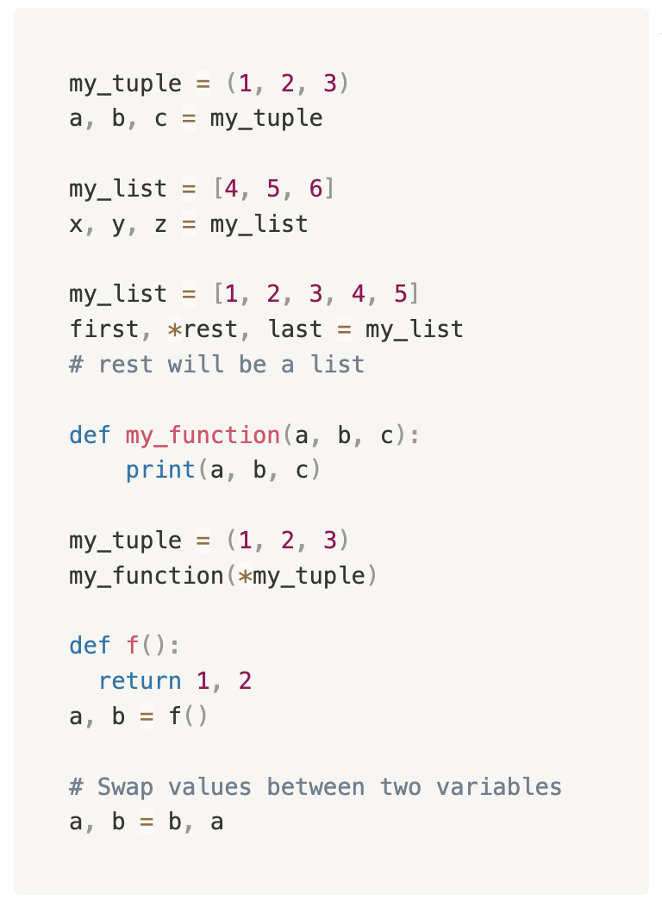
考点6. Unpack *
Unpacking in Python refers to the process of extracting elements from collections (like lists, tuples, or dictionaries) and assigning them to individual variables.
It allows you to easily assign multiple values contained within collection to multiple variables in a single statement.

Slide 40
考点1.

Slide 41

考点1.

Slide 42
经典题型放送

Slide 43

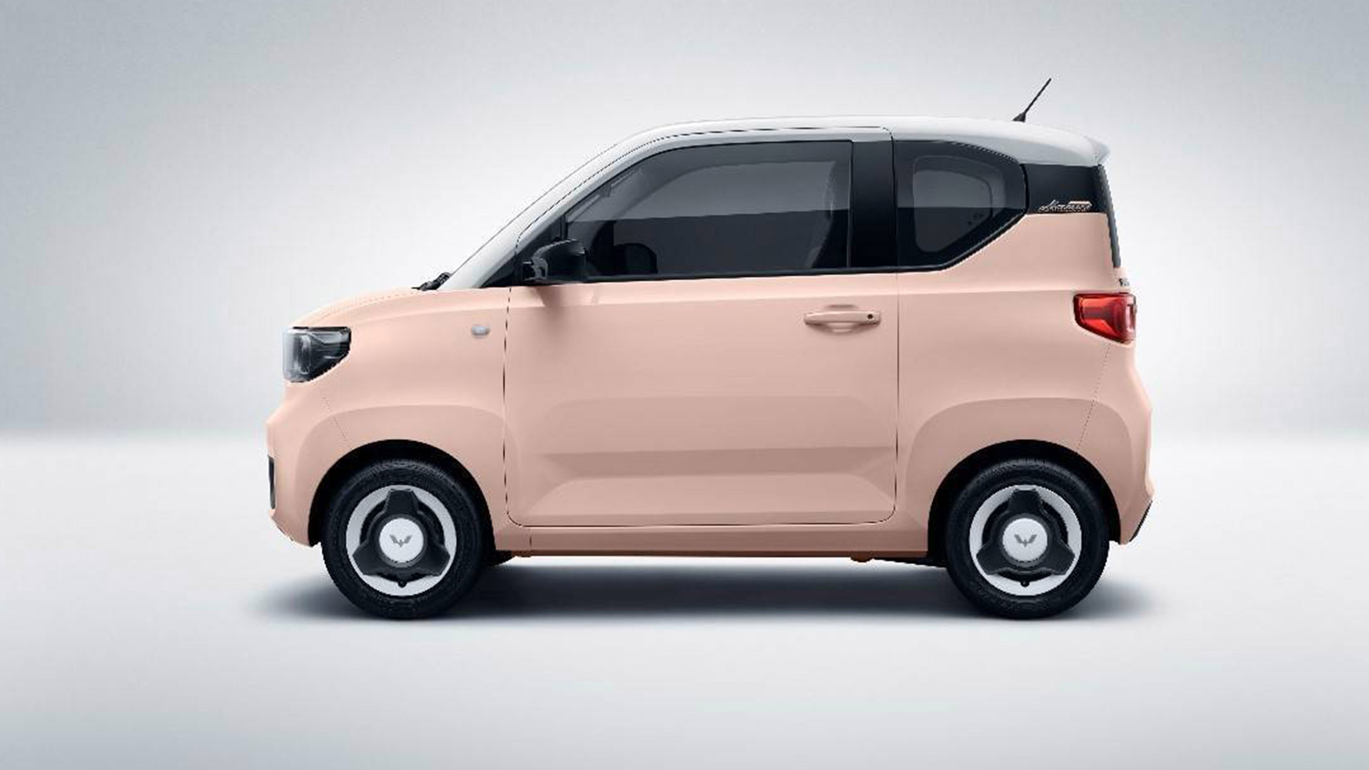
Classes Communication Example
(自编题)

Slide 44
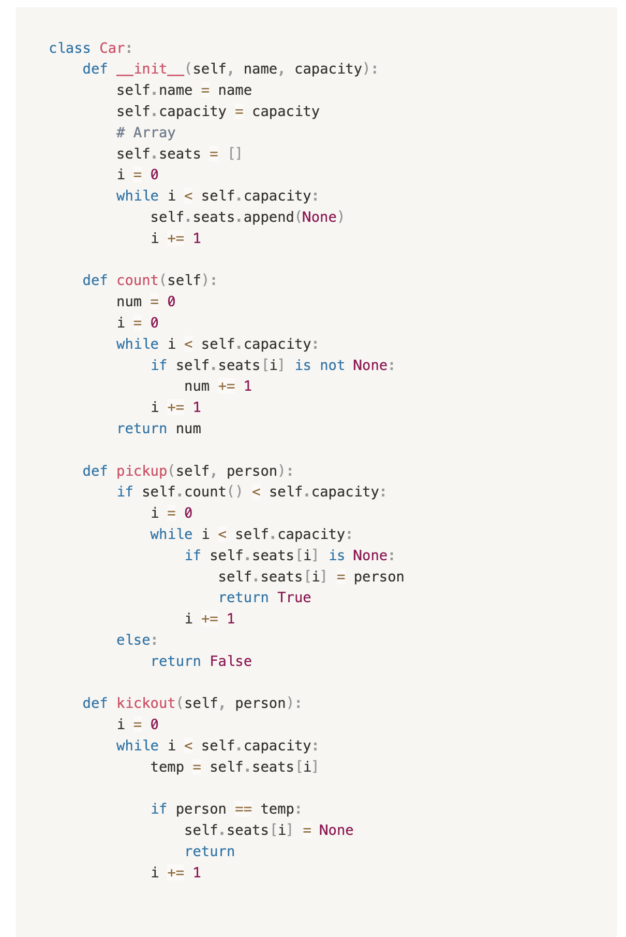
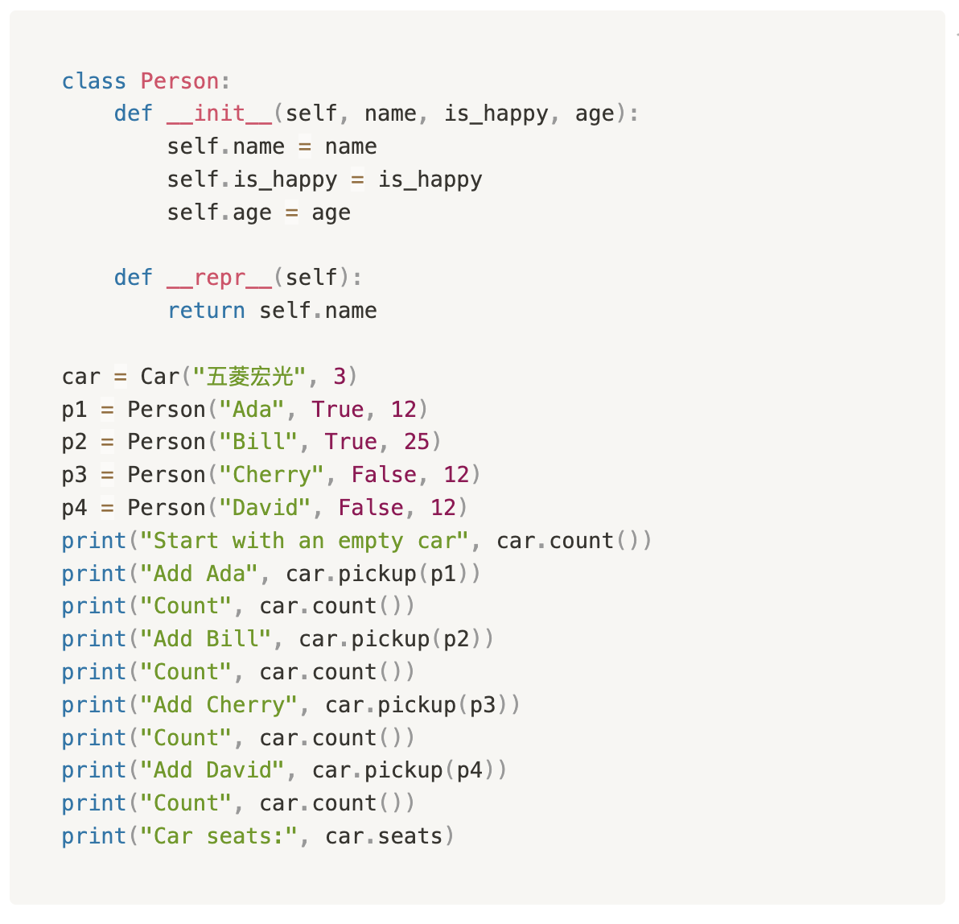
Classes Communication Example

Slide 45
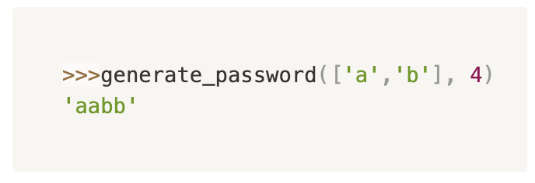
Random Password Generator
Write a function that outputs a randomized password base on two parameters char and length.
char: A list of characters where it contains all the possible characters to be used in the password string generated.
length: the length of the password.
(自编题)

Slide 46
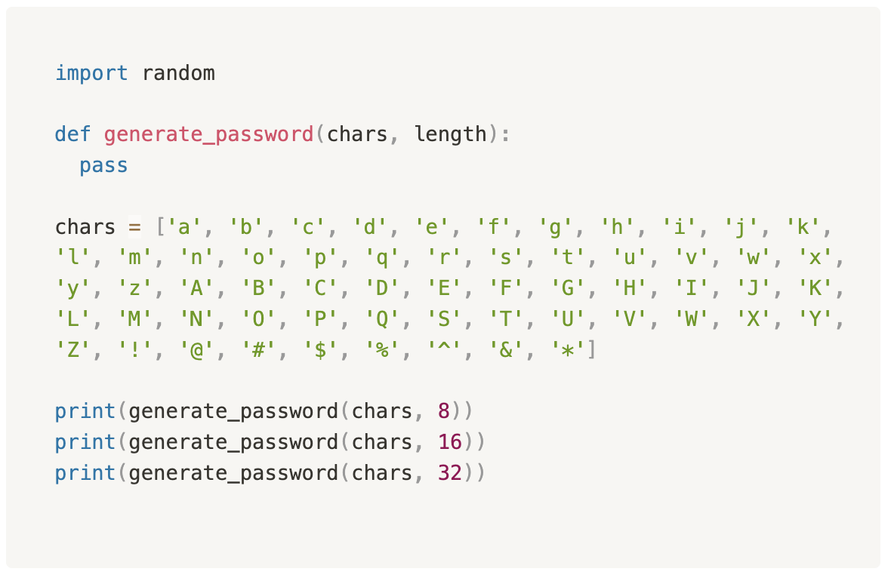
Random Password Generator

Slide 47
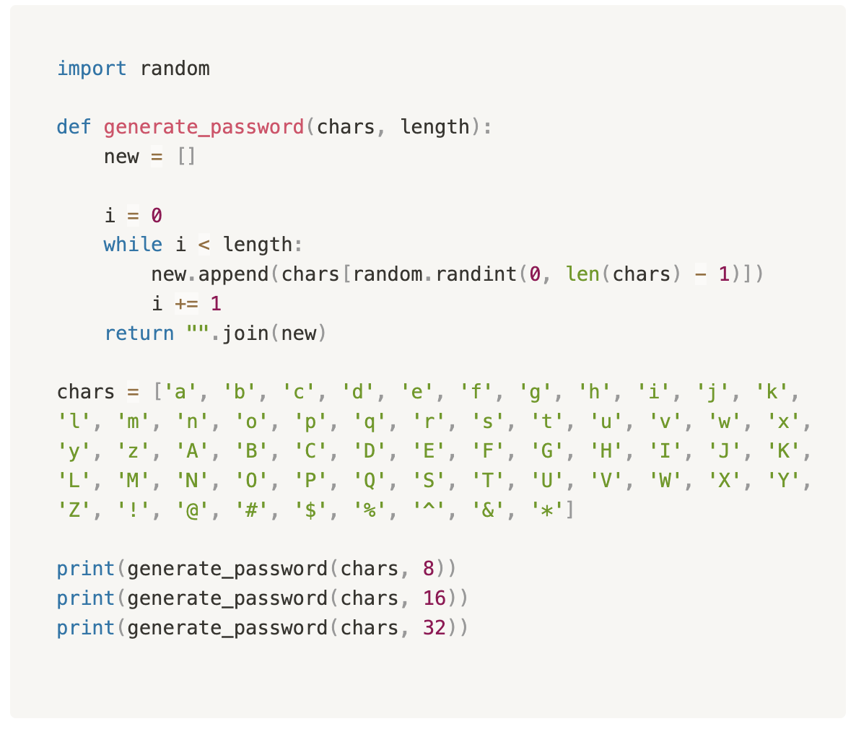
Random Password Generator

Slide 48
Code – Sort
(自编题)
Write a function sort(li) that receives a list of integers and return a sorted list in ascending order.
Assume the list does not contain duplicates.
sort([4, 5, 2, 8, 1, 0, 3, 7] -> [0, 1, 2, 3, 4, 5, 7, 8]

Slide 49
Intuitive Sort with Min
Function my_sort(collection):
new_collection = []
i = 0
while i < len(collection):
temp = find 第i小的element in collection
new_collection.append(temp)
return new_collection

Slide 50
Sort – in-place
Function bubble_sort(collection):
i = 0
while i < length of the collection then
j = 0
while j < length of the collection - i - 1 then
if collection[j] > collection[j+1] then
swap values between collection[j] and collection [j+1]
j += 1
i += 1
return
Descending order?
6 | 5 | 3 | 1 | 8 | 7 | 2 | 4

Slide 51
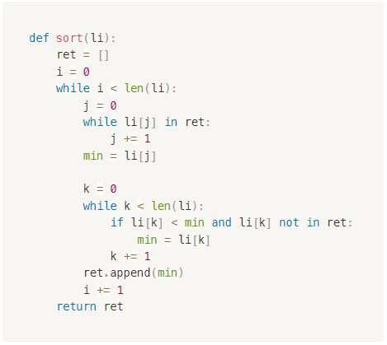

Code – Sort
(自编题)
Write a function sort(li) that receives a list of integers and return a sorted list in ascending order.
Assume the list does not contain duplicates.
sort([4, 5, 2, 8, 1, 0, 3, 7] -> [0, 1, 2, 3, 4, 5, 7, 8]

Slide 52
重难点总结

Slide 53

重难点总结

Slide 54
课后作业

Slide 55
下节课预告

Slide 56

下节课预告
Testing
  Black box vs White box testing
  Unit Testing
  Edge cases / Corner cases
File I/O
  How to read a file?
  How to write to a file?

Slide 57



您每一份诚挚的问卷都会拯救一根濒临掉落的头发。
帮我开个张吧，求求你了！

Slide 59
Q & A

