Slide 1
INFO1110
Introduction to Programming
同步辅导课3
Tutor：Hilbert

Slide 5


Hilbert
USYD Bachelor of Advanced Computing Honours First Class毕业 (Major in Software Development)
東京工業大学Master of Artificial Intelligence在读
曾任USYD INFO1110的Lab Tutor
INFO1110总分91.0 HD
2018年加入HD Edu，主要教授预科及本科的IT入门课程
HD Edu学科带头人兼面试官，曾经撰写过HD的INFO课程规范指南

Slide 8

1
Flow of Execution and Desk Check
2
Function
3
Variable Scope
4
Collection Datatype
5
Command Line Arguments
6
Primitive vs. Reference Data Types
7
pdb

Slide 9

本节考点
1、 Program Basics
题型：选择题、简答题
内容：
What is a program/interpreter/compiler?
Program running procedures
考察惯例：考察可能性较小
题目展示：
2、 Terminal Commands
题型：非考题，但是融入你接下来13周的方方面面
内容：Directory operations, Copy/Move, Run program, etc.
考察惯例：无
How does the execution process differ for a program written in an interpreting programming language compared to a compiled language?
(自编题)
注： 代表重要程度，并非难度

Slide 10
知识点讲解

Slide 11
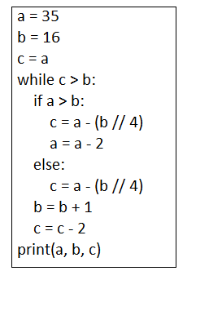
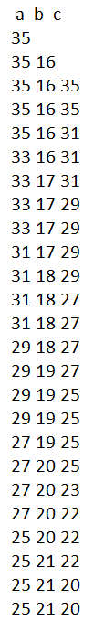
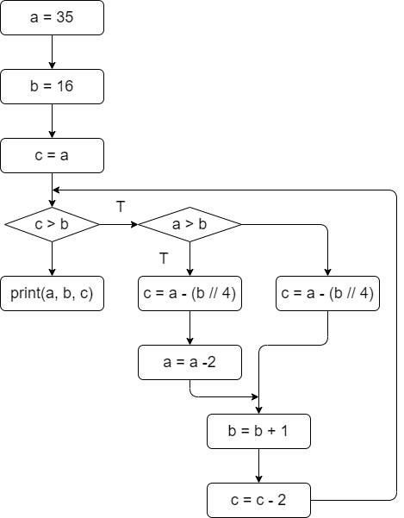
考点1. Flow – Variable Tracing and Desk check
A desk check, also known as dry run or trace table, is a manual way of walking through the code to understand how it executes without actually running it on a computer. It involves tracking the values of variables step by step.

Slide 12
考点1. 目前已学的Operations
Built-in Functions/Keywords
  import
  print(), input(), …
Variables的赋值和更新
（Arithmetic, Relational, Logical）运算
Control Flow (Condition and Iteration)
String Formatting
Type Conversion

Slide 13

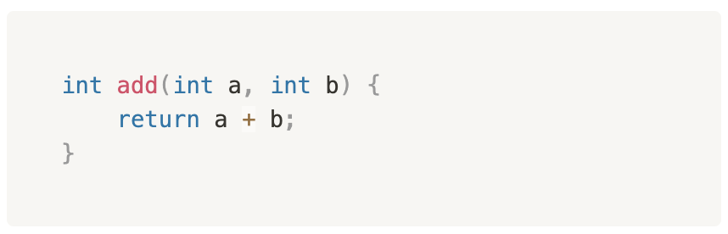
考点2. Function Basics
这部分不是在讲Python，而是Programming Basics
Return Type
Function Header/Signature
Body
Function Name
Arguments: Inputs
Return: Outputs
Function Body
Function Name
Arguments
我们用call作动词，意指使用一个已经defined function: add(1, 2);

Slide 14
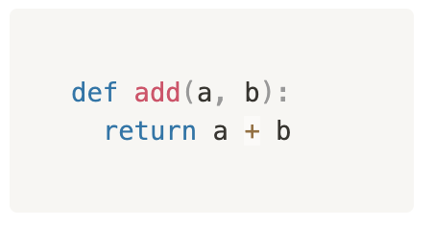
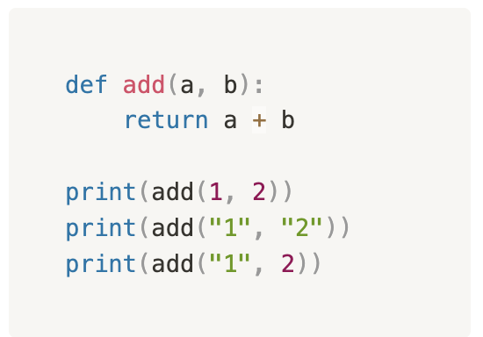
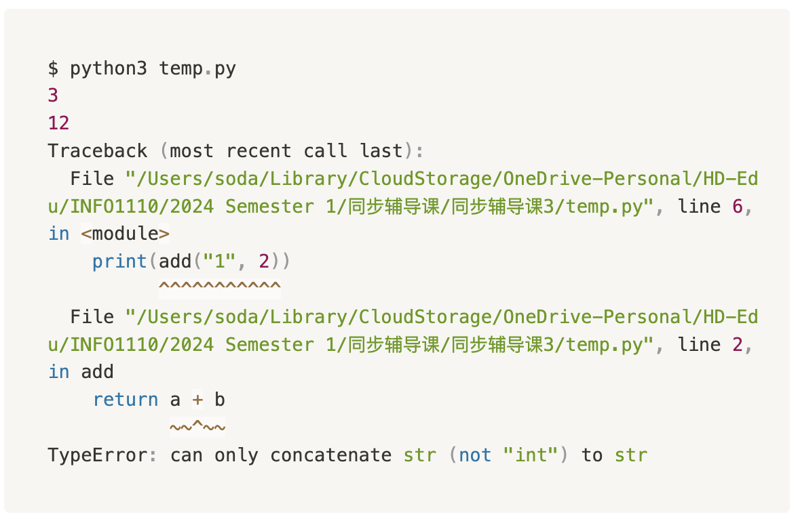
考点2. Python Function Basics
Function Name
  取名规则和Variable Name相同
Arguments
  Python对于arguments type没有严格要求
Return
  Python对于return type没有严格要求
Function Body

Slide 15
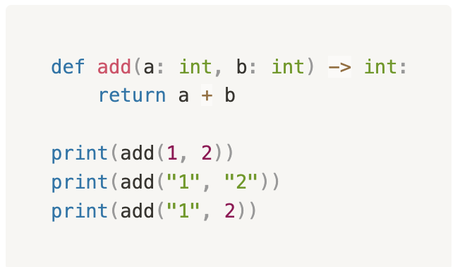
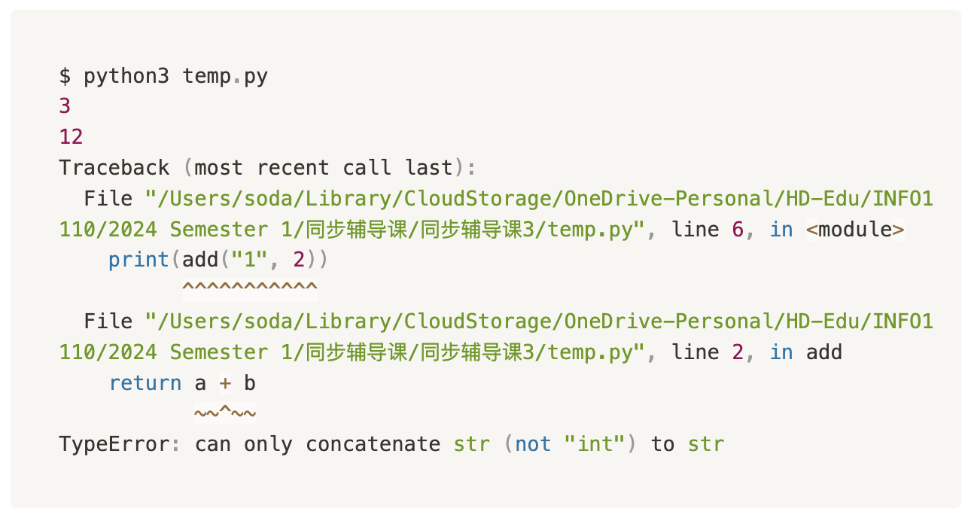
考点2. Python Function Type Hints *
新版Python有提供Type Hints的Syntax来补足缺失的Type信息
但是Python仍然不会enforce
所以代码运行结果仍然不变

Slide 16
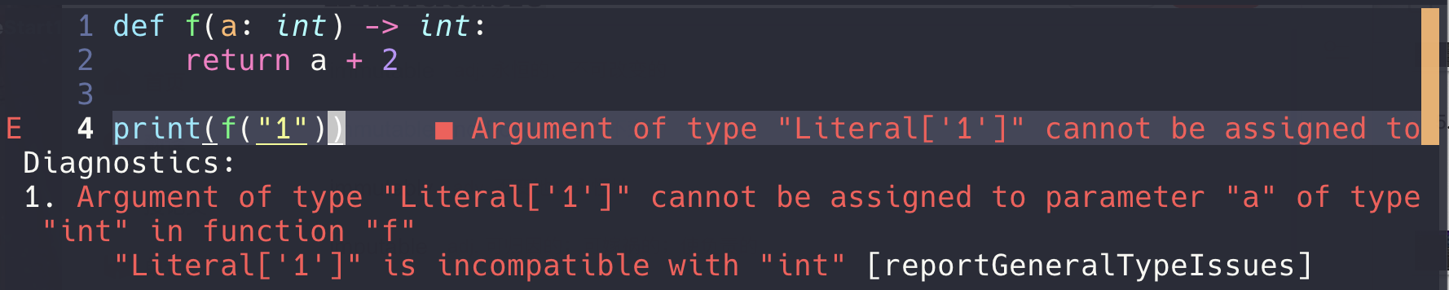
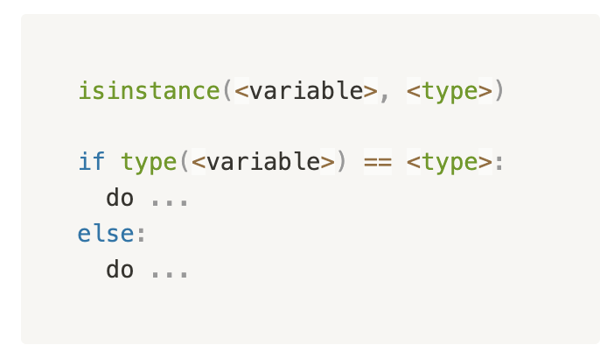
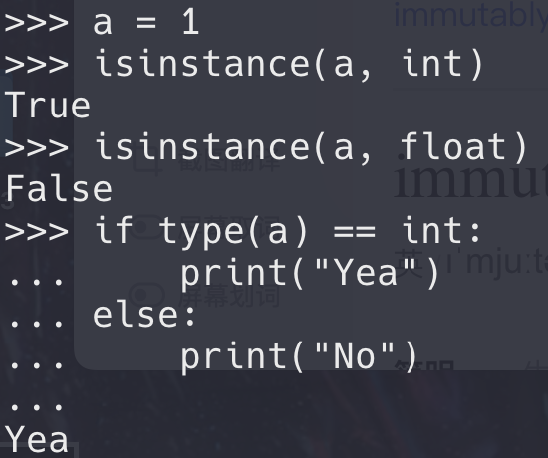
考点2. Type Check *
Python是一个对type要求相对宽松的语言，尽管我们可以通过Function Signature来enforce，但有的时候我们仍然希望验证一个variable所存的data type
Pay attention that no “ ” are here!

Slide 17
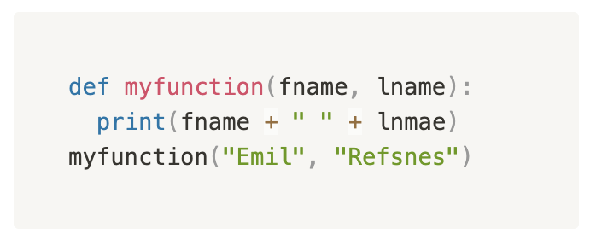
考点2. Parameters vs Arguments
Parameters
Arguments
From a function's perspective:
A parameter is the variable listed inside the parentheses in the function definition.
An argument is the value that are sent to the function when it is called.

Slide 18
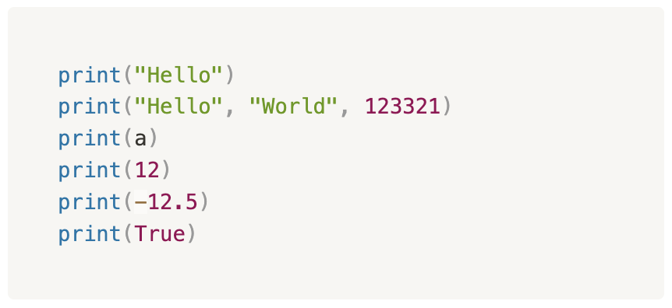
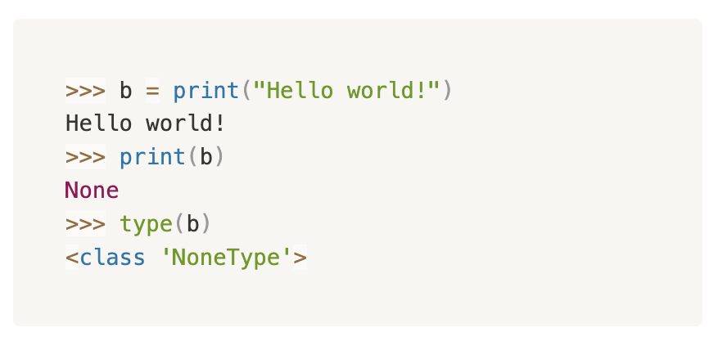
考点2. print() vs return (Reflect back to Wk1)
Function
Inputs
Outputs
(return)
Do something

Slide 19
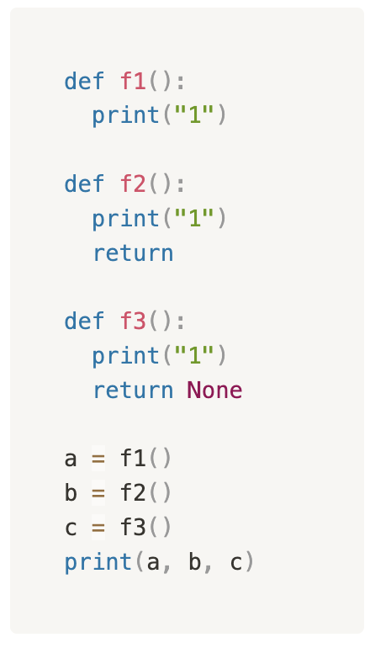
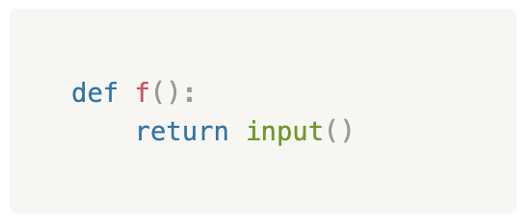
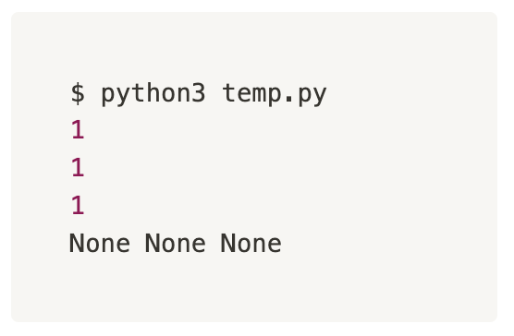
考点2. print() vs return (Reflect back to Wk1)
Function
Inputs
Outputs
print() 把Message给人看
return 把function运行后的最终结果返回给电脑
return 可以返回任何object，甚至是Function calls

Slide 20
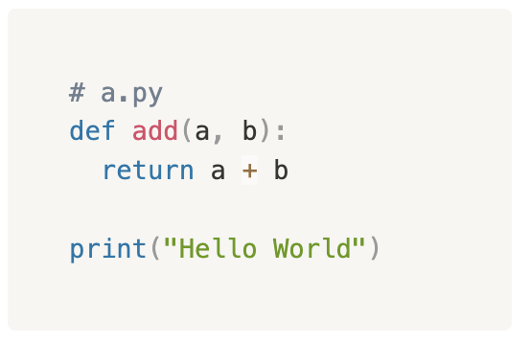
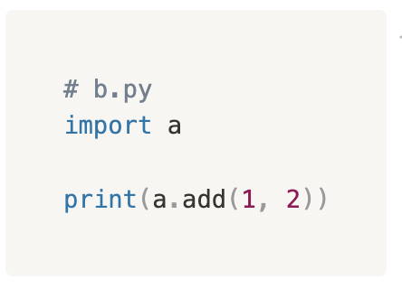
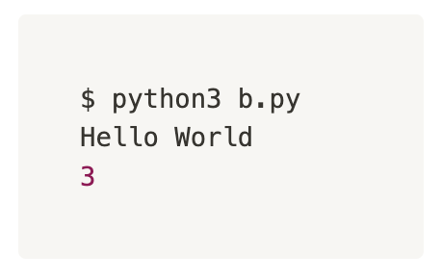
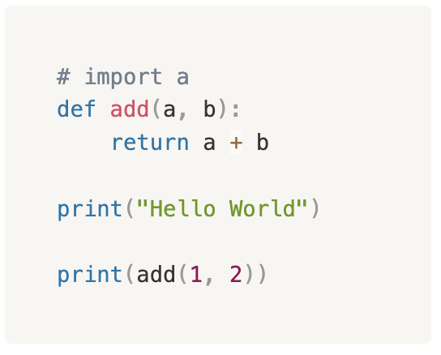
考点2. import *
import keyword让我们可以从别的文件中导入代码
import <file path>

Slide 21
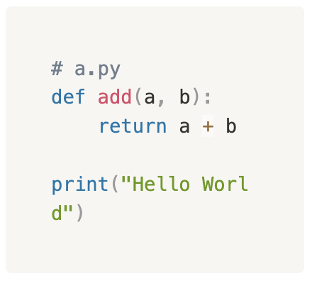
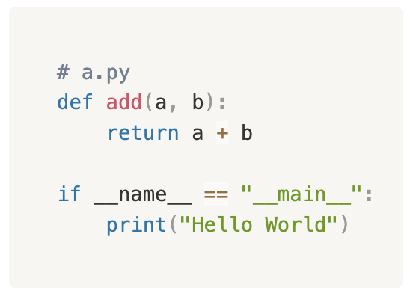
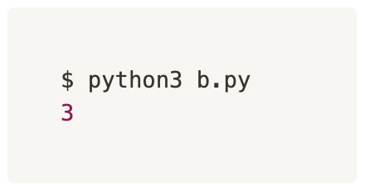
考点2. import *
我们一般只想import功能性的代码，而不是文件里的正文。
所以我们可以把正文写在这一个if语句里：
对于if里的条件，__name__是Python的一个Built-in Variable。里面存的值只有当python a.py运行时，才会等于”__main__”
这一块我们不想要
Ref. https://docs.python.org/3/library/__main__.html

Slide 22
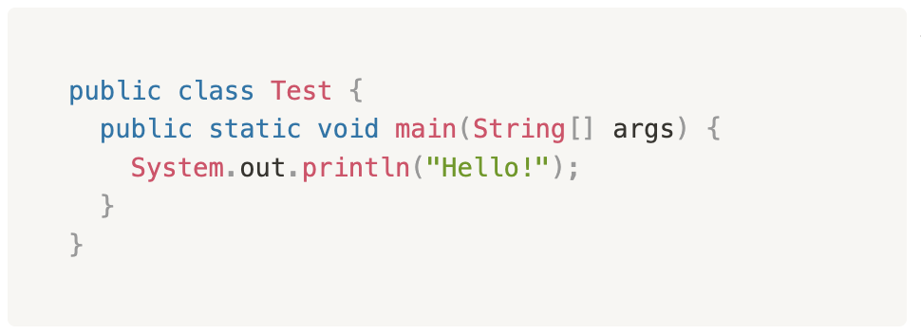
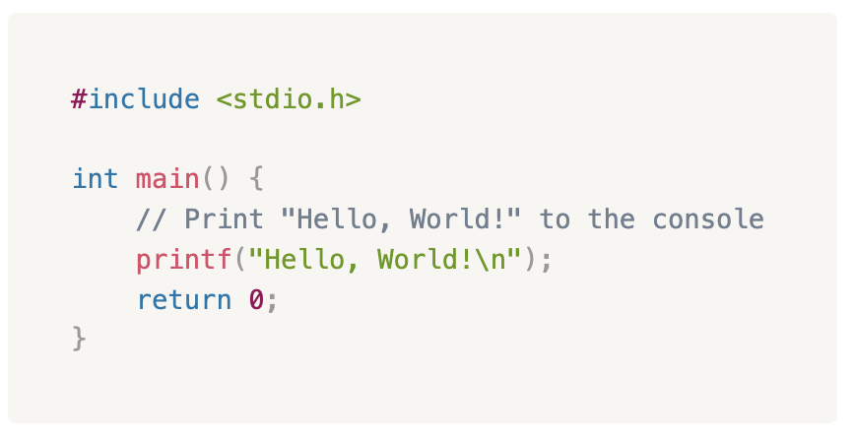
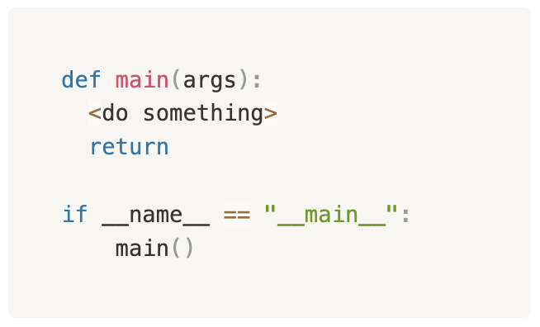
考点2. Main Function
在常用的编程语言像C(COMP2017), Java(INFO1113)中，程序正文一般都会写在一个叫main的function definition内作为切入点。
但是Python不需要。
我们可以模拟这种感觉：

Slide 23
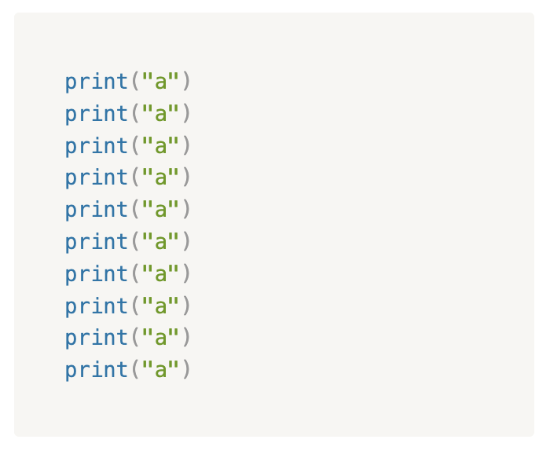
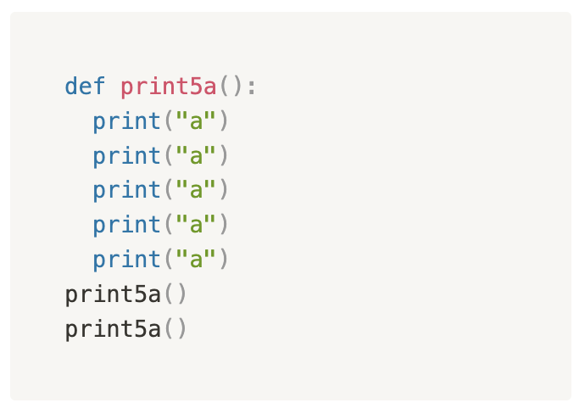
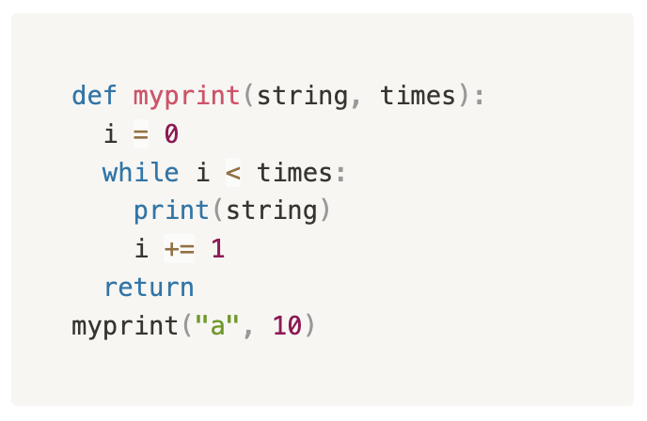
考点2. Functions - Why using functions?
Separation
Easy to reuse
Reduce chance of errors
Specific
Generic

Slide 24
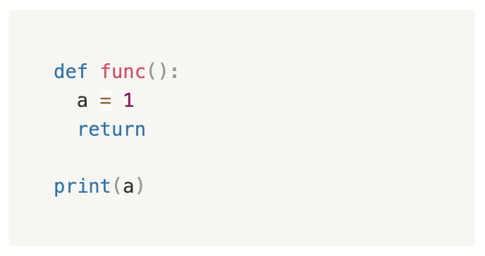
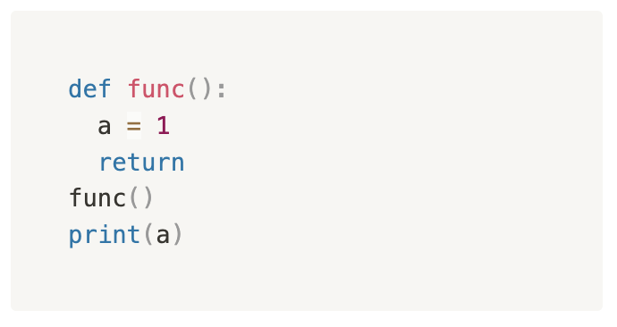
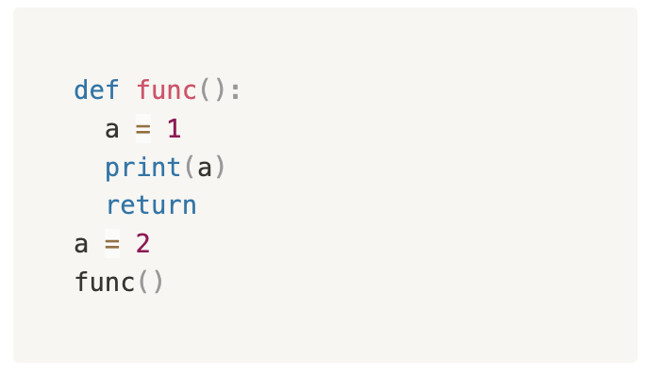
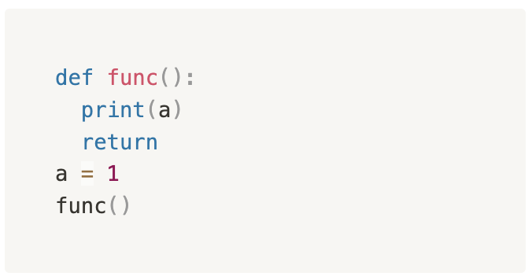
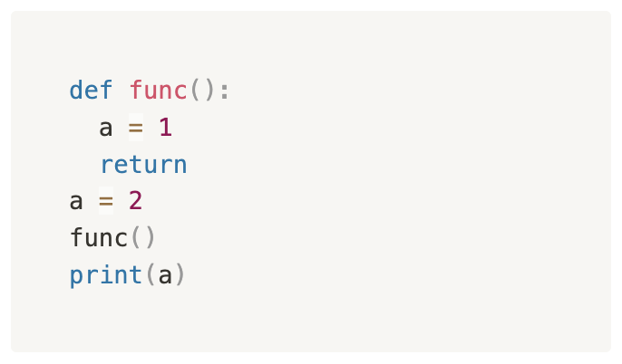
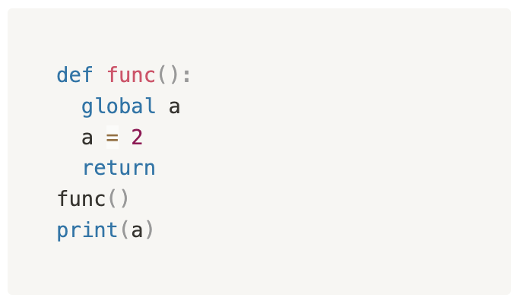
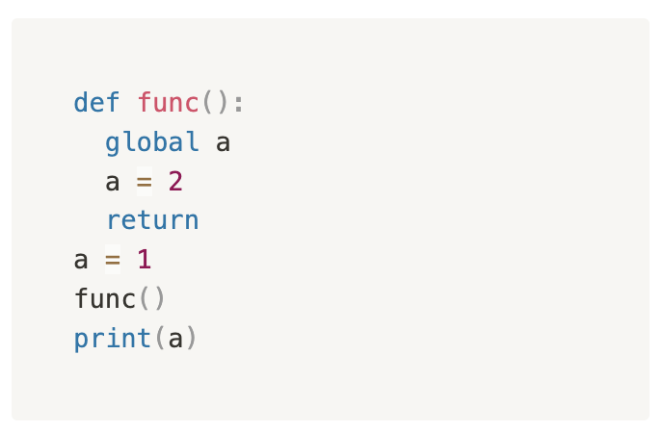
考点3. Variable Scope
Accessibility of defined variables
Error
Error
1
1
2
2
2

Slide 25
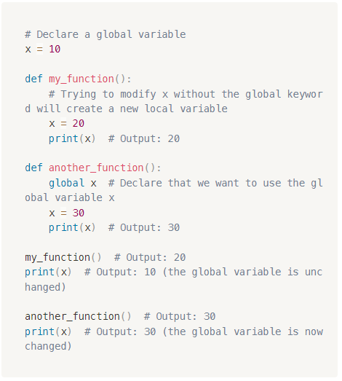
考点3. global
global这个keyword能够overwrite scope默认的行为
Functions that modify out-of-scope variables are called functions with side effects.
Pure functions are functions without side effects.

Slide 26

考点4. Collection (Container) Datatypes
A collection datatype is a type of objects that can store a group of objects.
Array
  Array is the most primitive collection datatype in most of programming languages. (Not in Python by default)
  You need to define the data type of the objects to be stored in an array.
  You need to specify the number of objects to be stored in an array.
C Array Initialization

Slide 27
考点4. Collection (Container) Datatypes
共有特点：
  Length：指代collection的size
    都能通过 len() function获得一个integer的长度
  Index：都可以通过index来定位到特定位置的一个object
    Index starts from 0
    Negative index *
  Slice operation: 都可以使用slicing operation分割出一个sub-collection
  Concatenation: collection1 + collection2 = collection12
  Dictionary除外

Slide 28
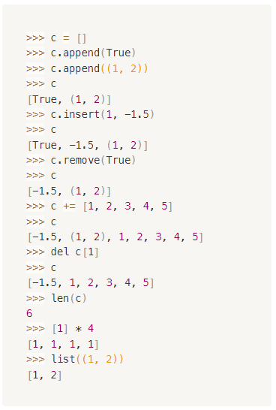
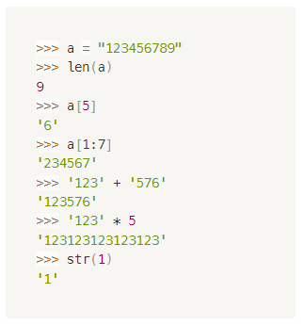
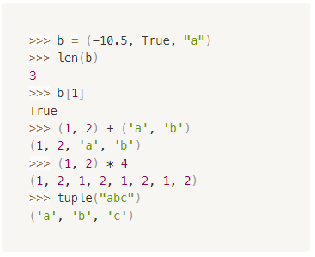
考点4. String, Tuple, List
String
Tuple
List
Official Doc

Slide 29
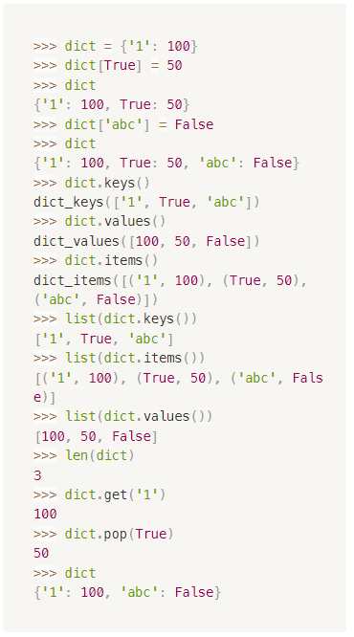
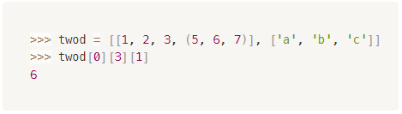
考点4. Dictionary, 2D Collection
Dictionary本质上相当于一个增强版的list，一般的list只有value是有意义的，但是以index来进行索引。Dictionary给予了程序员给索引的方式也创造意义的自由。
2D的Collection：即Collection之间产生嵌套。这种情况下，我们可能需要连续使用若干个index operator才能进到最深层的collection中去
[1, 2, 3, 4, 5],
[1, 2, 3, 4, 5],
[1, 2, 3, 4, 5],
[1, 2, 3, 4, 5]
matrix
Ref. https://docs.python.org/3.11/library/stdtypes.html#mapping-types-dict

Slide 30
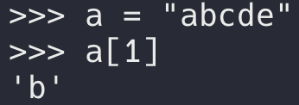
考点4. Slicing
When we want a single element from a collection, we can just use index operator:
When we want a subset from a collection, we use slice operator:
var[start:end:step]
当start=0、end=len(var)、step=1时，可以直接省略
Python里的range永远是包含起点不包含终点。
Slice operation是在原collection的基础上截取，生成一个新的collection。
*当start、end、step为负值是会发生什么？

Slide 31
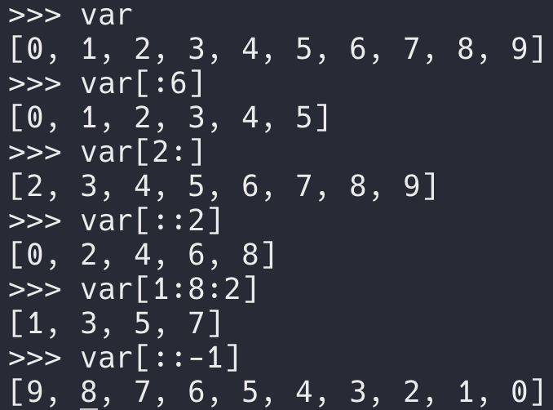
考点4. Slicing
Slicing常用于String和List的processing。

Slide 32
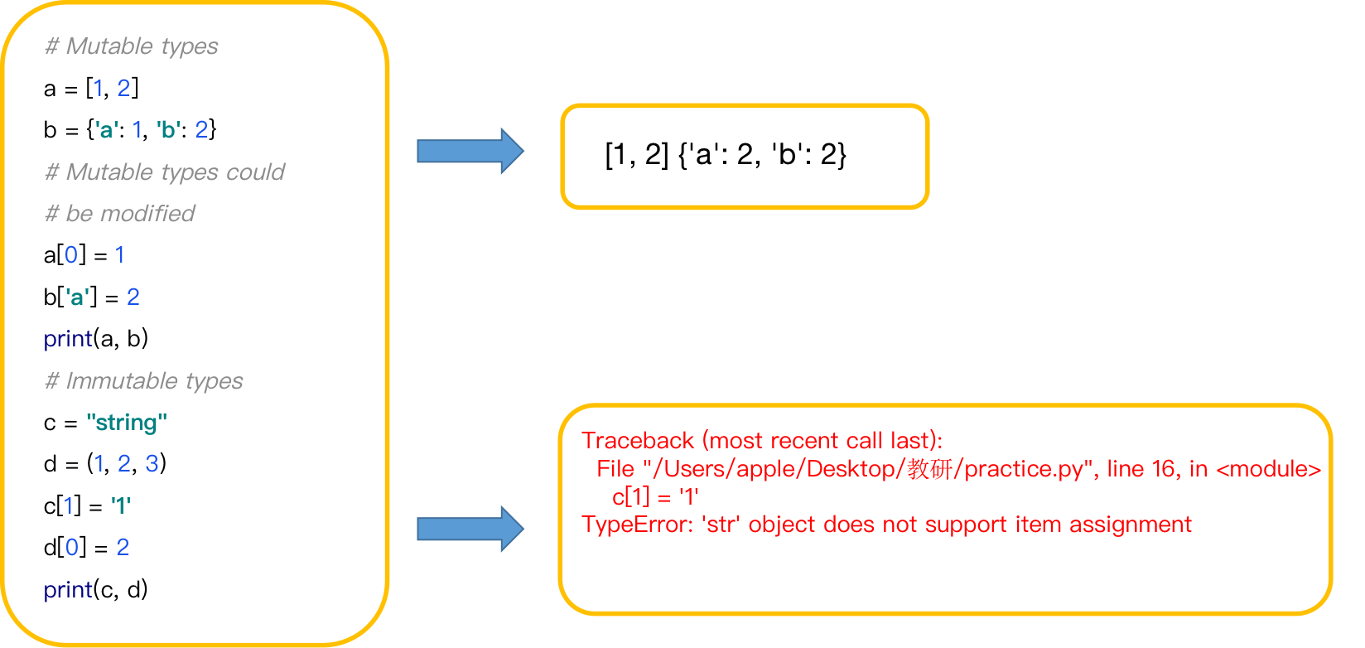
考点4. Mutability - Mutable vs. Immutable
Whether an object’s internal state can be modified or not after creation.

Slide 33
考点4. 从头到尾过一个Collection的范式
Traversal
i = 0
while i < len(collection):
current_object = collection[i]
<do something>
i += 1

Slide 34
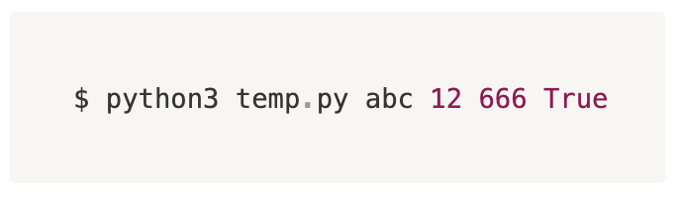
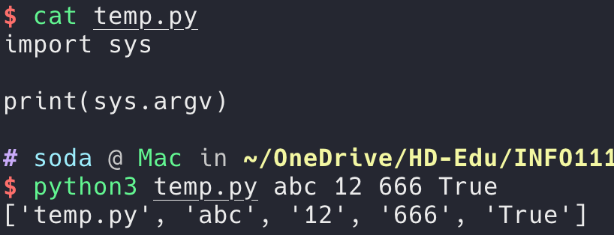
考点5. Command Line Arguments
跟在文件名后面输入的内容，归根结底就是给程序输入数据的一个方式
那我们应该如何在自己的程序里面调用这些arguments呢？
  使用sys module里的argv这个list
Caveat
  sys.argv这个list的第一个元素一定存在，且是这个程序的文件名
  无论我们input的是数字还是文本，list里的内容都是str

Slide 35
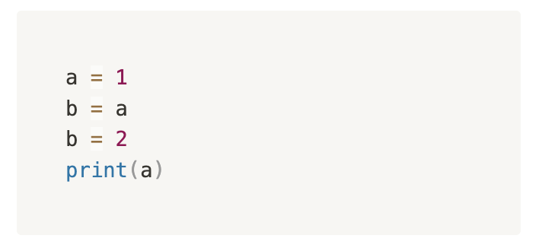

考点6. Primitive vs. Reference Data Types
但是，有的时候我们确实希望在内存里面复制一个新的list给variable b该怎么办？
a = 1
a: [2]
For primitive data types, data are stored as values.
For reference data types, data are stored as references.

Slide 36
考点6. Primitive vs. Reference Data Types
def list_copy(li):
    new_list = []
    for each element in li:
    new_list.append(element)
    return new_list
纯手动，或者有更好的办法？🤔
new_list = li[:]
new_list = list(li)
new_list = li.copy() <- This is a built-in method!

Slide 37

考点7. Python Debugger
我们先前教给大家的方法，是通过 comment out 无关的代码以及print()，来测试我们的程序是否达到我们期望的结果
而pdb本质上其实就是做一样的事情，只是把操作简化，不在需要我们去手动一行一行的comment 代码了
用VSCode或者IDE的同学可以善用Breakpoint来帮助自己debug。（Ed好像也支持Breakpoint）

Slide 38
考点1.

Slide 39

考点1.

Slide 40
经典题型放送

Slide 41

Code – str.split
(自编题)
Write a function split(s, sep) that mimics the behaviors of Python built-in str.split() method.
Assume len(sep) = 1

Slide 42

Code – str.split
(自编题)
Write a function split(s, sep) that mimics the behaviors of Python built-in str.split() method.
Assume len(sep) = 1

Slide 43



Boundary Cases
An edge case is an issue that occurs at an extreme (maximum or minimum) operating parameter.
一个维度的边界
A corner case is when multiple parameters are simultaneously at extreme levels.
多个维度同时到达边界
Reference: https://www.educative.io/answers/corner-case-vs-edge-case

Slide 44
Code – Sort
(自编题)
Write a function sort(li) that receives a list of integers and return a sorted list in ascending order.
Assume the list does not contain duplicates.
sort([4, 5, 2, 8, 1, 0, 3, 7] -> [0, 1, 2, 3, 4, 5, 7, 8]

Slide 45
Intuitive Sort with Min
Function my_sort(collection):
new_collection = []
i = 0
while i < len(collection):
temp = find 第i小的element in collection
new_collection.append(temp)
return new_collection

Slide 46
Sort – in-place
Function bubble_sort(collection):
i = 0
while i < length of the collection then
j = 0
while j < length of the collection - i - 1 then
if collection[j] > collection[j+1] then
swap values between collection[j] and collection [j+1]
j += 1
i += 1
return
Descending order?
6 | 5 | 3 | 1 | 8 | 7 | 2 | 4

Slide 47


Code – Sort
(自编题)
Write a function sort(li) that receives a list of integers and return a sorted list in ascending order.
Assume the list does not contain duplicates.
sort([4, 5, 2, 8, 1, 0, 3, 7] -> [0, 1, 2, 3, 4, 5, 7, 8]

Slide 48
重难点总结

Slide 49

重难点总结
到目前为止，我们已经学完写程序功能性这一块的全部基本操作

Slide 50
课后作业

Slide 51
下节课预告

Slide 52

下节课预告
Classes and Objects
  Constructors
  Attributes
  Methods
File I/O
  How to read a file?
  How to write to a file?

Slide 53



您每一份诚挚的问卷都会拯救一根濒临掉落的头发。
帮我开个张吧，求求你了！

Slide 55
Q & A

