Slide 1
INFO1110
Introduction to Programming
同步辅导课1
Tutor：Hilbert

Slide 5


Hilbert
USYD Bachelor of Advanced Computing Honours First Class毕业 (Major in Software Development)
東京工業大学Master of Artificial Intelligence在读
曾任USYD INFO1110的Lab Tutor
INFO1110总分91.0 HD
2018年加入HD Edu，主要教授预科及本科的IT入门课程
HD Edu学科带头人兼面试官，曾经撰写过HD的INFO课程规范指南

Slide 8
Housekeeping

Slide 9
How to do well in INFO1110?
Learn Programming from
中文？
English?
学科特点：
1. 理论与实践
2. 软硬件结合
3. Error
学习方法：
1. 理论和实践分开来学习
2. Debug与试错
3. 刷题（认真对待Tutorial的题目和Ed上的练习）
INFO1110 is about Python?

Slide 10

答疑
提问之前，务必：
  先自己思考
  Textbook, lecture slides, tutorial materials, etc.
  Google, StackOverflow, CSDN, etc.
交流沟通的前提是尊重。大家都有很多要忙的事情，请珍惜彼此的时间，问有意义的问题！
专门答疑时间段：待定

Slide 11
PEP8
不需要严格参照
但是请尽量写美观的代码！
最简单的方法，就是模仿我写代码的Convention。

Slide 12

1
Computer Program
2
Terminal and Shell Commands
3
Built-in functions: print(), input()
4
Strings and String formatting
5
Variables
6
Data Types and Objects
7
Expression and Operator
8
Comments

Slide 13

本节考点
1、 Program Basics
题型：选择题、简答题
内容：
What is a program/interpreter/compiler?
Program running procedures
考察惯例：考察可能性较小
题目展示：
2、 Terminal Commands
题型：非考题，但是融入你接下来13周的方方面面
内容：Directory operations, Copy/Move, Run program, etc.
考察惯例：无
How does the execution process differ for a program written in an interpreting programming language compared to a compiled language?
(自编题)
注： 代表重要程度，并非难度

Slide 14
知识点讲解

Slide 15

考点1. Computer Program - Basics
计算机有自己思考的能力吗？
What is a program?
ChatGPT
A program is a set of instructions written in a programming language that a computer can interpret and execute.
It defines a sequence of operations to perform a specific task, solve a problem, or achieve a desired outcome.
Programs can range from simple scripts to complex software applications, and they are the fundamental building blocks of computer software.
← What does a program do?

Slide 16
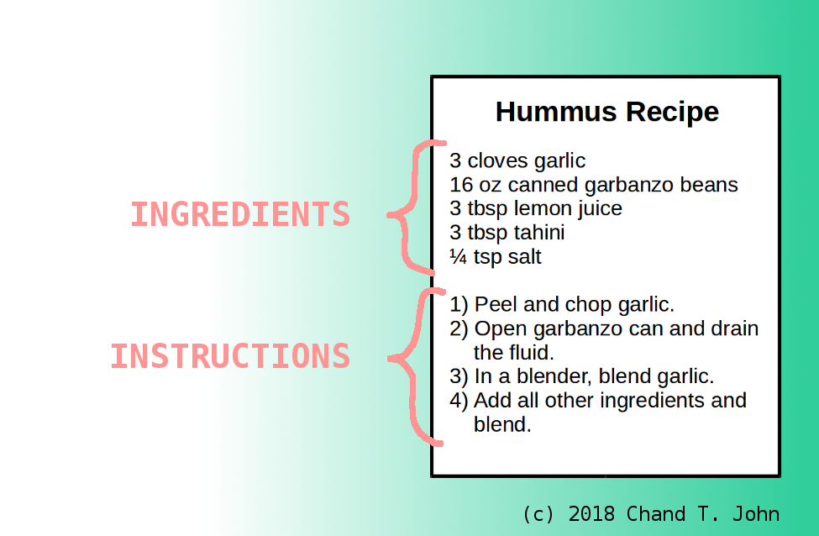
考点1. Computer Program – Recipe Example
Data
Calculation
Ref. https://www.cs-comics.com/computer-programs-are-like-recipes/

Slide 17
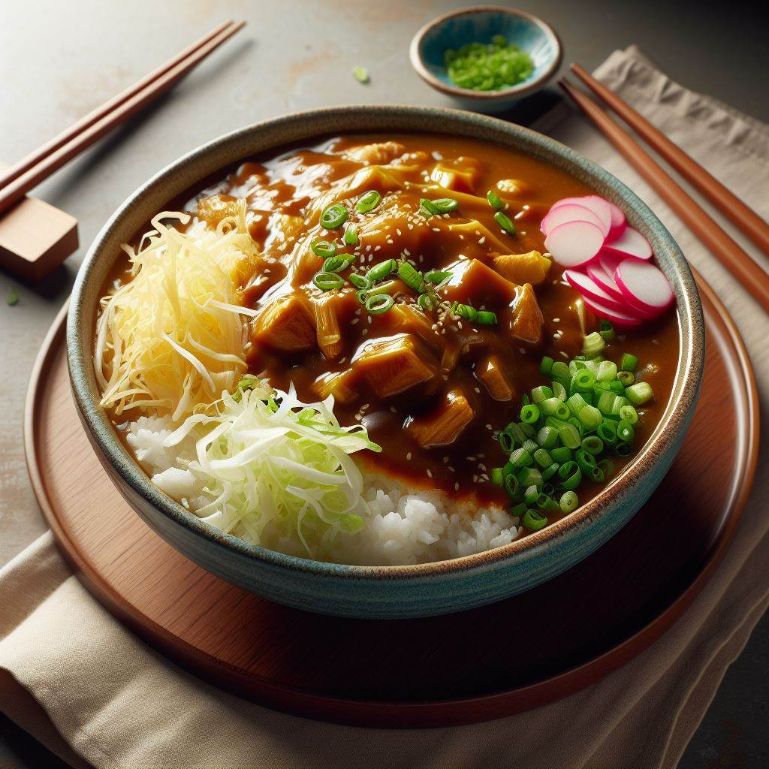
考点1. Computer Program – Curry Rice
Let’s make curry rice!
Abstraction
Raw Rice
Water
Vegetables
Oil
Rice
Curry Sauce
Curry Rice
We can cook from the base ingredients, but also, we can just purchase cooked rice and curry sauce or even just the curry rice

Slide 18
考点1. Computer Program – Basic CPU Instructions
The detail of this part is taught in ELEC1601.
CPU Instruction sets: CPU指令集，指CPU能理解并且执行的指令的集合。通常，仅包含非常基本的操作如内存的读写，两个数字比大小，两个数字的四则运算等。
How can we achieve complex operations? ➔ Abstraction!
Example:
Let’s swap the data between position a and b!
 | a |  |  | b

Slide 19
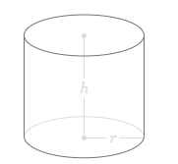

考点1. Programming Language
Me: Can you calculate the volume of a cylinder for me?
PC: 0b1010100101010010101010011010
← Machine Code
$$V= πr^{2}h$$
我们只能用Machine Code和电脑交流，但是它过于抽象。。。
人类语言 ➔ 二进制机械语言 X
← What does a program do?
我们从Machine Code出发，确立了一系列指令集（电脑能理解的Operation）如加减乘除及内存存取
但是指令集本身还是二进制还是抽象
我们发明了另一套只有有限个词汇，符合特定格式的语法（Syntax）以及一个能理解这个语法并且将其翻译成Machine Code的程序 (Compiler/Interpreter)。
现在我们是不是只需要用这个语法表达我们的指令，就能让电脑执行了？
这样一套语法就是一个编程语言。

Slide 20

考点1. Compiler vs Interpreter
print(“Hello world!”)
Source Code
Interpreter
Output
print(“Hello world!”)
0b1010010100101011101010010…
Machine Code
Source Code
Compiler
Output

Slide 21
考点1. Compiling vs Interpreting Language
Before there is clear difference between two categories. Now not anymore!
For instance, python now have properties of both interpreting languages and compiling languages (.pyc).
Interpreting Language | Compiling Language
Flexibility and Ease of Change Local Execution | Speed and Efficiency Control over Hardware
Python, MATLAB | Java, C

Slide 22
考点1. Compiling vs Interpreting Language
Compiled Languages:
Speed and Efficiency:
  Pros: Compiled languages are converted directly into machine code that the processor can execute. As a result, they tend to be faster and more efficient to execute than interpreted languages.
  Cons: However, compiling the entire program requires more time upfront.
Control Over Hardware:
  Pros: Developers have more control over hardware aspects, such as memory management and CPU usage.
  Cons: The need for a manual “build” step – you must compile the program before execution. Any changes require rebuilding the entire program.
Interpreted Languages:
Flexibility and Ease of Change:
  Pros: Interpreters run through a program line by line and execute each command. If you need to make changes, you can modify the code directly without a separate compilation step.
  Cons: Historically, interpreted languages were slower than compiled languages, but with just-in-time compilation, this gap is shrinking.
Local Execution:
  Pros: You don’t need to compile the entire program upfront. An interpreter analyzes and executes code on the fly.
  Cons: Execution in an interpreter is less efficient than regular program execution.

Slide 23
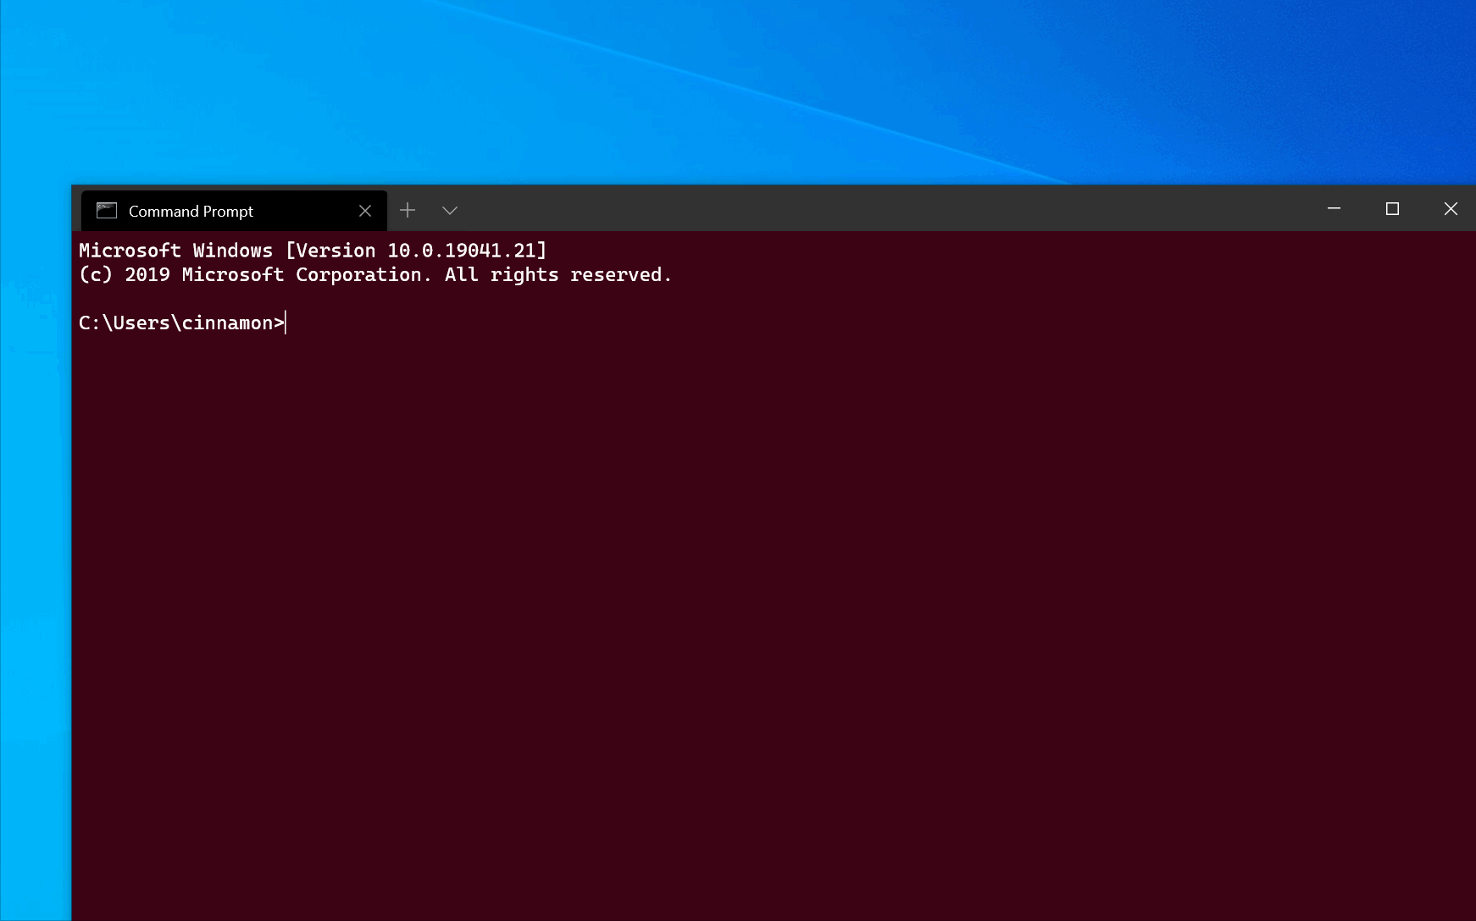

考点2. Terminal/Shell
A terminal or shell is a text-based interface that allows users to interact with a computer's operating system through command-line commands.
Some tricks you should know:
<Tab> for auto complete.
<Up> and <Down> to browse through the input history.
Ctrl + C to abort.
Windows Command Prompt is slightly different from Unix-based Terminals. Unfortunately, INFO1110 enforces the Unix-style.

Slide 24
考点2. Terminal/Shell - Commands
Navigation Operation
  pwd – Print working directory
  ls – List items in the current directory
  mkdir <name> - Make a directory with <name>
  rmdir <name> - Remove an empty directory with <name>
  cd <name> - Change directory to <name>
File Operation
  touch <name> – Create an empty file named <name> in the current directory
  mv <file> <location> – Move the file with name <file> into <location>
  cp <file> <location> - Copy the file with name <file> into <location>
  rm <name> - Remove the file with name <name>
  cat <name> - Print the content of the file
  python3 <name> - Use Python3 interpreter to run the file with name <name>
For your interest
  man <command> – Get the 说明书 of a command
  ls –l - List items in the current directory in vertical format
  ls –a - List all items (including the hidden) in the current directory
  rm –r <name> – Remove a directory named <name> containing files
  echo <text> - Print <text> as a message

Slide 25
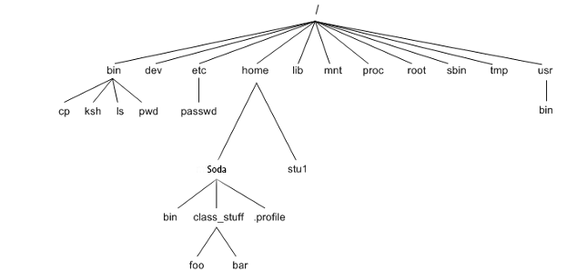
考点2. Unix File System
Absolute Path vs Relative Path
Absolute: You can access the same file from any location. E.g. /bin/sh
Relative: You can access the file based on current location e.g., soda/Downloads

Slide 26
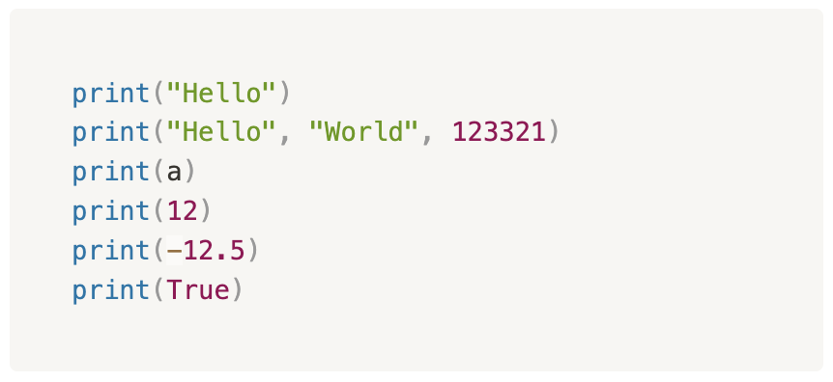
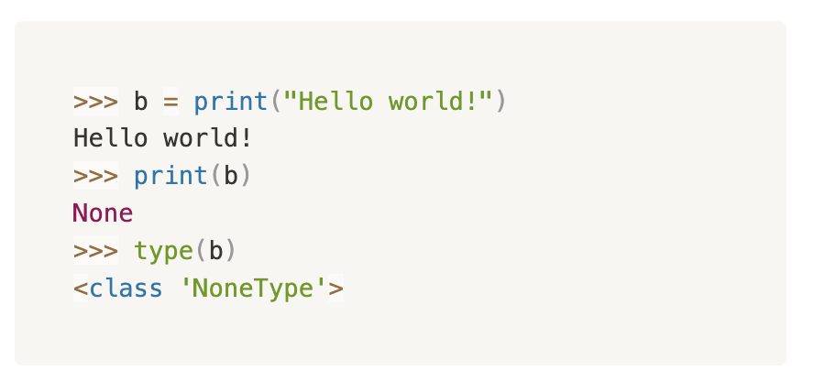
考点3. Built-in Functions – print()
查任何与Built-in相关的内容，务必优先看Official Documentation! 这是由最懂Python的人编写的。
Function
Inputs
(Call function时括号里放的内容）
Outputs
(return)
Do something
What is the difference between built-in keywords and built-in functions?

Slide 27
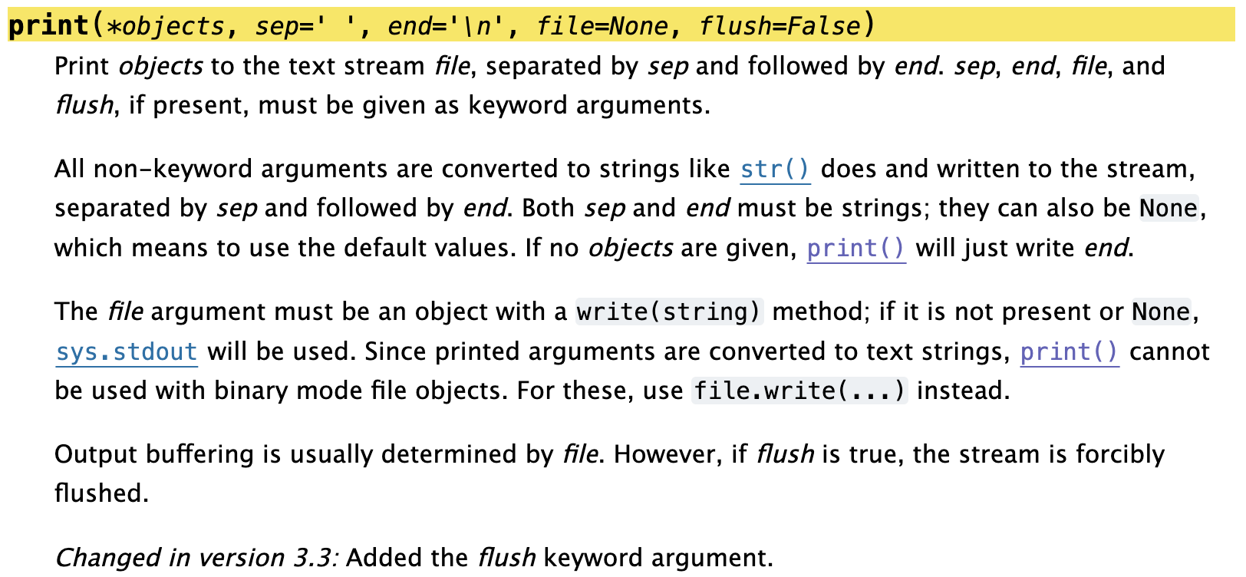
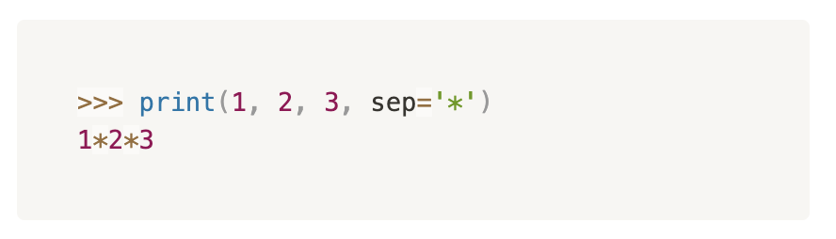
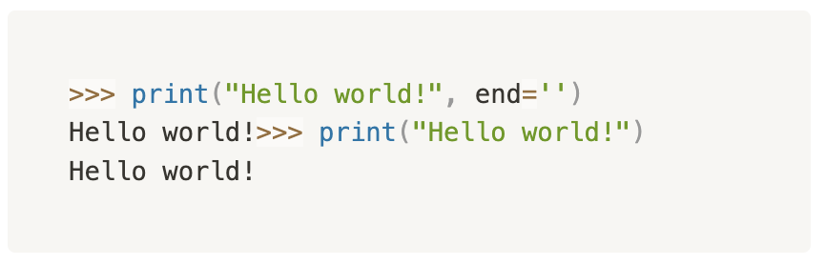
考点3. Built-in Functions – print()
sep: 当print()接收若干个inputs时，逗号会被sep设置的字符所取代。
end: print()会自动在每次print结束后添加end设置的字符。默认为\n所以我们每次print都会自动换行。
Ref. https://docs.python.org/3.11/library/functions.html#print

Slide 28
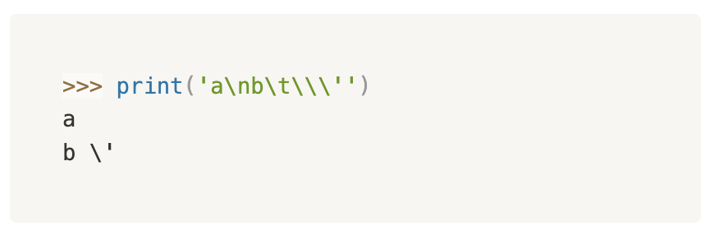
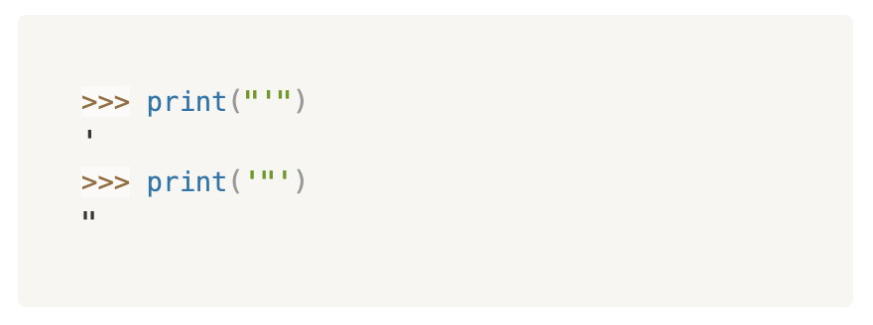
考点4. Strings
String指的就是文本。
Syntax：Must be enclosed by ‘ or “（一定要前后对应）
特殊字符：单靠键盘按键无法打出来的字符
Escape character: backslash \ 反斜杠
\n: Newline character等效于按回车键（换行）
\t: Tab characte等效于按Tab键（indent）
\\: 如果我只想print一个普通的反斜杠
\ + 引号：用于告诉Python，把该引号作为文本处理而不是关闭String的提示符。

Slide 29
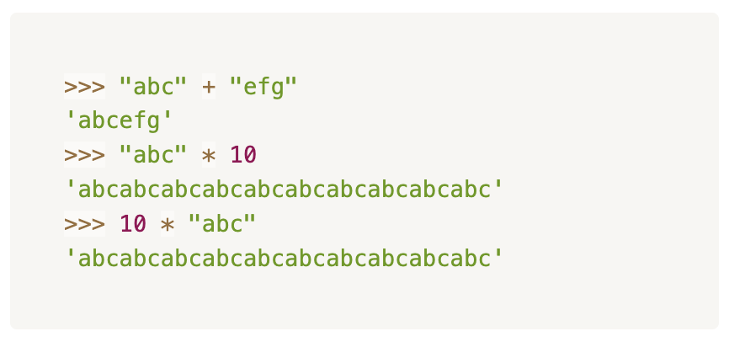
考点4. String Concatenation
String在Python里有加法和乘法，严格意义上来讲不叫运算。
不能说String Addition or Multiplication!
乘号一定是跟一个正整数!

Slide 30
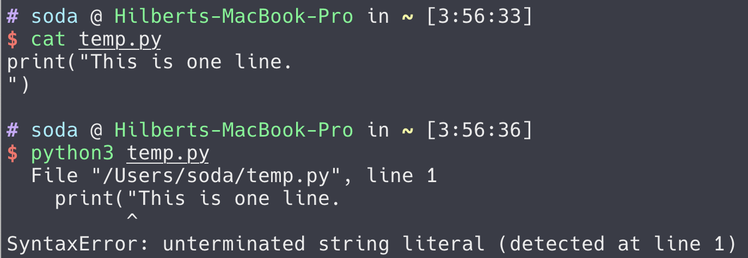
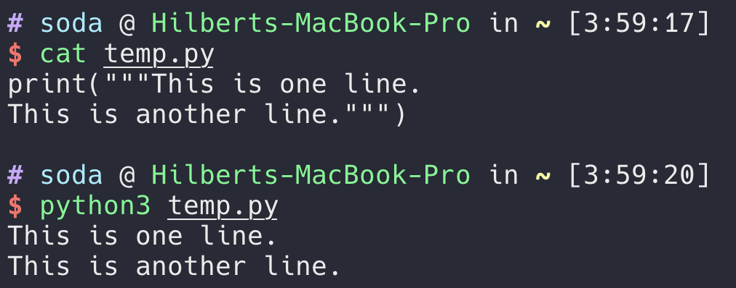
考点4. Strings – Multi-line String
当你想要打多行文本的时候会发现：
Python Multi-line string syntax —— 用三个单引号或双引号做提示符：

Slide 31
考点5. Variables
What are variables?
Variables are named containers to store information.
Basic data types
int 整数
float小数 实数 (Not accurate)
bool (True or False)
str
(NoneType)
Etc.
When to use which data types?
What is a valid variable name?
Upper/Lowercase letters, numbers, special symbols?

Slide 32
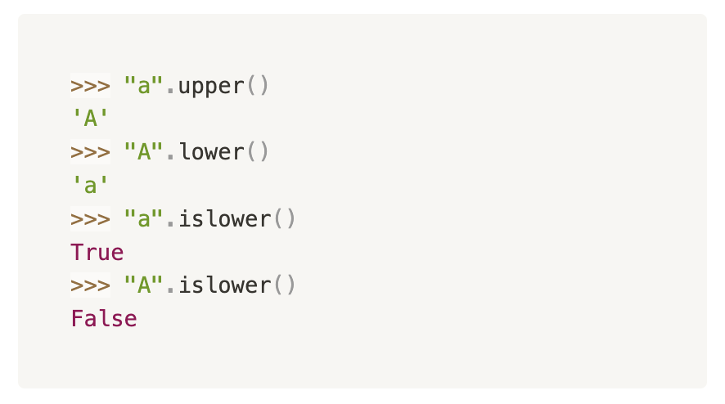
考点6. Data Types and Objects
Data Type: Class类
  我能自称一类说明我有特别的性质（attribute）和特别的行为（method）。
Object：一个类下的个体（instance）。一个object能包含多个别的object。（初涉，以后还会讲到）
Method
  可以把它理解成一种特殊的只有一类object有的function。
  使用Syntax格式为：
    object.<method name>(inputs)
  比如String的built-in methods可见：https://docs.python.org/3.11/library/stdtypes.html#string-methods

Slide 33
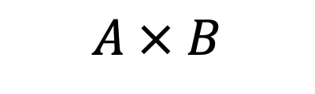
考点7. Expression Terminologies
$$A × B$$
Operand
Operator 运算符
Unary Operator: These operators work with one operand.
Binary Operator: These operators require two operands.
Ternary Operator: The ternary operator is unique because it requires three operands.

Slide 34
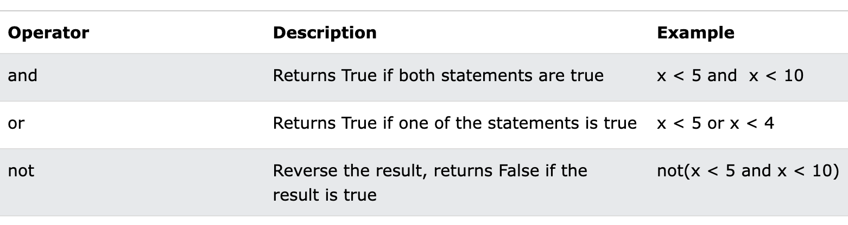
考点7. Operators
Mathematical
+ - * / // % ** math.sqrt() += -= pow() round() abs()
Relational
== !=
> < >= <=
做运算的前提是两者同类!
Logical
Truth Tables?

Slide 35
考点7. Operators
无括号情况下的运算优先级：
Numeric Evaluation
||
比大小，相等
||
not
||
and
||
or
not 10 ** 2 // 7 – 999 != -100 and False or False
not 100 // 7 – 999 != -100 and False or False
not True and False or False
False and False or False
False or False
False

Slide 36
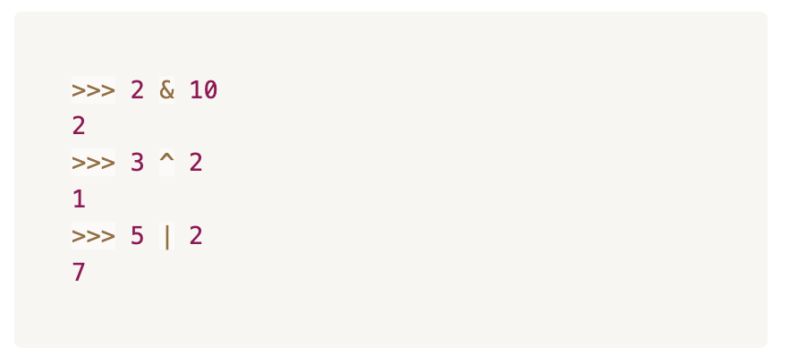
考点7. Bitwise Operators
There are three bitwise operators in Python:
  & (ampersand) AND
  ^ (hat) XOR
  | (pipe) OR
These operators operate on binary numbers.
XOR Truth Table
1 | 1 | 0
1 | 0 | 1
0 | 1 | 1
0 | 0 | 0
2
0 | 0 | 1 | 0
5
0 | 1 | 0 | 1
AND
OR
10
1 | 0 | 1 | 0
2
0 | 0 | 1 | 0
0 | 0 | 1 | 0
2
0 | 1 | 1 | 1
7
3
0 | 0 | 1 | 1
XOR
2
0 | 0 | 1 | 0
0 | 0 | 0 | 1
1

Slide 37
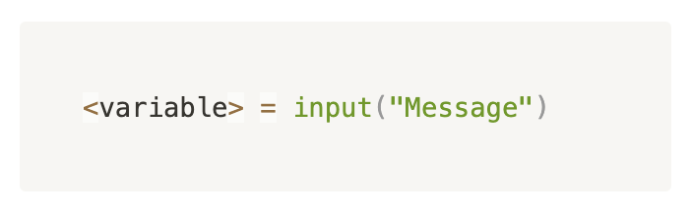
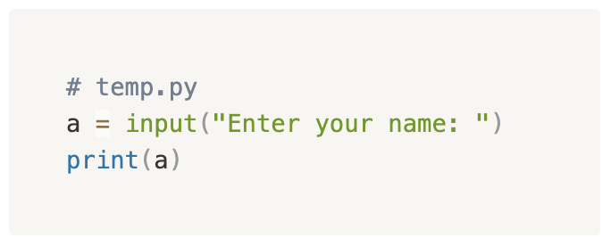
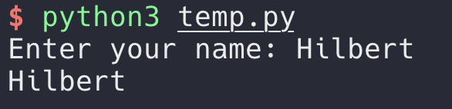
考点8. input()
通用样式
无论用户input什么，return type都是str
input() 可以接受一个String作为argument，运行时会先print出这个string，同时在同一行接受input

Slide 38
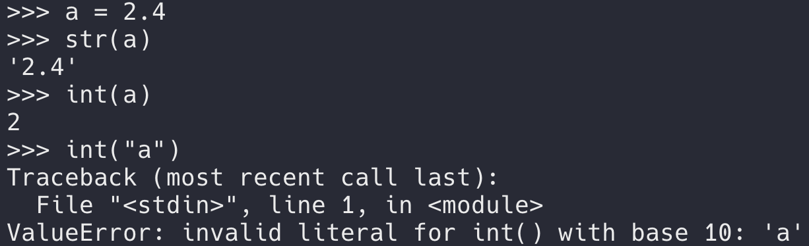
考点9. type() and Type Conversion
We can use type() to find the datatype of certain data.
  每一个type function给的class type都是一个built-in functions
We use:
  int() to convert data into an integer.
  str() to convert data into a string.
  float() to convert data into a float-point number.
Conversion works only, when possible, otherwise ERROR!

Slide 39
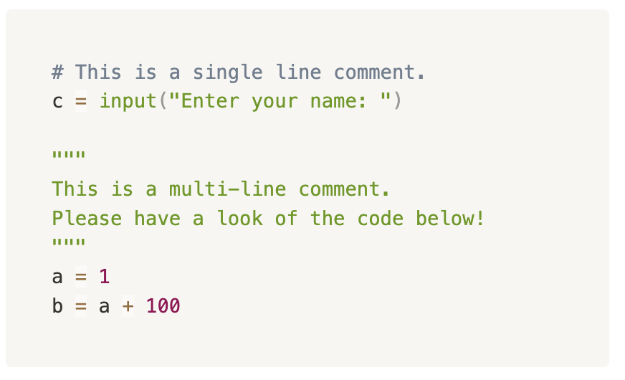
考点10. Comments
Write some memos
Deactivate certain lines of code
  Ctrl + / to quickly toggle commenting in mainstream code editors.
Single-line Comment
  Start with #
Multi-line Comment
  We use the same syntax as multi-line strings.

Slide 40
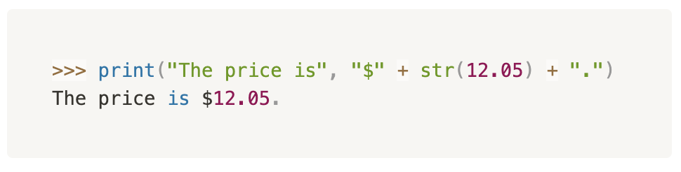
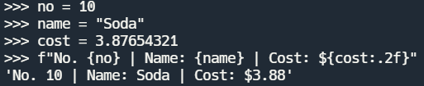
考点11. String Formatting
The most intuitive way —— String concatenation
str.format() method Template(str).format(data_to_insert)
F-strings —— a simplified syntax of str.format()
如何保留Float小数点后若干位数
如何提供和使用多个插入位置
最详解见 str.format()
Formatted string literals

Slide 41
考点1.

Slide 42

考点1.

Slide 43
经典题型放送

Slide 44
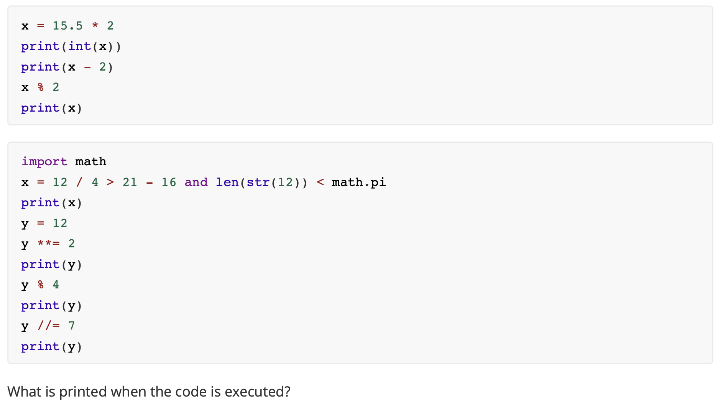
Short Answer
(自编题)

Slide 45
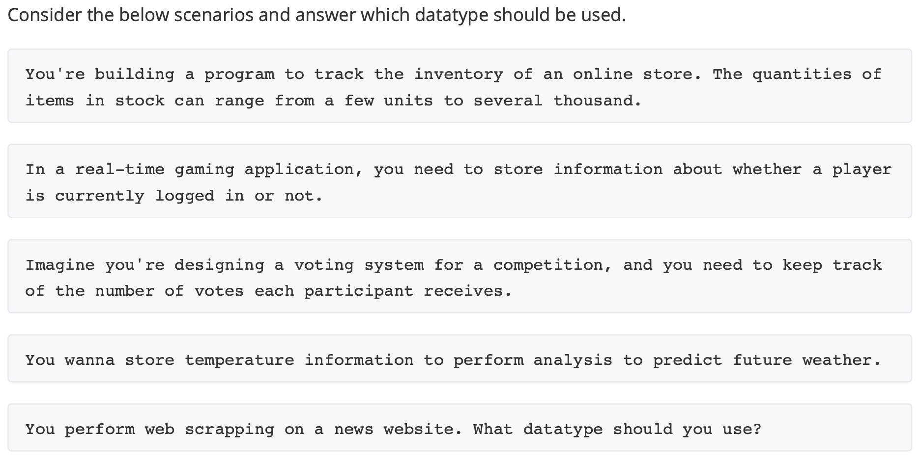
Short Answer
(自编题)

Slide 46
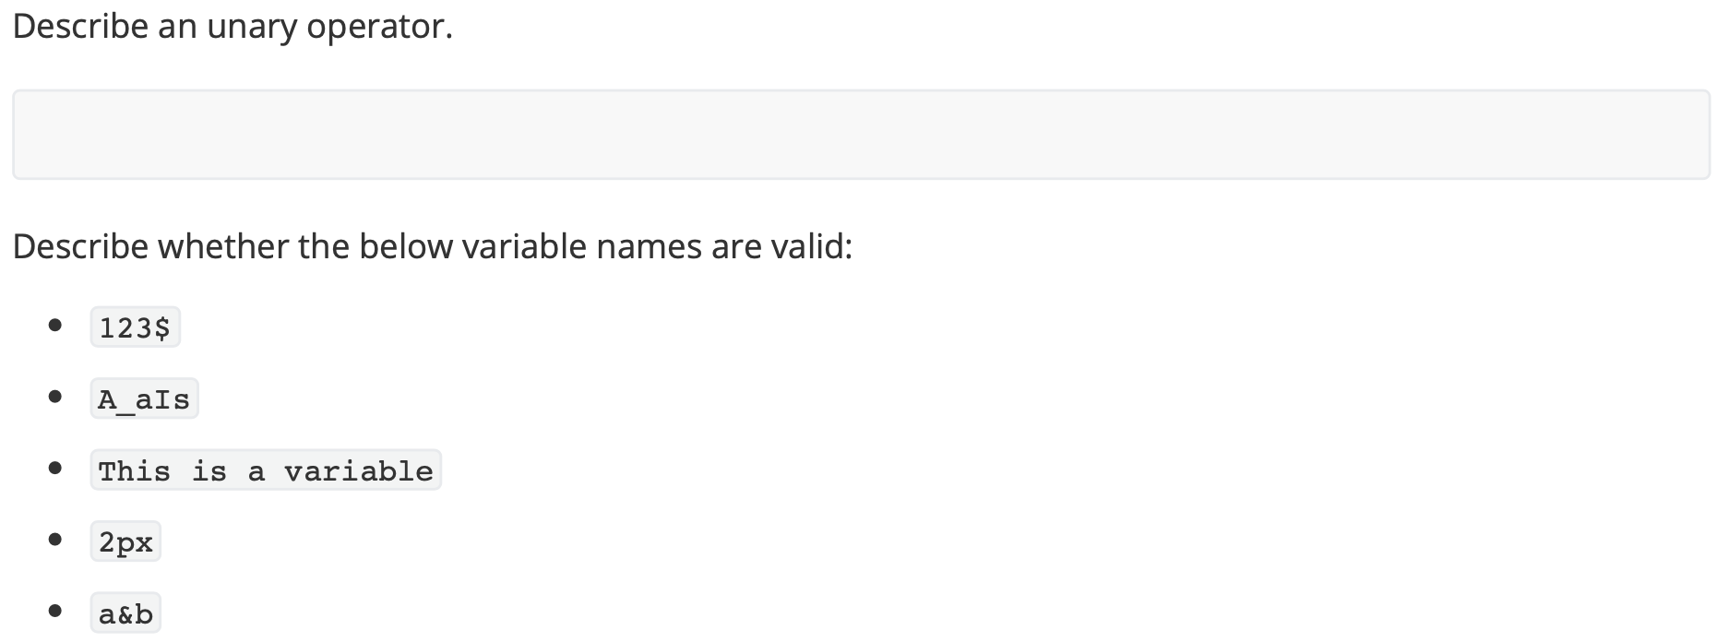
Short Answer
(自编题)

Slide 47
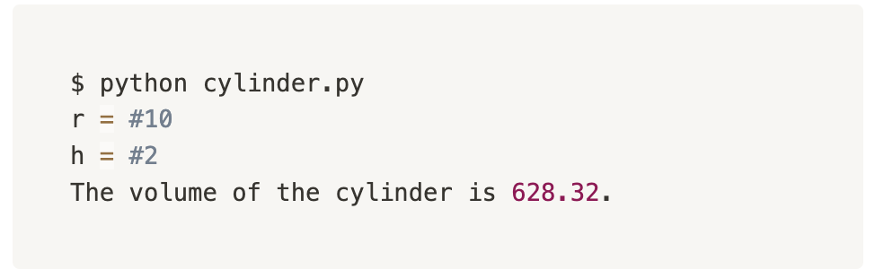

Code
(自编题)
$$V= πr^{2}h$$
Write a program that calculate the volume of a cylinder round to 2 decimal places.

Slide 48
重难点总结

Slide 49
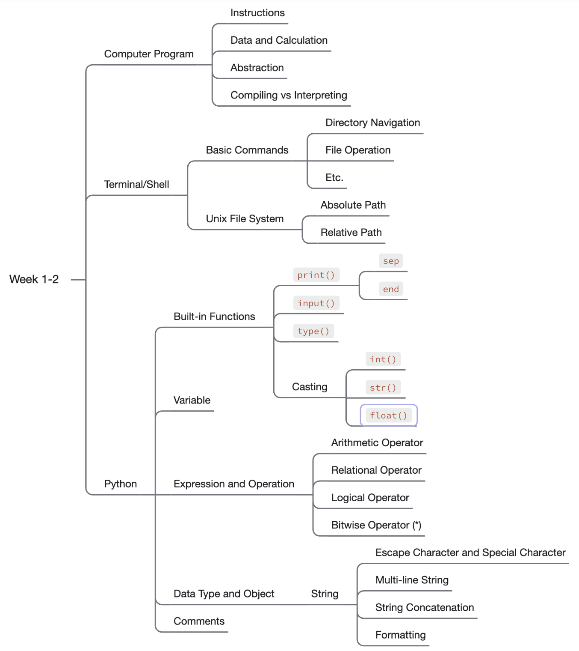

重难点总结
如果觉得前两周内容吸收的还可以，千万不要松懈喔！

Slide 50
课后作业

Slide 51
下节课预告

Slide 52
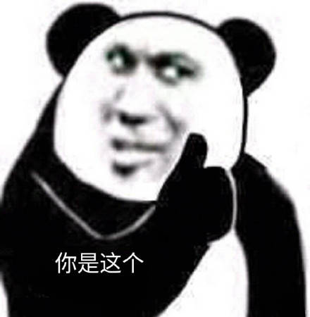
下节课预告
Conditionals
  if
  else
  elif
Iteration
  while
  break
  continue

Slide 53

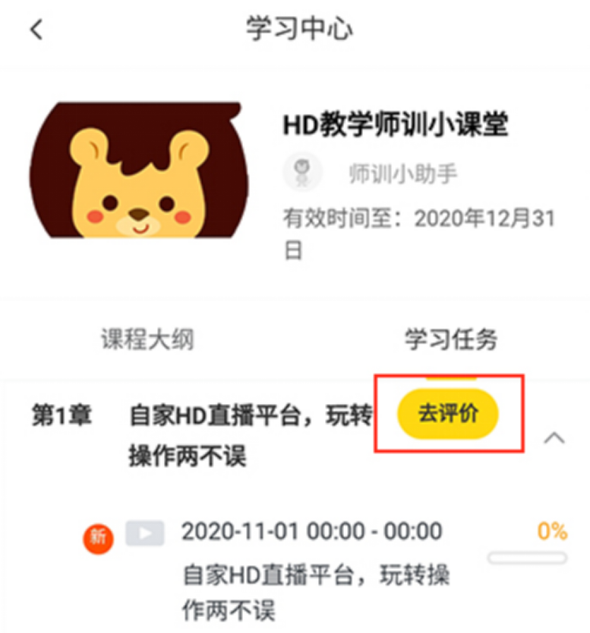

您每一份诚挚的问卷都会拯救一根濒临掉落的头发。
帮我开个张吧，求求你了！

Slide 55
Q & A

